Slide 1
Telling OUR Story
Crafting a Narrative
The Message House
Lessons Learned
Media Tricks & Tips

Slide 2
Meet our Panel
CSAVR consultant - Brit Crampsie
Colorado - Kristin Corash
Arizona - Kristen Mackey
Deivergent - Bryan Dai
New Jersey - Charyl Yarbrough

Slide 3
Lead With Values

Slide 5
Know Your Audience
Not everyone is convinced by the same message
We can reach the same goal with different paths
All audiences are not the same, but can still be convinced of our values

Slide 6
Different Audience, Different Theme
Economic ROI
Workforce development
Human Impact

Slide 7
Sandwich the Problem

Slide 8
We all want to meaningfully contribute to our communities, but the future of an essential program for adults with disabilities is uncertain. We can employ ready, willing adults if the VR program continues to be funded.

Slide 9
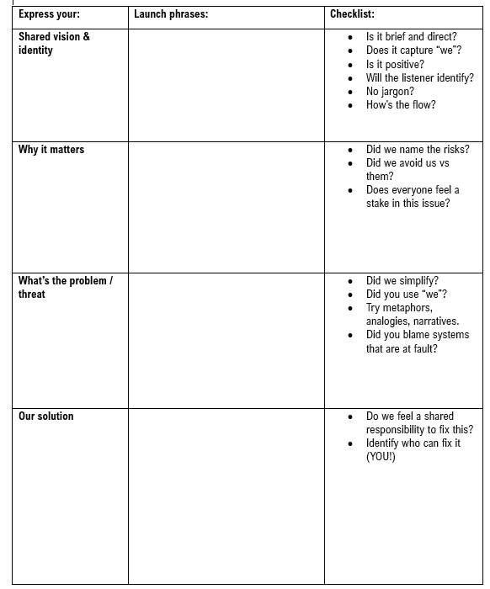

Slide 10
Every person has value, and nearly everyone wants to share that value with the world. Unfortunately, there are hurdles to employment for adults with disabilities. The VR program builds on ramps for adults with disabilities to share their value, and needs continued funding at the federal level.

Slide 11
The vocational rehab (VR) program at the federal level helps adults with disabilities find work by pairing them with businesses who need workers, but misunderstanding about the value of this program could end it. Everyone benefits from investing in a program like this - the employers, the workers and the community as a whole.

Slide 12
Real World Examples

Slide 13
Defining & Measuring Success of Messaging

Slide 14
What Tactics Are Working

Slide 15
Media Relations 101

Slide 16
Evaluating an Opportunity
Research the outlet and the reporter
Set goals
Pitch Pro Actively

Slide 17
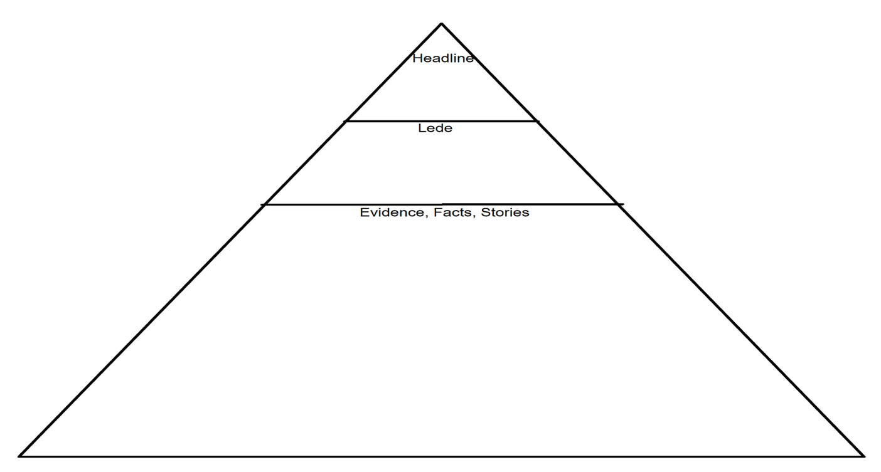

Slide 18
What Lessons Have You Learned?

Slide 19
What does this reporter mean?

Slide 20
Off the record
Not for attribution
On background
On the record

Slide 21
The Intersection of Messaging, Advocacy and Partnerships

Slide 22
Final Tips & Tricks

Slide 23
Don’t assume your audience is an expert - avoid jargon and acronyms
Don’t argue, pivot

Slide 24
Pivot or Bridge
Re direct the conversation to where you want to go
Don’t answer anything you don’t want to
I can’t speak to that, but what I can say is
I might have to get back to you with that answer and in the meantime,

