Slide 1
Building College Pathways to Employment: Collaboration between Vocational Rehabilitation Agencies and Inclusive Postsecondary Education Programs
Melinda Fruendt
Executive Director
Oklahoma Department of Rehabilitation
Rachel Hoard, MA
Supported Employment Program Manager
Division of Vocational Rehabilitation
Colorado Department of Labor and Employment
Russ Thelin, MS, CRC, CRL
Senior Policy Fellow
Institute for Community Inclusion
University of Massachusetts, Boston

Slide 2
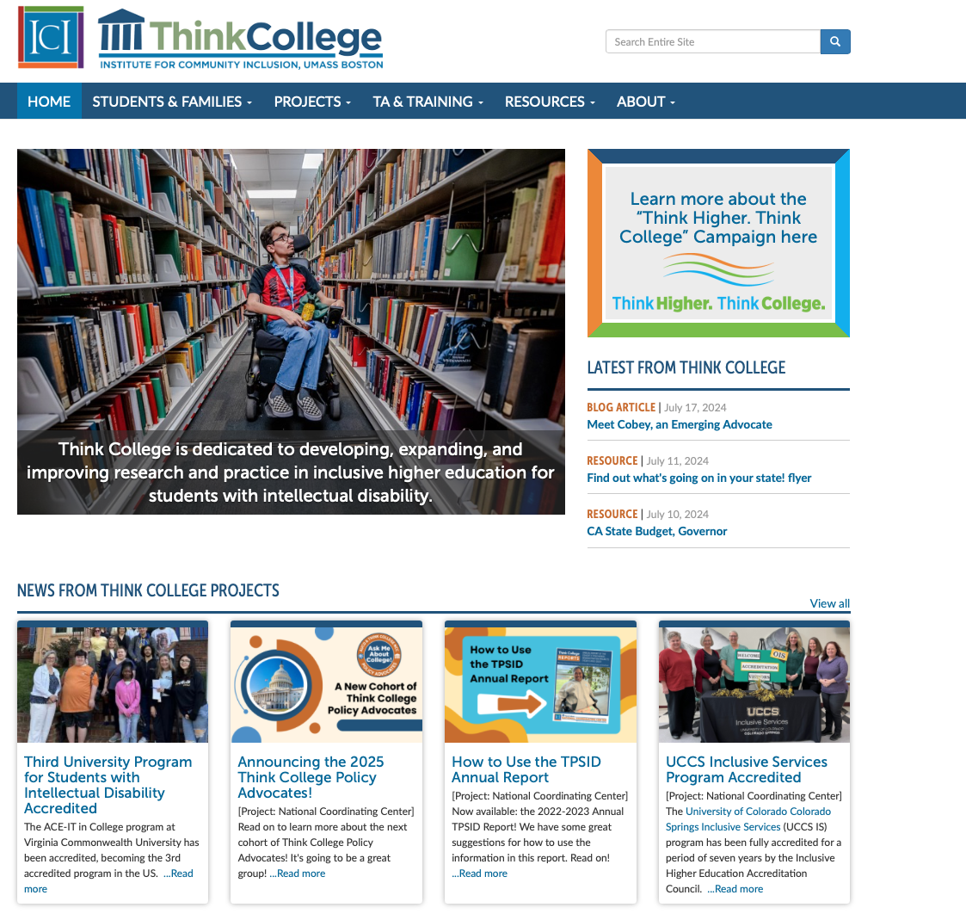
What is Think College?
Think College is a national technical assistance, research, training, and evaluation center dedicated to developing, expanding and improving higher education options for students with intellectual disability.
www.thinkcollege.net

Slide 3
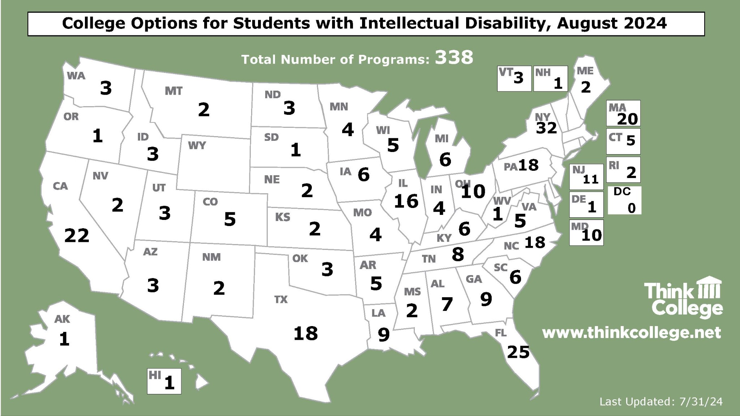

Slide 4
Growing funding and knowledge
$165+ million in federal funding
State funding in 16 states
Data on 4,800+ students
Growing research base
Newly developed accreditation options and training

Slide 5
Some Key Features of Inclusive College Programs
Student-centered approach
Alternate admissions process/requirements
Emphasis on WBL and paid employment
Access to credit/audit classes
Program specific non-degree credentials
Housing opportunities based on campus
Some financial aid availability

Slide 6
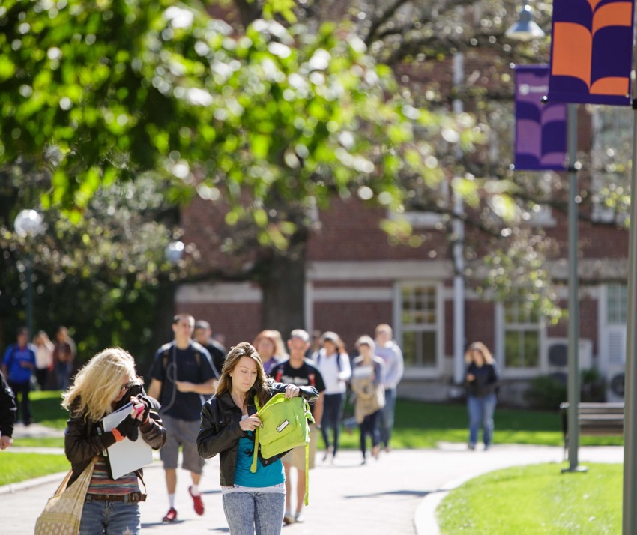
Transition Postsecondary Programs for Students with Intellectual Disability (TPSID)
Government grant funded model demonstration projects
TPSIDs create, expand, or enhance high-quality, inclusive higher education experiences to support positive outcomes for individuals with ID.
Collect and share data with Think College National Coordinating Center
Notes:
Intro to the TPSID portion of the slides

Slide 7
TPSID Model Demonstration Grantees
Since 2010, TPSID grants have supported 126 colleges and universities to advance higher education for students with ID
Approximately 1/3 of the higher education programs enrolling students with ID have received TPSID funding at some time.
Notes:
Meg
This is of about 320 programs in the United States.

Slide 8
12 Years of TPSIDs (2010 – 2022)
Paid jobs while in program |  | 3,675
Course enrollments |  | 59,727
Inclusive course enrollments |  | 26,597
Students who completed program and earned credential |  | 2,134
Notes:
Meg
Paid Jobs (paid employment only, not WBL): 3,675 (I used 8/1/22 as the start date cut off, but this could potentially include jobs inputted as part of 22-23 data collection.
https://franksmith2.quickbase.com/db/bf5rr57hy?a=q&qid=257
Course Enrollments: 59,727
https://franksmith2.quickbase.com/db/bf62xex4j?a=q&qid=189
Inclusive Course Enrollments: 26,597
Completion + Credential, this report didn’t cut it: https://franksmith2.quickbase.com/db/bf5rvsg65?a=q&qid=449
Took 1962 + 58 (20-21 AR) + 114 (21-22) for 2,134

Slide 9
Paid Employment After Exit
1 Year After Exit
2 Years After Exit
3 Years After Exit
59%
66%
67%
had a paid job
402 respondents
had a paid job
196 respondents
had a paid job
102 respondents
Data from September 20, 2022
Notes:
Caitlyn
It may be misleading to use ”n = 402” here, it sounds like we have 402 employed, nor 402 total.

Slide 10
TPSID Data: Predictor of Employment
Specialized courses are a negative predictor of employment
Students who obtained a paid job while enrolled were almost 15 times more likely to have a paid job at exit than those who did not
Earning a credential awarded by the IHE almost doubled the odds of having a paid job at exit

Slide 11
Research on impact of PSE on employment for people with ID using RSA-911 data

Slide 12
IPSE is cost effective
Cimera et al., 2018
Findings: PSE for people with ID is both cost-effective (cheaper than other services) and cost-efficient (pays for itself over time).
Notes:
VR services (per hour worked in a resulting job) cost $437 for people with ID who received PSE supports, compared to $454 for those with a high school diploma and $508 for those without a high school diploma. While providing higher education services to people with ID did have some up-front costs, those costs were paid for within 28 months due to these cost savings and the reduction in government benefits resulting from their employment
This kind of calculus is not needed when conducting research on students with other disabilities we only seem to ask if its worth it when someone has an intellectual disability.

Slide 13
PSE Impact on Employment and Earnings
VR clients with ID who experienced PSE were more than twice as likely to be employed and had increased earnings compared to their counterparts who had not had access to PSE while receiving VR services
-Sannicandro et al 2018
Youth who received PSE services as part of their IPE were 14% more likely to exit with paid integrated employment and earned 51% higher wages than those who did not access PSE services
Smith et al., 2018
VR clients who completed a postsecondary certificate or degree earned more than those who did not -Miller et al., 2019
For transition aged youth with ASD the odds of exiting VR with an employment outcome were 1.59 times higher with PSE services
Rast et al., 2019

Slide 14
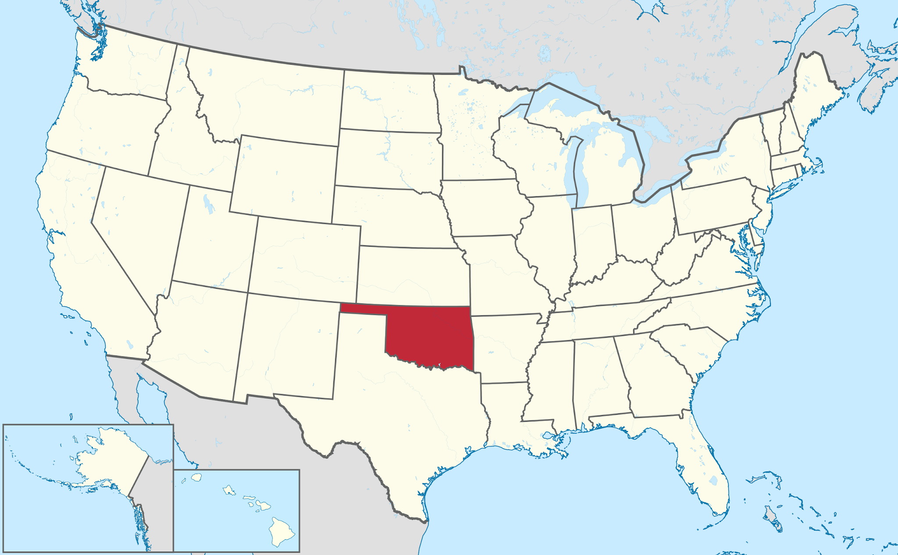
What is happening in Oklahoma?

Slide 15
7 Divisions
Over 1,000 employees
25 Statewide Programs
School for the Blind
School for the Deaf

Slide 16
Beginnings…
PROCESS:
Early Discussions – Early Relationships/Education re: IPSE
Information/Discussion with other states: Ex: Pennsylvania
Team Discussion – Key leaders for a working session
Budget and Logistics – Discovery Period
Pilot Development – Develop Pilot Contract with First Program
Why?:
Data backs up improved employment rates for graduates
DRS Mission alignment with successful employment outcomes

Slide 17
DRS and IPSE Programs Now
IPSE Contracts in place:
3 CTP designated programs
1 degree-seeking program for students with autism
Up to $3,000 per semester
Internships
Must be VR Client
Based on Family Financial Guidelines
All paperwork must be completed before approval
Counselors must be educated and involved prior to student’s acceptance into IPSE program
IPSE must be included in IPE
Up to 15 hours per week
Minimum Wage
10 weeks per semester
DRS pays IHE/Program; Program pays student
Counselors check on student’s progress and employment in area of interest

Slide 18
Partnerships and More
Workforce Boards – “IPSE NEXT”; Partnership with Pre-ETS
Pilot project with 2 Work Skills Trainers hired to assist IPSE students with community employment both during and after the IPSE program.
Trainers assist with all things employment.
Potential Pilot Projects –
Career Tech and Community College
Potential to utilize Pre-ETS Specialist as point person.
Discussions ongoing
Legislation – for students attending CTP-designated programs
Oklahoma Access & Achievement Scholarship-
Pays equivalent of full tuition for up to 5 years from first enrolled semester
Oklahoma Tuition Aid Grant – IPSE students now eligible with language change

Slide 19
Considerations
State Directors
Start with a Pilot
Data backs up the “why”
If you lead, others will join!
Counselors/
Program Mgrs
Long Game = Improved Employment!
Reinforce Leadership Support
Issues will happen, solve them!
Educate and Inform
Identify gaps in educating staff
Provide information in a variety of formats: video, infographics, email
Work in Progress; Issues are a chance to Improve!

Slide 20
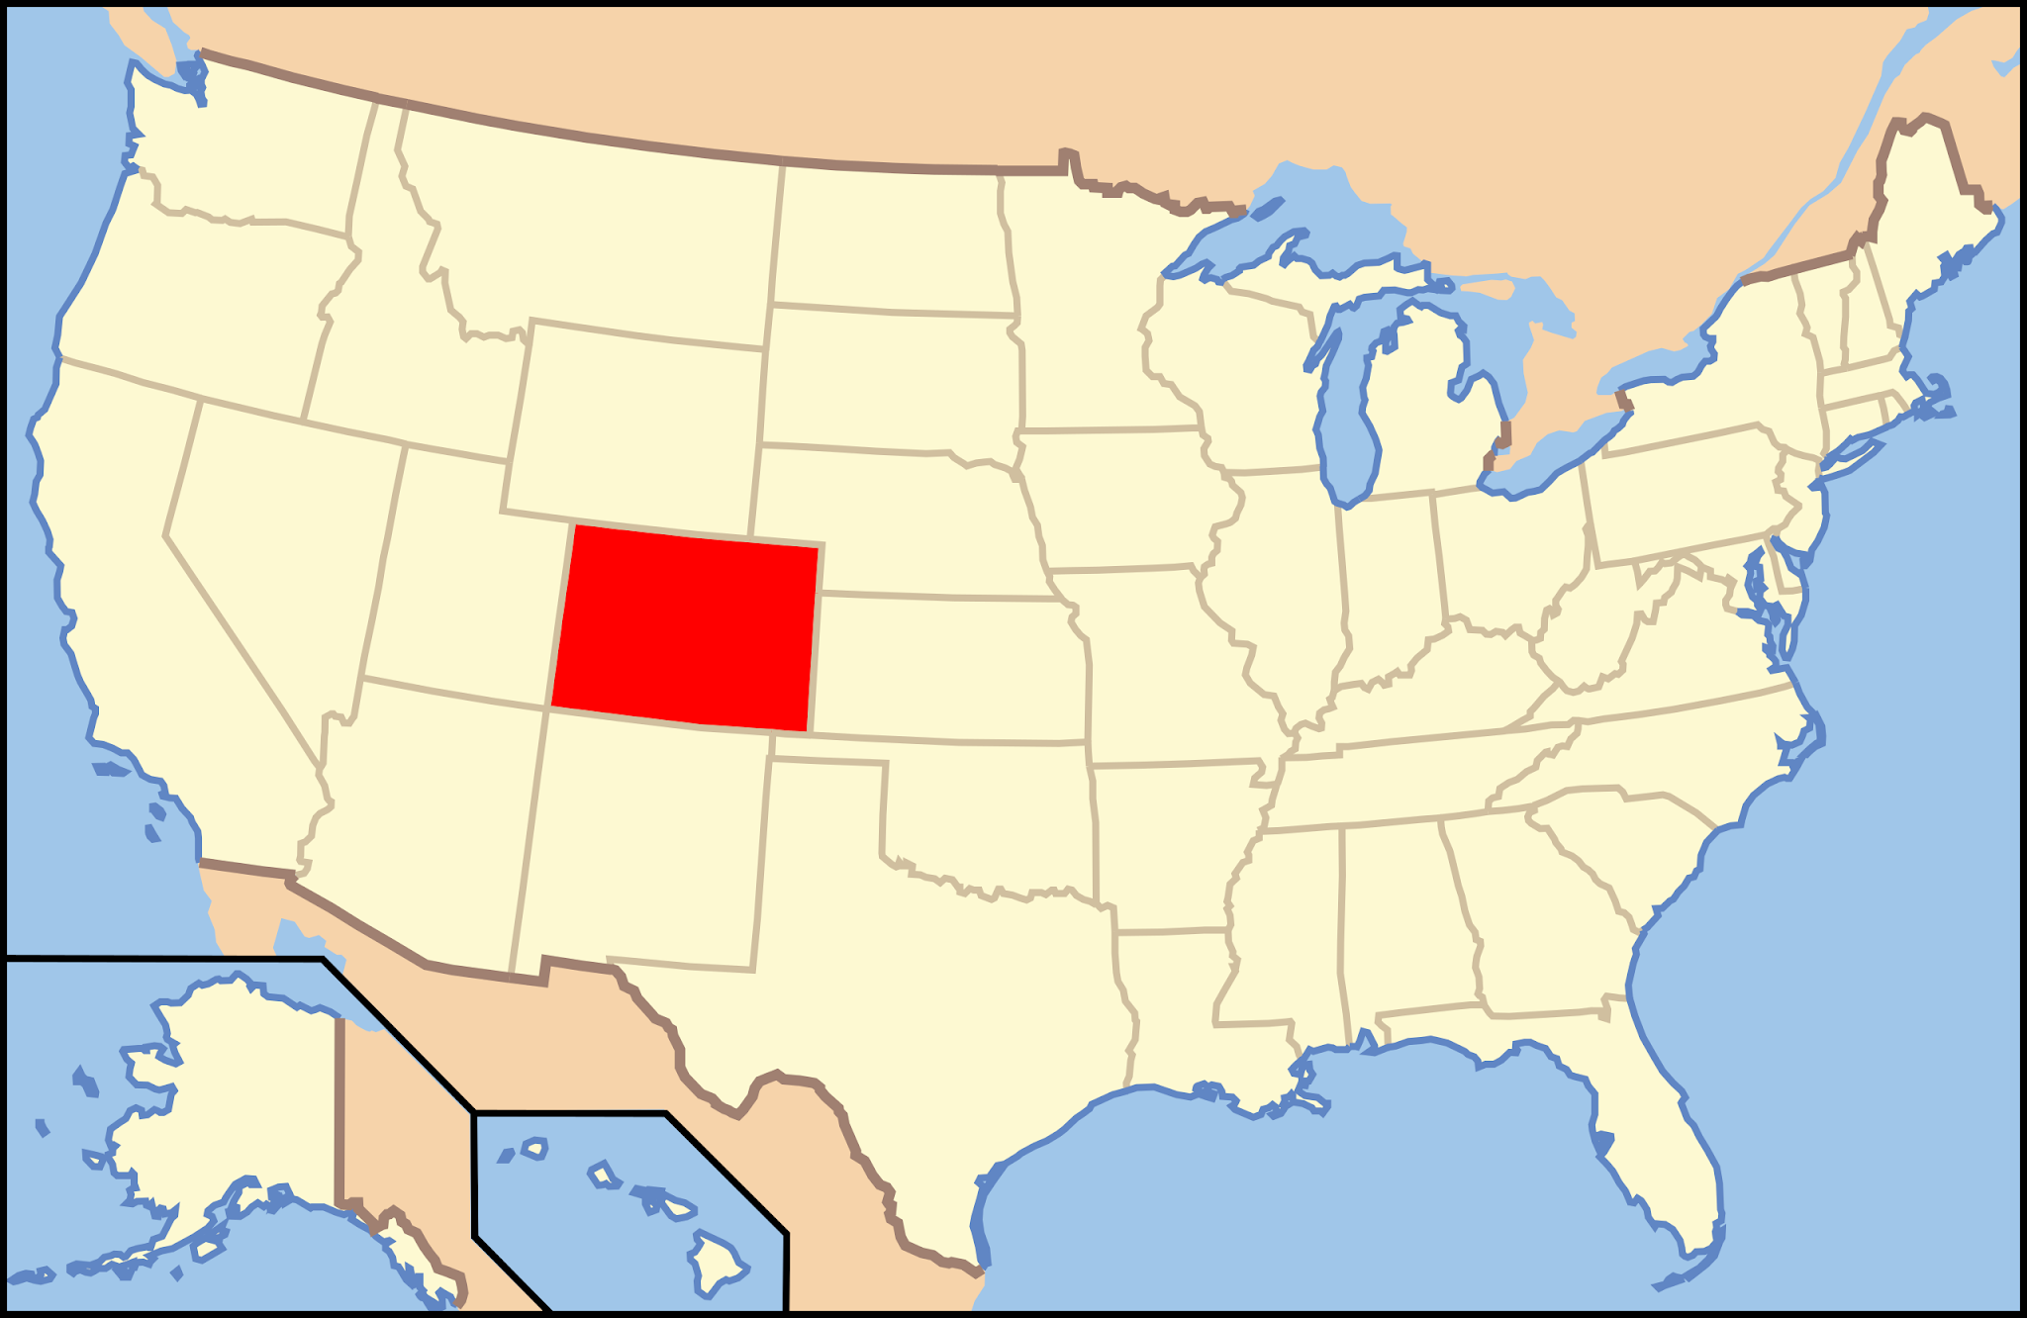
What is happening in Colorado?

Slide 21
Where We Started
2008
Federal Reauthorization of Higher Education Opportunity Act passed nationally
2016
CO was 1 of 3 states that had not offered inclusive higher education
CO SB-0196 Inclusive Higher Education Act passed
Established 3 pilot programs at institutes across the state
2020
Added Inclusive Higher Education Skills Training Fee to DVR Fee Schedule
2022
HB 1107 Inclusive Higher Education Opportunities Act passes

Slide 22
DVR Supporting IHE
Tuition to the university (if FNA allows)
Program Fee is the responsibility of the family. Per DVR fee schedule we do not pay the program fee that is listed within the tuition items on the tuition statement.
IHE Fee payment directed to the IHE program
Usual and customary rate, not to exceed $3000.00 per semester
Notes:
Darby

Slide 23
Approved IHE programs
Notes:
Darby

Slide 24
Upcoming IHE programs

Slide 25
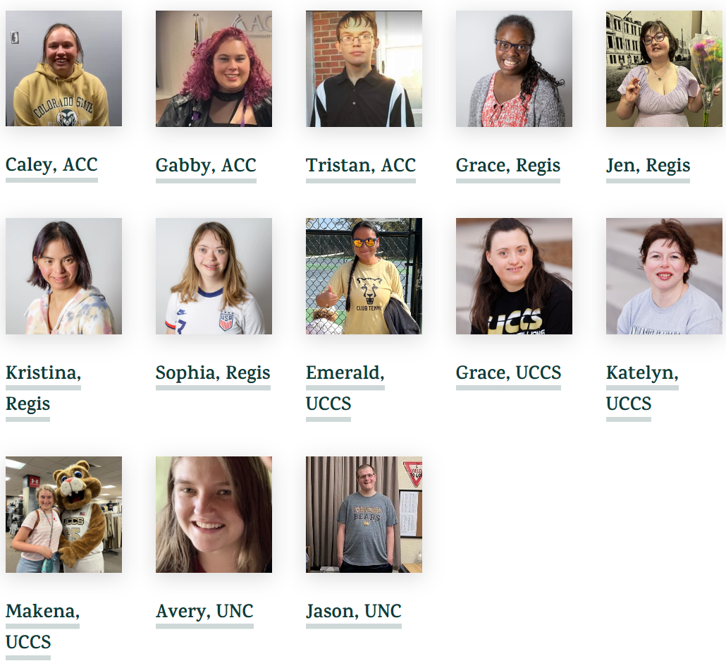
Congratulations class of 2024
In May of 2024, 19 students graduated from Inclusive Higher Education programs all across Colorado! Colorado now has a total of 63 students with intellectual disabilities who have completed college in Colorado! Click on the picture below to access the IN! graduation page and learn more about each graduate.

Slide 26
HB 1107 Inclusive Higher Education Opportunities Act
$450,000/year
5 year grant
Allowing colleges across the state to apply for needed funding to establish or expand Inclusive Higher Education pathways for students with Intellectual and Developmental Disabilities
Established evaluation requirements on student and program outcome date for grant recipients that is reported to IN! As well as the Colorado Dept. of Higher Education
$267,000 left of grant to establish IHE on the Western Slope

Slide 27
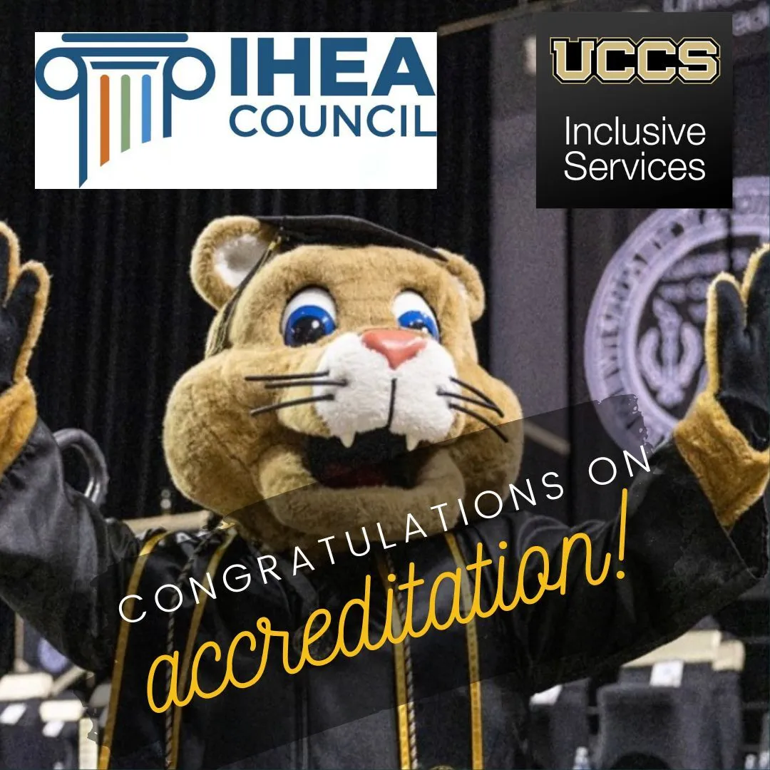
UCCS is Accredited!!!
The University of Colorado at Colorado Springs (UCCS) is now only the 2nd inclusive postsecondary program in the country to receive National Program Accreditation from the Inclusive Higher Education Accreditation Council (IHEAC)
Notes:
Darby

Slide 28
Resources for working with VR Code of Federal Regulations for VR, Comments Section
34 CFR 361.48(b): Services for individuals who have applied or been determined eligible for VR services (Advanced Training)
“Of these commenters, a few suggested that§361.48(b)(6) allow DSUs to provide tuition and other services for students with intellectual or developmental disabilities in a Comprehensive Transition and Postsecondary Program.”

Slide 29
Resources for working with VR Code of Federal Regulations for VR, Comments Section Continued…
34 CFR 361.48(b): Services for individuals who have applied or been determined eligible for VR services (Advanced Training)
“Similarly, we clarify here that the vocational and other training services specified in final§361.48(b)(6) encompass tuition and other services for students with intellectual or developmental disabilities in a Comprehensive Transition and Postsecondary Program for Students with Intellectual Disabilities.”

Slide 30
Resources for working with VR Transition Guide to Postsecondary Education & Employment for Students and Youth w/ Disabilities (RSA, 2020)
https://sites.ed.gov/idea/files/postsecondary-transition-guide-august-2020.pdf: Vocational Rehabilitation Supports for Postsecondary Education
“The VR program assists individuals with disabilities, including students and youth with disabilities, to acquire the knowledge and skills needed to achieve employment that can sustain economic independence.”
Notes:
TPSID’s are specifically mentioned in the Transition Guide

Slide 31
Resources for working with VR Transition Guide to Postsecondary Education & Employment for Students and Youth w/ Disabilities (RSA, 2020) Continued. . .
https://sites.ed.gov/idea/files/postsecondary-transition-guide-august-2020.pdf: Vocational Rehabilitation Supports for Postsecondary Education
“If it is determined to be necessary. . . VR agencies can provide financial support to eligible individuals to pay for or offset higher education-related expenses, including college expenses not covered by student financial aid, or disability related expenses.”
Notes:
TPSID’s are specifically mentioned in the Transition Guide

Slide 32
Resources for working with VR Increasing Postsecondary opportunities & success for students and youth with Disabilities (OSERs and OPSE, 2019)
https://thinkcollege.net/sites/default/files/files/resources/increasing-postsecondary-opportunities-and-success-09-17-2019.pdf: Can VR funds be used to support a student with a disability in a CTP?
“Yes. VR funds can be used to support students with disabilities in CTPs if certain conditions are met. Students, youth, and their families, with the assistance of the VR program as appropriate, should consider the wide array of postsecondary options that are available, including but not limited to, two- and four-year colleges and universities, career and technical schools, adult education programs, . . .

Slide 33
Resources for working with VR Increasing Postsecondary opportunities & success for students and youth with Disabilities (OSERs and OPSE, 2019)
https://thinkcollege.net/sites/default/files/files/resources/increasing-postsecondary-opportunities-and-success-09-17-2019.pdf: Can VR funds be used to support a student with a disability in a CTP?
“. . . and comprehensive transition and postsecondary education programs. A comprehensive transition program is an example of one postsecondary option for which the VR program could provide assistance to students and youth with intellectual disabilities when appropriate and agreed to on their approved IPE.”

Slide 34
Resources for working with VR Think College
Think College Home Page
https://thinkcollege.net/
Think College Resource Library (VR Specific)
https://thinkcollege.net/resource-search?sort=field_resourc_publication_date&order=desc

Slide 35
Let’s discuss…outcomes
How has the collaboration between VR and IPSE programs improve student employment outcomes?

Slide 36
Let’s discuss…collaboration
Share some strategies for fostering collaboration between VR agencies and IPSE programs to enhance employment for students with intellectual disability

Slide 37
Let’s discuss…barriers
What are common barriers to collaboration between VR and higher education programs for students with ID, and how might we address those challenges?

Slide 38
Final Comments
If you could provide one final piece of advice to VR personnel related to employment, IPSE, VR, what would it be?

Slide 39
Free VR Resources Hyperdoc!
Scan me:-)
Notes:
https://thinkcollege.net/resource/vocational-rehabilitation/vocational-rehabilitation-resources

Slide 40
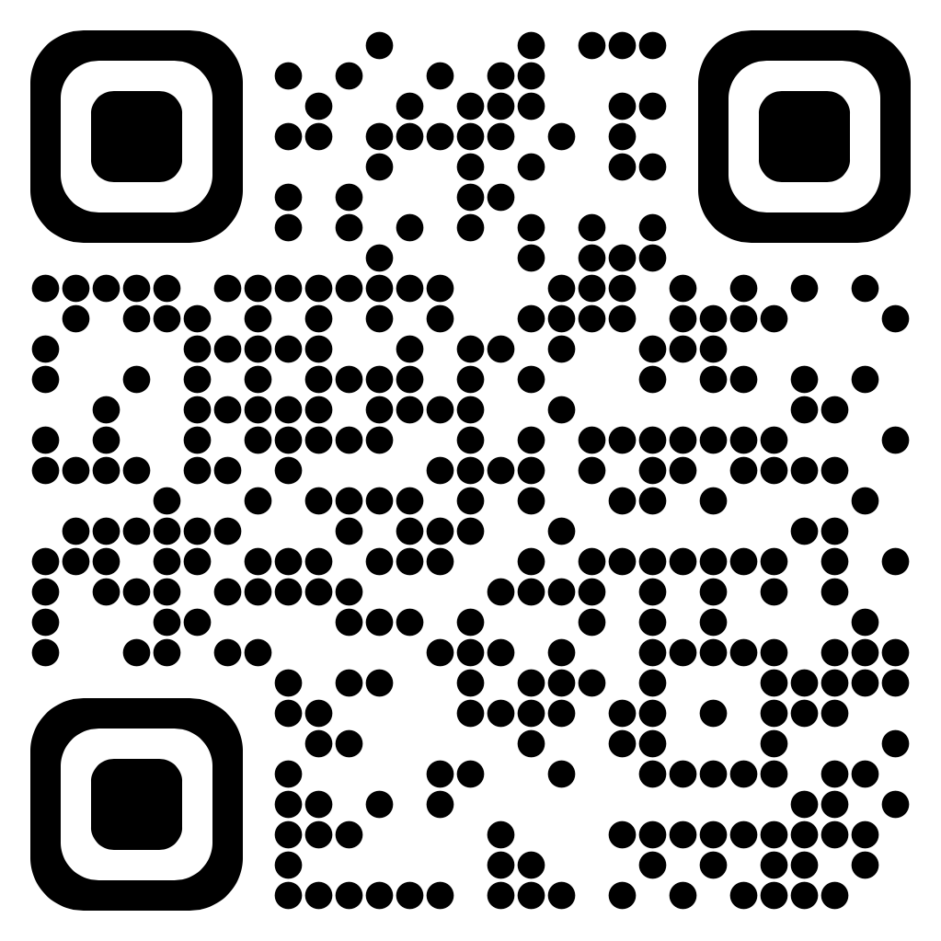
Want info delivered to your inbox?
https://thinkcollege.net/about/contact-us#newsletter
Notes:
https://thinkcollege.net/about/connect-with-us

