Slide 1
Supporting Counselors to Empower Entrepreneurs
ENHANCING SKILLS AND RESOURCES FOR SELF-EMPLOYMENT SERVICES

Slide 2
Introduction
Jamie Blondin, HireAbility Vermont
Molly Sullivan, Griffin-Hammis Associates
Notes:
Jamie kicks it off –
Grateful to CSAVR to be part of this conference.
Then introduces who she is, what HAVT is VocRehab for State of Vermont. The purpose of being here today is to present on our self-employment program redesign which we have been working closely with Griffin-Hammis to accomplish.
Molly introduces herself & G-H.

Slide 3
What will be covered?
HAVT’s background and organizational needs that inspired program change
Partnership with Griffin-Hammis and the proficiency scale
Updated and simplified policies
Staff training, community of practice and the Self-Employment Specialist’s role
Review process for High-Cost Self-Employment plans
Notes:
Jamie – We’re going to cover the process that we took to redesign our self-employment program including our organizational needs that led us here, policy change, trainings, resources, partnerships, and funding.

Slide 4
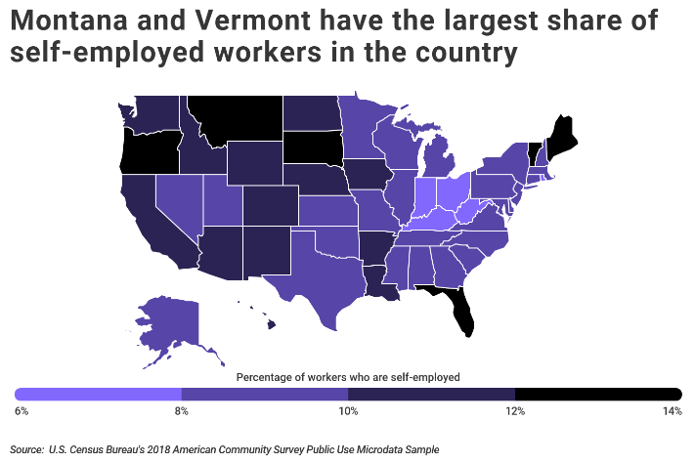
Self-Employment in Vermont
Self-Employment can be beneficial to some participants because it can naturally accommodate a person’s disability and expand upon the number of employment opportunities available to them.
According to the most recent Vermont Census data, it is estimated that about 14% of Vermonters are self-employed.
A very important goal of ours is to work towards achieving equity with the general population for our participants who desire self employment.
Notes:
Jamie: An important goal for us as part of this project is that all our staff have a strong grounding in Self Employment that naturally promotes that possibility for the participants that we serve.

Slide 5
Background & Organizational Needs of HAVT
HireAbility Vermont has wanted to redevelop the Self-Employment Program for many years now.
Need for more resources and training around self-employment. Our VCs are skilled in human service side, but not as well-versed in business or self-employment.
We have strong partnerships with outside organizations however, each district has varying available resources. There is a strong need for building in-house capacity because of it.
We recognized that our former funding levels were not enough for some businesses to help them get to their next step whether it was a startup or expansion.
Notes:
We have attempted to update our policy and guidance for self employment over the years without making significant progress. Our counseling staff have been looking for more guidance and clarity when it came to providing services to participants because in our service delivery model they are really working closely with participants as they develop their plans. In VT, while there are outside organizations that assist Vermonters with self employment plans, these services vary depending on which part of the state you are in.
Our recommendations for funding self employment might have seemed generous at one time but were clearly too low at the present time.
I was a vocational counselor in one of the district offices and have background as an entrepreneur, so it was an opportunity to blend my skills and meet the needs of HAVT to move this project forward.

Slide 6
Process Map
Formed
Steering Committee
Determined Goals
Started working with Griffin-Hammis
Jamie became Coordinator
Jamie became coordinator
Received feedback from HAVT & stakeholders
Refined implementation plan & goals
Implement & monitor plan
Evaluate Plan
Notes:
Jamie – In order to redesign the self-employment program, we needed to create a process and draw from feedback across many parties. A steering committee was formed including HAVT central office staff, a vocational counselor and someone from CAP agency. Throughout this process we have solicited feedback from a variety of stakeholders including our own HAVT central office & field staff, community partners, and outside agencies. Jamie was enlisted as the Program Coordinator to help design and oversee this change process and implementation plan. Initially started working with Griffin-Hammis in group setting but realized that individual sessions would be more beneficial as each state as differing needs. We have been able to work with them for guidance around our program redesign including policy, training and ongoing support which has proved to be invaluable to us. The proficiency scale and training programs are helping us with our framework. Molly is going to talk more about the proficiency scale.

Slide 7
VRC Self-Employment Proficiency Scale
The Center on Self-Employment finished the VRC Self-Employment Proficiency Scale in the Summer 2024.
Link to scale: https://centeronselfemployment.org/documents/VRC_SE_Proficiency_Scale.pdf
The scale serves as a guide for VRCs and VR management in:
Setting realistic expectations for VRCs who support VR customers with self-employment, given the VRC’s level of proficiency, and
Developing a system of support for VRCs to ensure all VR customers exploring or pursuing self-employment receive quality VR services regardless of their VRC’s level of proficiency.
Serves as a guide for The Center on Self-Employment in developing curriculum (https://centeronselfemployment.org/training/courses.cfm)
Notes:
Molly’s slide –
Explain that at the time HireAbility VT was exploring how to revamp their self-employment services, The Center on Self-Employment was finishing the VRC Self-Employment Proficiency Scale, so they were able to use the scale to help with some of their planning (a link to the scale is provided on the slide)
Explain the Center on Self-Employment developed the scale for two key reasons (noted on the slide)
Explain the scale was developed in a methodical way, drawing from input and feedback from VR staff across the country.

Slide 8
VRC Self-Employment Proficiency Scale Development
1). Identified Knowledge and Skills
Delphi Study resulted in 42 knowledge and skills needed for VRCs to support self-employment
2). Drafted Competencies
Combined knowledge and skills from the Delphi Study to create 23 competencies
3). Drafted Proficiency Scale
Created a broad description of 3 proficiency levels
Created competency-specific descriptions of 3 proficiency levels
4). Validated Proficiency Scale
Conducted a survey, interviews, and a focus group with VR staff to finalize the scale
Link to scale: https://centeronselfemployment.org/documents/VRC_SE_Proficiency_Scale.pdf
Notes:
Molly’s slide
Explain the scale was created in partnership with Dr. Tim Reisen at Utah State University
Explain a Delphi study was the first step – which resulted in 42 knowledge and skill items
Explain we rolled up 42 knowledge and skill items up into 24 competencies, which ultimately ended up being 23 competent ices (1 was redundant)
We then drafted a 3-level proficiency scale by creating a broad description of each of the three levels and competency-specific descriptions for each of the three levels – this was based on the work of Dreyfus and Dreyfus (multi-stage typography to skill development)
We then had VRCs and managers review all the descriptions and give feedback through a survey then a focus group – we incorporated their feedback to finalize the scale.
With this scale in place, we are hope that VR agencies can use it develop a strategy for supporting self-employment.

Slide 9
Using the VRC Self-Employment Proficiency Scale
People with disabilities face far too many barriers to employment; we need to ensure all options are available to help counter those barriers, including self-employment.
To make that possible, VRCs need the knowledge/skills and support to help a person explore and pursue self-employment.
Using the scale:
If you are a VRC: use the scale to ensure you are at least at a novice level (Use free training at https://centeronselfemployment.org/training/courses.cfm)
If you are a VR manager/administrator: encourage all VRCs to reach the novice level and ensure your novice and competent level VRCs have someone at the expert level to provide support.
HireAbility VT has created a plan to do this!
Notes:
Molly slide –
Cover bullets on slide
Explain the timing on finishing the scale has worked wonderfully with the work of HAVT because they have been able to use the scale to help plan out who at HAVT could realistically provide self-employment supports and what level of support they could provide.
I will transition back to Jamie/Hib to share their goals in revamping their self-employment services andthe steps they’ve taken to make it happen!

Slide 10
The Goals to Improve HAVT Self-Employment Services
Update the HAVT policy to have higher spending guidelines and add a review process for high-cost plans.
Provide all HAVT staff training and resources to help them support participants in self-employment plans.
Develop a comprehensive self-employment practice manual that walks the vocational counselor step by step through the process of a self-employment case.
Promote existing vocational counselors who will complete additional training and achieve a high level of proficiency regarding self-employment in their districts.
Notes:
Jamie – These are the overarching goals of our program redesign. After learning about the proficiency scale and trainings by G-H we were able to fine tune our implementation plan and monitoring and assessment moving forward. These will continue to evolve over time.

Slide 11
The New HAVT Self-Employment Policy
The new policy is much shorter, easier to follow, and includes the following:
New requirements for assessment and feasibility determination.
New requirements for the development of a business plan.
Provide more ongoing supports to participants who initially start self-employment.
New spending guidelines and an approval process for high-cost plans.
Notes:
Jamie - recap

Slide 12
Spending Guidelines
Business plans that provide supplemental income but do not lead to self sufficiency - up to $2,500 with exceptions.
Business plans leading to self sufficiency - up to $10,000 with exceptions.
HAVT funding is not an automatic “grant.” The Individualized Plan for Employment (IPE) and business plan must outline how the funds will be specifically used. The commitment of funding beyond $2,500 must not be made without the Cohort’s approval.
HAVT funds are to supplement the participant’s resources, individual investments, and funding they have secured from other sources. SSI/SSDI beneficiaries will not be required to contribute to their self employment plans.
A standard scoring rubric will be used to assess viability of high-cost self-employment plans, and the cohort provides feedback to the participant with suggestions for improvement if it does not pass review.
Notes:
Jamie – All self-employment IPEs start as a “supplemental business” with the $2,500 funding level. If the participant’s is seeking more funding, they must go through the review process for a “high-cost self-employment plan.” The VC will send the business plan and request to me (and I’ll share to the cohort). We use a rubric to score and then come together and discuss based on our findings. rotating group of HAVT staff that serve on the Business Cohort – Regional Managers & SME’s. Currently working to recruit a variety of business owners who would be willing to provide feedback and information about their specific industry.

Slide 13
Documentation & Considerations
Documentation:
Business Structure Type
Secretary of State business registration certificate
Monthly Budget
Cash Flow Projections
Profit and Loss Statement
Break-Even Analysis
Proof of Insurance
List of supports (accountant, bookkeeper, lawyer, etc.)
Proof of Market Research
Proof of business bank account
Comprehensive Business Plan
Funding Considerations:
Is it clear what products/services the business will provide?
What strategies will the business use to market to potential customers?
How much net profit (income minus expenses) can be expected once the business is fully operational?
What will their day-to-day operations look like once the business is launched?
Is this consistent with participant's financial and personal needs and goals?
Notes:
Jamie - These are some of the documents and just a few samples of what we consider when we review the request for a high-cost self-employment plan. Because this is so individualized, not all documents may be needed or even available depending on what stage the business is in or the type of business it is. No one size fits all model or template to use. We recognize that organizations or consultants will have their own templates to use. We are happy to accommodate so the participant can best express their business and funding needs. After we review, I send a detailed feedback form so there is always opportunity to resubmit if it was not approved.

Slide 14
Training & Resources for Staff
All HAVT staff will receive and/or have access to trainings around self-employment based on their role.
All vocational counselors, certified work incentive counselors, and regional managers will receive trainings through the Center on Self-Employment to reach the novice level.
A smaller group of promoted vocational counselors will complete the Griffin and Hammis “expert” level training and become our specialist counselors and will provide inhouse expertise for their district.
The Self-Employment Guidebook contains guidance, tools, and resources on how to support participants in self-employment.
Notes:
Jamie – Our staff have been asking for more resources and training, so we knew we needed a large portion of our focus to be around professional development.
The trainings we are encouraging include Core Concepts of Self-Employment, Self-Employment through the VR Lens, and Business Financials. They are loaded on YesLMS, the learning management system we use which will help us keep track of it all.
Those promoted self-employment counselors will engage in Certified Business Technical Assistance Consultant training, Vermont version, and we will offer mentorships during and after this training. We hope to have one specialist counselor in each district and be a leader/mentor/champion for self-employment to other staff in their district.
Another piece of feedback we got was that the self-employment policy had good information about “rules and regulations,” but was not guidance about the actual process of leading a participant through a self-employment plan. The purpose of the Self-Employment Guidebook is just that – to be guidance and a tool for VCS and all staff to be informed about the process.

Slide 15
Community of Practice
Opportunity for further discussion and learning around specific topics.
Ongoing education and keeping current with self-employment best practices and trends.
Leadership opportunity for Self-Employment Specialists.
Utilize multiple learning modalities – video clips, readings, discussion, quotes, podcasts, etc.
Notes:
Jamie – Another way we plan to support staff with ongoing support is through a community of practice. Rotating topics and creating a feedback loop from staff on what to address next in the realm of self-employment. Monthly newsletter with upcoming classes, resources, pertinent info, etc.

Slide 16
Participant Expectations & Requirements
Timing is everything – process can be lengthy or require additional training, skill building, time or financial investments.
Participant has full ownership over the business plan development and carrying out all the steps.
Funding needs and HAVT policies and requirements should be discussed early and often throughout.
Participants receiving SSI/SSDI are strongly encouraged to work with CWICs.
Notes:
Jamie – It is imperative for vocational counselors to be transparent about the participant’s expectations and requirements to ensure informed choice.
The self-employment process is one that can be quite lengthy. Self-employment is the right path for some people, but not for everyone. Sometimes it is the right path, but the timing is wrong, or the participant needs more training or technical skills development before launching a business. Perhaps a PWE, apprenticeship, job shadow or training would be best.
It is important that the participant understands at the very beginning of the self-employment process that they are expected to complete all assigned tasks. The VC will provide support and assistance, but most of the work that needs to be done will be the responsibility of the participant. It is important that the participant have ownership of the Business Plan. Ownership only occurs if the participant writes the Business Plan or works very closely with the resource person or organization doing the actual writing.
Finances should be discussed early in the process. HAVT will not commit to financially supporting a self-employment plan until that plan has been approved and determined to be feasible by HAVT. We highly encourage participants receiving SSI and/or SSDI benefits to work closely with a Certified Work Incentive Counselor (CWIC) to ensure that they are well informed on their responsibilities.

Slide 17
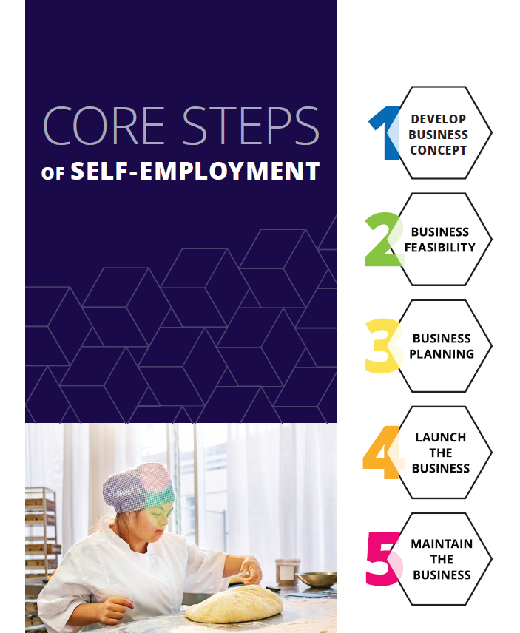
Core Steps to Self-Employment
HAVT recommends the successful completion of each activity and/or step before proceeding so the participant has all they need to be successful in their business endeavor.
HAVT encourages vocational counselors to connect participants with outside resources as needed (bookkeeper, business consultant, lawyer, mentor, etc.).
Core Steps of Self-Employment
Notes:
Jamie – HAVT is going to closely follow the G-H core steps to self-employment to support participants through a self-employment plan. Molly will discuss each step in further detail.

Slide 18
Follow-Up and Closure
Once the Business Plan is implemented, HAVT follow-up is critical. The VC and participant must write a follow-up schedule into the evaluation section of the IPE.
At a minimum, HAVT staff will schedule monthly meetings about the business during the first three months of operation. More frequent meetings may occur if appropriate in the judgment of the VC. These meetings can be done in person, especially if the business has a physical location.
In most cases, after three months of operation, meetings will fade to one every two months until the case is closed. Contacts will include periodic reviews of tax records and business books by either the VC or a business consultant.
Notes:
Jamie – the follow-up and closure portion of a case is going to look different that competitive employment case in the sense that it will provide more support and more individualized based on that participant’s and business’ needs. Success is not necessarily going to be profit based and may be benchmarks on their way to profit (i.e. quilt 6 blankets by EOY or gain 3 new business clients in Q3 & Q4).

Slide 19
HAVT Current Status & Next Steps
We rolled out the new policy and spending guidelines in July 2024.
Staff have been eager to have this guidance and support, and it has overall been well-received by the field!
Jamie has had several meetings and consultations with VCs, participants, and community partners. They have been productive and educational for all parties.
A few high-cost self-employment plans have been submitted to the Business Cohort for review. Both required more information before we could approve their funding, but both have great potential for success.
Finalizing promotion process for VCs, monitoring plan, and specific VC benchmarks.

Slide 20
Resources & References
HAVT Self-Employment Guidebook
HAVT High-Cost Self-Employment Plan Scoring Rubric
Self-Employment Courses - National Center on Self-Employment, Business Ownership, and Telecommuting (centeronselfemployment.org)
VRC Self-Employment Proficiency Scale (https://centeronselfemployment.org/documents/VRC_SE_Proficiency_Scale.pdf)
Center on Self-Employment – Self-Employment Trainings (https://centeronselfemployment.org/training/courses.cfm)
Core Steps of Self-Employment (https://griffinhammis.coursearc.com/index.php/download_file/2933/)
Griffin-Hammis | Customized Employment (griffinhammis.com)
Riesen, T., Sullivan, M., Snyder, A., & Keeton, B. (2023). Identifying the knowledge, skills, and barriers for self-employment. Journal of Vocational Rehabilitation, 59 (1), 69-79.
Notes:
Jamie – touch upon first 2
Molly – also touch upon

Slide 21
Contact Information
Jamie Blondin, Jamie.Blondin@vermont.gov
Molly Sullivan, Msullivan@griffinhammis.com

Slide 22
Thank you!
Many thanks to CSAVR for having us here today!

