Slide 1
Building on Success
Concurrent Session X.X
Rewriting the Rules: SCVRD’s Creative Overhaul of Consumer Services and Fiscal Policies
Commissioner Felicia Johnson, Harriett Abner, Betsy McWhite

Slide 2
Key objectives and takeaways
Objectives
Understand the challenges that led to the need for a complete policy overhaul.
Explore the collaboration between departments and units in executing the initiative.
Examine the creative strategies employed to balance urgency with effectiveness.
Assess the impact of the overhaul on organizational effectiveness.
Apply key takeaways to manage large-scale policy updates in other organizations.
Takeaways
The importance of balancing urgency with thoughtful execution.
Effective communication strategies to drive change.
Practical steps for organizations considering similar overhauls.

Slide 3
Session connection to CSAVR Strategic Priorities

Slide 4
Session connection to CSAVR Message House

Slide 5
Background & Purpose
Our Mission
To prepare and assist eligible South Carolinians with disabilities to achieve and maintain competitive employment.
Our Vision
We will be the leader in quality employment outcomes for our consumers and business partners through our people, partnerships, and performance.
We Value
People with disabilities who strive to achieve competitive employment,
A consumer-focused culture,
Quality service provision,
Highly qualified and committed employees,
Mutually beneficial partnerships with business and industry,
Professional, coordinated, results-driven relationships with other governmental agencies and organizations,
An environment of continuous improvement and learning; and,
Accountability to taxpayers.
Overview of SCVRD’s mission and role.

Slide 6
Background & Purpose
SCVRD 107 Monitoring in 2021
Performance
Financial Management
Corrective Action Plan (CAP)
Why the overhaul was critical for consumer service delivery and financial accountability.
§ 361.50 Written policies governing the provision of services for individuals with disabilities.
(a) Policies. The State unit must develop and maintain written policies covering the nature and scope of each of the vocational rehabilitation services specified in § 361.48 and the criteria under which each service is provided. The policies must ensure that the provision of services is based on the rehabilitation needs of each individual as identified in that individual's individualized plan for employment and is consistent with the individual's informed choice. The written policies may not establish any arbitrary limits on the nature and scope of vocational rehabilitation services to be provided to the individual to achieve an employment outcome.
Purpose for the overhaul: Corrective action plan and the need for a sustainable solution.

Slide 7
The Overhaul Process
Key players: Policy, finance, legal, frontline staff, and executive leadership.
Collaboration strategies: Cross-departmental teams, stakeholder engagement, and iterative feedback loops.

Slide 8
The Overhaul Process
Engaging with outside Technical Assistance: Using expertise to guide a structured, thoughtful process.
Community Partners and Stakeholders.

Slide 9
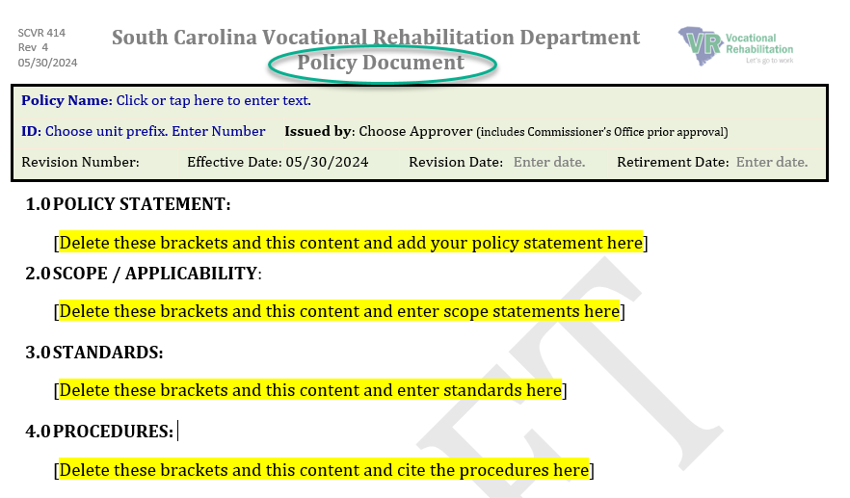
The Overhaul Process
Developing a comprehensive template and structure for policies.

Slide 10
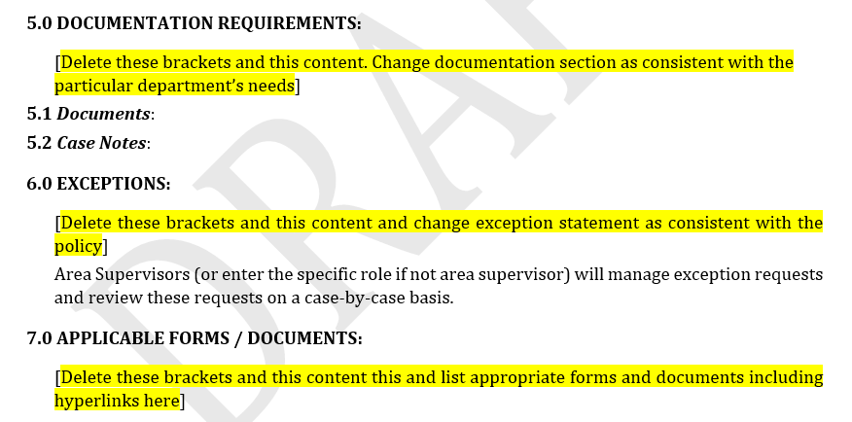
The Overhaul Process
Developing a comprehensive template and structure for policies.

Slide 11
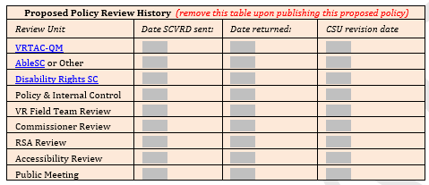
The Overhaul Process
Developing a comprehensive template and structure for policies.

Slide 12
The Overhaul Process
Policies and Internal Controls.

Slide 13
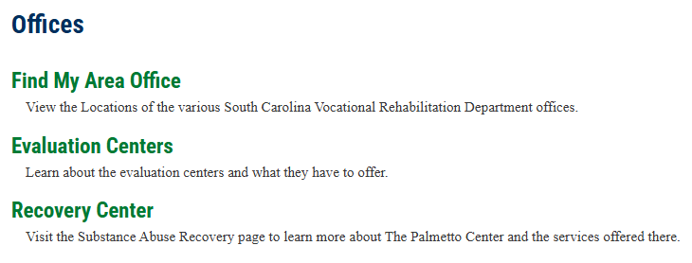
The Overhaul Process
Forming a dedicated working group to ensure effective implementation.
Training and Follow-up.

Slide 14
Organizational Impact
Increased efficiency in consumer service delivery.
Improved financial oversight and compliance.
Enhanced staff alignment and engagement with organizational goals.

Slide 15
Evaluation and Feedback
Complete evaluation – get your CRCC credits
Also may provide direct feedback to info@csavr.org
What’s next on the agenda?

