Slide 1
I’m A Counselor, Not A Banker:
Six Easy Steps to Review a Business Plan

Slide 2
WELCOME and Introduction
Kathy West-Evans
Lisa Kisiel
Gary E. Horton

Slide 3
WELCOME
Agenda
I’m A Counselor, Not A Banker!
Self Employment Opportunities & Challenges
Background
Policy & Procedure Analysis
Building the Rubric
The Six-Step process
Perform Deliverables Inventory
Comprehend the Business Concept
Compliance Pass/Fail
Desk Review
Deep Dive: Audit Interview preparation
VR Consumer Audit Interview
Go/No Go
DLC: A Case Study
Take Aways
Questions & Answers

Slide 4
WELCOME
Kathy Opportunities & Challenges
The Opportunity:
According to the Bureau of Labor Statistics, individuals with a disability have pursued self-employment four times more than that of their abled counterparts.
There are expanding opportunities and growth in the Gig Economy.
The Challenge:
VR counselors will undoubtedly be faced with an increased number of self-employment requests. Some VR Counselors may not have a background in self-employment - the review and planning process may be overwhelming.

Slide 5
WHY
1. Lack of training, understanding and confidence.
· 82.9% of VR professionals reported needing training in referring clients for technical assistance
(e.g., market research, business planning).
· 58% said they needed help supporting clients who hadn’t yet developed a business concept.
2. Overreliance on generic business resources.
· VR counselors often refer clients to Small Business Development Centers (SBDCs) or SCORE, which may not have experience working with business owners who have a disability or understand how to tailor services to meet their needs related to disability and access.
3. Rigid and biased assessments.
· 60 out of 73 agencies require pre-IPE assessments, which may filter out clients based on “traits” like lack of persistence, poor credit, or limited formal education—none of which are necessarily predictive of success.
· These assessments may not be valid for people with disabilities and can unjustly disqualify promising candidates.

Slide 6
WHY
4. Policy and systemic barriers
· 86.3% of VR agencies require clients to submit business plans or conduct market analysis before receiving support via an IPE.
5. Lack of access to specialized self-employment resources
· Over a quarter (27.3%) of agencies don’t even mention specialized resources for self-employment in their policies.
· Where these exist, their roles and scope vary greatly, and many counselors must guide clients through complex processes without proper tools or backup.
• Source: “Understanding the Provision of Self-Employment in the United States. ” – 2022 Drake University Study

Slide 7
Meeting Objective
Discuss A methodology for effectively defining the critical elements of a Policy and its related documents.
Recommend a Six-Step process designed to demystify and normalize the process aimed at a non-Banker audience.
Provide a demonstration of applying the method to a Case Study.
A methodology for effectively defining the critical elements of a Policy and its related documents.
Develop relationships with resource providers focuses on business development.

Slide 8
Background
• Michigan had a desire to expand the number of Vendors of Self-Employment Vendors
• East Region planned a simple Primer for its Counselors
• Presentation was given to Field Services Management and Policy & Compliance
Vanward was asked to perform the presentation for the Field Services Organization

Slide 9
Employing An Audit Approach

Slide 10
Employing an Audit & Compliance Approach
1. Collect all relevant Policy (Level 2), Procedure (Level 3), and Deliverables or Key Records (level 4) artifacts related to Self-Employment
2. Perform an analysis utilizing the LeadingEDGE Algorithm to determine Key Policy Requirements (“Shalls”)
3. Categorize Compliance Elements into one of 4 categories
a. Policy Requirements (Physical Deliverables)
b. Business Plan Elements
c. Feasibility/Sustainability/Risk
d. Financial Projections
4. Assign a relative weight to each element
5. Develop compliance Tools
a. Assessment of Compliance Form
b. Business Plan Rating Tool
c. VR Consumer Audit Questions
d. Policy/Procedure Reference Documents

Slide 11
Assessment of Compliance Matrix
Display Matrix Spreadsheet

Slide 12
Business Plan Rating Calculator
Display Rating Spreadsheet

Slide 13
VR Business Plan Audit In Six Easy Steps

Slide 14
Six-Step Business Plan Audit Process
Objective: To evaluate a Consumer's Business Plan to Ensure:
The Plan Complies with the State Policy Governing such arrangements;
Reasonableness and consistency of the overall Plan
Capability of the VR Consumer to carry out what is proposed;
Financial Viability of the Plan to sustain the Consumer

Slide 15
Six-Step Business Plan Audit Process
Step 1:Conduct Deliverables Inventory
Step 2: Comprehend the Business Concept
Compliance Pass/Fail
Step 3:Desk Review
Step 4:Deep Dive: Audit Interview preparation
Step 5:VR Consumer Interview
Step 6: Go/No Go

Slide 16
STEP ONE: CONDUCT DELIVERABLES INVENTORY
Take inventory of all Prerequisites (Deliverables)
Take an Inventory of the following:
Consumer's Self-Assessment
Consumer's Letter of Intent
Consumers Venture Feasibility (Self-Assessment)
Consumer's Job Description
Personal Financial Statement
Business Plan
Business Consultant's Review (if Applicable)
Check the Business Plan Section Headings . Note which key sections are missing

Slide 17
STEP TWO: COMPREHEND THE BUSINESS CONCEPT
Read the Executive Summary
Should be no more than 1 Page
Should explain in simple language:
What is the type of business How am I Organized?)
What is the Product/Service Offered(What am I Selling?)
What is the Value Proposition (Why am I selling it?)
How much is being requested and for what use (How much am I asking for and Why?)
When is Consumer expected to be self-sufficient (When do I expect to be independent?)

Slide 18
STEP TWO: COMPREHEND THE BUSINESS CONCEPT
Compliance Pass/Fail
If all the required documents are not present and/or the Executive Summary does not describe in language that you can understand:
1- Reach out to Business Consultant to gain insight.
2-Return the submission to the VR Consumer to prepare a complete package. Refer to a Consultant (if necessary).

Slide 19
STEP THREE: AUDIT PREPARATION
Taking an Audit approach necessitates that the Auditor review the critical breakdown points and drilling down to find noncompliance or discrepancies that may be used in the VR Consumer interview.

Slide 20
STEP THREE: AUDIT PREPARATION
Use of Funds
1-Review Use of funds/Start-up Grant
A-Are the funds requested specifically delineated? (the IPE cannot be completed if this detail is not provided
B- If not, write out a question to be answered during your drill down or interview.

Slide 21
STEP THREE: AUDIT PREPARATION
Financial Forecast Assumptions
2- Financial Estimate Assumptions
A- Do the assumptions describe How much is to be sold how often? This should generally match what is in the VR Consumer's Self-Assessment
B- This information may also be found in the Product/Services Section or Marketing Plan
C- If this information is not found or clear, be sure to make a note in the form of a question for the VR consumer

Slide 22
STEP THREE: AUDIT PREPARATION
Profit and Loss Statement Review
Review Profit and Loss Statement (Balance Sheet, Income Statement, and Cash Flow Analysis will be based on this document).
Does it show detail for the first 12 Months? If not, you cannot actually assess the plan
Does the Plan show the VR-Consumer receiving income in the first Month? If so, make a note, where is this money coming from?
Does the "Sales" line up with the Assumptions? If not, it bears more investigation
Does the Plan show when the VR Consumer is estimated to support him/herself? If it takes more than 1 Year, you must see monthly detail.
Make a note of discrepancies. Document in the form of a question.

Slide 23
STEP THREE: AUDIT PREPARATION
Job Description
Job Description and Accommodations
Does the VR Consumer's background, education, training, and skills match his/her role in the business
if not in plan, review Letter of Intent and Self-Assessment.
Document in the form of a question.

Slide 24
STEP FOUR: Deep Dive: Audit Interview preparation
If you have unanswered questions, review the balance of the plan to determine whether they are answered.
Operations and Resource Plan
Marketing Plan, including Competition and Target Customer and Competitor Analysis
SWOT Analysis
Strike out answered questions. Add questions concerning the above if they are not clear.

Slide 25
STEP FIVE: VR CONSUMER INTERVIEW
Armed with your questions, schedule a discussion with the VR Consumer and their preparer (if necessary) Pose your questions and weigh the responses with the following in mind:
1- While it is not required for a VR Consumer to be a Banker or Financial Analyst, it is their responsibility to understand the business, its operations, and Risks.
2-VR Consumer should do most of the talking. If they do not, they must be asked who is going to report to BSBP and manage all the moving parts.
3-The VR Consumer should know the sources and significance of the Market and Competitor research.
4-Freelancers or DBA's must be versed in all the roles of any business, Namely:
Accounting and Finance
Sales and Marketing
Service Delivery

Slide 26
STEP SIX: GO/NO GO
If your questions are answered to your satisfaction, move the proposal forward. If not, document your findings and return to the VR Consumer for modifications. This happens with Banks all the time.

Slide 27
Business Plan Review Case Study

Slide 28
DCC: A Case Study
DCC is an LLC Dedicated to providing Life Coaching services to two groups, Individuals with a disability and their Families/Caretakers and individuals coping with Addiction.
Owner is Low Vision and has a BA in Sociology.
She has worked in addiction Counseling until beginning to lose her vision
She is currently seeking Life Coach Certification.
She is currently engaged with her first paying customer as part of her certification
She has stood up a Website, which demonstrates her commitment to the project.
She is asking for $21,682 for:
Office Equipment
Social Media Coordination
Website
Life Coach App
Certification
-She estimates revenue of $52,000 in the first 12 Months.
Her Executive Summary was 4.5 Pages and her total Plan was 44 Pages.

Slide 29
DCC: A Case Study
Initial Uses of Capital
1 desktop computer |  | $1,000
Monitor |  |  |  | $250
Printer
File cabinet |  |  |  | $300
Website Development |  | $700
Social Media coordination | $2,000
Life Coaching Certification | $6,000
Coaching App |  |  | $10,000
Internet/zoom fees |  | $850
Quicken accounting software | $132
Total: $21,682

Slide 30
DCC: A Case Study
Display Desk Check

Slide 31
DCC: A Case Study
Pro Forma Profit and Loss
 | Year 1 | Year 2 | Year 3
Sales | $51,797 | $70,900 | $89,000
Direct Cost of Sales | $0 | $0 | $0
Other Costs of Sales | $0 | $0 | $0
Total Cost of Sales | $0 | $0 | $0
Gross Margin | $51,797 | $70,900 | $89,000
Gross Margin % | 100.00% | 100.00% | 100.00%
Expenses
Payroll | $21,000 | $25,000 | $30,005
Marketing/Promotion | $0 | $500 | $600
Depreciation | $0 | $0 | $0
Rent | $0 | $0 | $0
Utilities | $3,000 | $3,400 | $3,600
Insurance | $0 | $500 | $500
Payroll Taxes | $3,150 | $3,750 | $4,501
Equipment & Supplies | $500 | $1,200 | $1,500
Independent Contractors | $0 | $0 | $0
Total Operating Expenses | $33,650 | $34,350 | $40,706
Profit Before Interest and Taxes | $8,147 | $20,550 | $27,294
EBITDA | $8,147 | $20,550 | $27,294
Interest Expense | $0 | $0 | $0
Taxes Incurred | $2,444 | $6,165 | $8,188
Net Profit | $21,703 | $30,385 | $51,106
Net Profit/Sales | 41.90% | 42.85% | 57.42%

Slide 32
DCC: A Case Study
Yearly Revenue | $51,840
AVG Prod Price | $60
Yearly Trans | 864
Monthly Trans | 72
Daily Trans | 3.6
Trans Per Cust | 8
Target Yearly Caseload: | 108
Yearly Wages: | $21,000
Full time: | $11.17
Half Time: | $22.83
Quarter Time | $44.68
Exit | $15
ramp up | 90 Days
Monthly Hours Worked | 116.6667

Slide 33
DCC: A Case Study
Question/Comment | SA
Need to confirm Consumer completed Step 1-10 of Process (e.g. Job Description, Personal Financial Statement, Letter of intent, self Feasibility Questionaire, Etc.) | Compliance Deliverable
Who is the manufacturer of the Life Coach Software? | Compliance Deliverable
Is this a start up or is this an expansion? | Description of Business
What financial goal are you attempting to achieve? In consideration of your existing income. | Executive Summary/Proof of Passion
What specifically is the income target that should trigger exit from BSBP (Break Even or some other number?) | Financial Statements/Forecast
What professional services are you employing and for how much beyond your role in the Business?ess? | Financial Statements/Forecast
What are your Costs of Goods Sold (COGS)? It shows as zero on the PnL? | Financial Statements/Forecast
What contribution (in kind or cash) are you pledging, if any? | Financial Statements/Forecast
How and when will you draw a salary from this business? | Financial Statements/Forecast
Can you describe what is in the $2,000 Social Media coordination? | Financial Statements/Forecast
What is included in the $3,000 "Utilities Expense?" | Financial Statements/Forecast
Why no insurance expense in year one? | Financial Statements/Forecast
Is any revenue from the State of Michigan expected before Break Even? | Marketing Plan
What is the medium income of people with a disabilty in this area? How does it relate to your more global stats? | Marketing Plan
Do you perceive licensed Life Coaches and traditional Therapists as competitors? | Marketing Plan
Which of the several Sales approaches mentioned will be employed at launch? (Cold Calling, Mass Marketing, digital, Referrals, Etc.) | Marketing Plan
Walk me through a day in the life from providing service to receiving funds? | Operations Plan
In what form and how frequently are you planning to report your progress if you receive the BSBP Grant? | Operations Plan
Have you spoken to others in the Life Coach Industry or performed a job shadow? | Personnel Plan, including Consumer Job Description
How long have you been a Life Coach? The plan states "Experienced Life coach" | Personnel Plan, including Consumer Job Description
Describe your background in offering Life Coach Business services? | Personnel Plan, including Consumer Job Description
Can you provide your current resume? | Personnel Plan, including Consumer Job Description
What is your visual status/condition? | Personnel Plan, including Consumer Job Description
What type of Life Coaching will you provide to the 80% Blind and Visually Impaired? Will it include all types (Financial, Career, Relationships, Etc.) | Product/Service Description & Overview
What are the Weaknesses (if any ) in your plan/approach? | SWOT Analysis
What are some threats you perceive preventing from your venture being successful? | SWOT Analysis
Describe what the Life Coach Software does (e.g. Case Management, etc.) | Use of Funds (Start Up/Investment/Requests)
What sets Destinyy CC apart from its competitors listed in the plan? | Value Proposition/Target Customer/Competitive Analysis

Slide 34
DCC: A Case Study
Policy/Process Verbiage | Source | Ref | Complies (Y/N/NA)
A longer period than the required 90 days in employment may be deemed necessary in a case where the employment objective reflects the establishment of a small business or self employment. The time period will be agreed upon between the BSBP counselor and the consumer. | Policy | Step 9 | N
Please write a job description for your business addressing any physical accommodations that you feel you will need for this job. | Process | Step 4 | N
Remember that the summary, which starts your plan, is the single most important part. It gives you an opportunity to convey your business idea and allows you to express your enthusiasm about your business. Your plan will probably not be much longer than ten pages. The complexity of a business plan will vary with the type of business, and the size will reflect that complexity. | Process | Step 8 | N
Customers pursuing self-employment will be encouraged to participate in the startup capitalization of the business, as the Bureau should not be the sole source of startup capitalization. Financial assistance is only approved for goods and services as outlined in an approved business plan and must be detailed in the Bureau customer's IPE and approved by both the customer (or guardian), and the Bureau counselor. No goods or services can be provided that violate state or federal law. | Policy | 602 | N
Customer will provide written documentation in regard to investment of funds from micro-loans, commercial and customer loans, loans from family, forgivable loans, grants from any source, personal savings, income, funds from PASS plans, and/or equipment and inventory necessary for the business operation. If the customer is using equipment and inventory to satisfy their customer participation, they must provide proof of purchase or documentation regarding the fair market value of the equipment and/or inventory. | Policy | 602 | N
A longer period than the federally required 90 days in employment may be deemed necessary in a case where the employment objective reflects the establishment of a small business, self-employment, or microenterprise. The time period will be agreed upon between the Bureau counselor and the customer and should be documented in writing and in IPE. | Policy | 605 | N
· The customer must be earning at least minimum wage at the time of case closure. | Policy | 605 | N
· Operations: Explain any systems or processes that will be used. | Process | Step 8 | N
Financial participation by the customer will not be required for the Bureau investment in: 1-· Training, consultation, and technical assistance related to the proposed business.. 2-· Accommodations necessitated by the customer's disability and any training required to use the accommodations. 3-· Any vocational rehabilitation service if the customer in need of the service has been determined eligible for Social Security benefits under Titles II or XVI of the Social Security Act (34 CFR 361.54(b)(3)(ii)). | Policy | 603 | N
You will incur many costs to open your business. Some of these expenses will be of a continuing nature, such as rent, utilities, and insurance; others will be nonrecurring, such as equipment purchases, security deposits, and the like. These start-up costs must be identified as you analyze your business idea’s feasibility. Only by knowing the total costs to get your business to an operating stage can you determine what financial assistance you will need and what resources you have at your disposal. | Process | Step 7 | N
o Who will provide the labor and how will it be accessed? | Process | Step 8 | N

Slide 35
DCC: A Case Study
Display VR Consumer Business Plan Rating Tool and statement of compliance.

Slide 36
DCC: A Case Study Takeaways
If sections of the plan are significantly redundant, this is an indication that an AI was employed. If so, this in and of itself is not a deal-breaker but should be noted.
The plan should be as long as its complexity. Most plans should not exceed 20 pages or so (Excluding Attachments)
Remember: Counselors are not Bankers. Debt to Earnings ratios for a startup are not predictive of a plan's success/Failure.
The Business Start up failure rate in MI is 22% or about 1 out of 5. Adjust your expectations accordingly.
It is the responsibility of the VR Consumer to understand the Audience and develop a document that is easy to understand
If the plan is in an Industry that is not understood by the Counselor, they should consult a Business Consultant or Industry Expert.
The State Process states that a Business Consultant will be employed to assist the Consumer and Counselor. When encountering more detailed or complex plans, bring in a consultant to do a more thorough review.

Slide 37
Questions and Answers

Slide 38
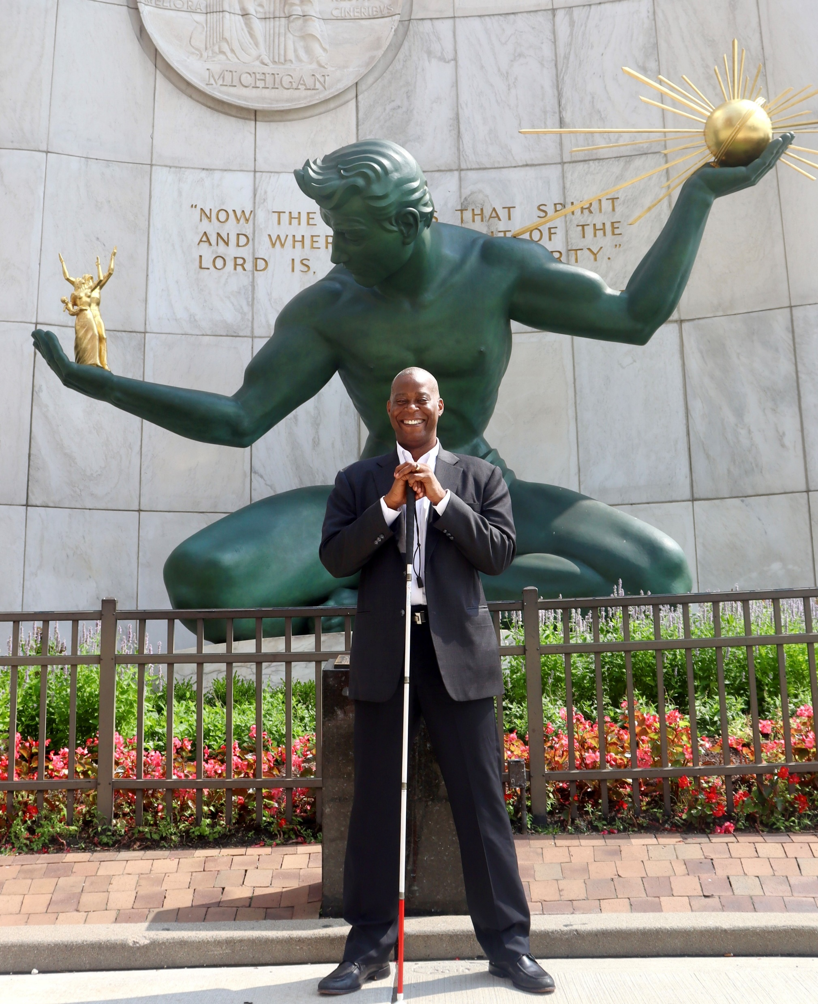
Vanward Consulting Services, LLC
Gary E. Horton President
gehorton@vanwardconsulting.com
313.774.2791

