Slide 1
Building on Success
Concurrent Session Two:
Streamlining Service Access: Revolutionizing the Intake Process
Lola Akinlapa, Director of Strategic Initiatives
Kaitlin Morrissette, Director of MassAbility Connect

Slide 2
Key objectives and takeaways
Objectives
Explain the purpose of the assisted intake form
Highlight key features and benefits
Discuss the impact on efficiency and customer service
Takeaways
For Staff & Operations
Next Phase Outcome

Slide 3
Background & Need for the Assisted Intake Form
Challenges in the Previous Intake Process
Lengthy processing times
High volume of applications causing bottlenecks
Manual data entry errors and inconsistencies
Drivers for Change
Increased demand for services
Need for improved efficiency and accessibility
AI partnership with EOTSS to expedite applications

Slide 4
Previous Challenges
Empowers people with disabilities to live life on their own terms. Their programs and services expand possibilities in careers and training, home and community life, and legal rights and benefits – including disability determination for federal programs.
Key Operational Challenges
Lengthy Processing Times
Extended eligibility verifications create financial uncertainty and delays assistance.
Bottlenecks from Volume
During periods of higher volume, overwhelmed staff leads to increase in bottlenecks.
Inaccuracies & Inconsistencies
Manual data entry is prone to errors and can introduce significant delays into workflows.
Notes:
Challenges in the Previous Intake Process
Lengthy processing times
High volume of applications causing bottlenecks
Manual data entry errors and inconsistencies

Slide 5
Drivers for Change
Efficiency & Accessibility
Enhance information access, streamline processes, improve services, and accessibility.
Increased Service Demand
Higher demands to meet the needs of individuals with disabilities.
AI Partnership with EOTSS
Partnership with EOTSS to expedite applications.
Notes:
Drivers for Change
Increased demand for services
Need for improved efficiency and accessibility
AI partnership with EOTSS to expedite applications

Slide 6
Drivers for Change
Improves User Experience:
Assisted Intake Form enhances constituent experience, reducing friction in the eligibility process.
Multi-Channel Access:
Helps MassAbility meet the applicants where they are – online, mobile, or in-person.
Smart Automation: Automates intake and verification while keeping human-centered interactions at the core.
Notes:
Drivers for Change
Increased demand for services
Need for improved efficiency and accessibility
AI partnership with EOTSS to expedite applications

Slide 7
Session connection to CSAVR Strategic Priorities

Slide 8
Session connection to CSAVR Message House

Slide 9
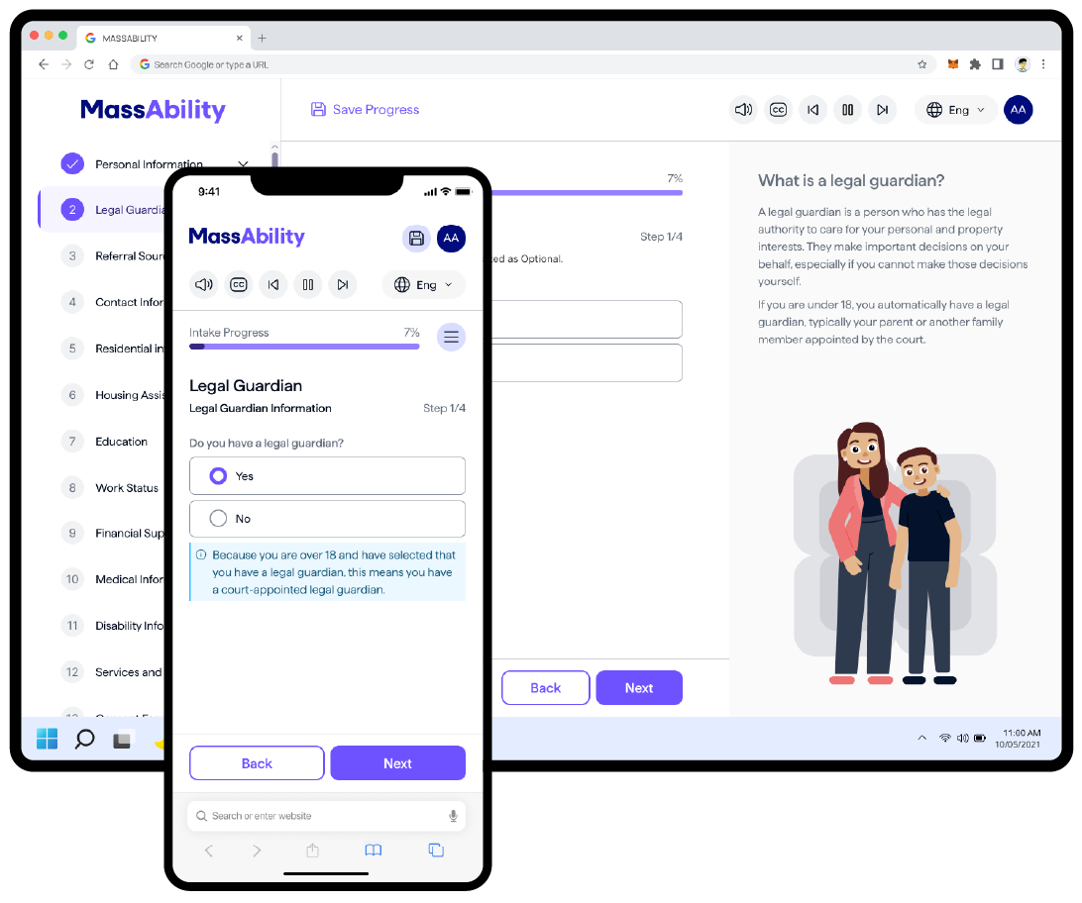
Overview of Assisted Intake Form
AI-assisted support
Speech-to-Text
Multilingual (9) Support
Analytics
Case Management Integration
Unified Intake
WCAG 2.2 Compliance
Multi-Device Accessibility
AI-enhanced solution to streamline eligibility determination.
A single application for multiple programs (SHIP, SL, Career Services, and Homecare).
Real-time data validation to prevent errors.
Smart pre-fill features to minimize manual input.
Automated eligibility checks.
User-friendly interface for applicants and staff.
Notes:
3. Overview of the Assisted Intake Form (8 min)
What is the Assisted Intake Form?
Digital, AI-enhanced solution to streamline eligibility determination
Integration with existing systems for automated processing (case management integration)
Key Features
Pre-filled data fields for accuracy
Real-time validation to reduce errors
Automated eligibility checks
User-friendly interface for applicants and staff

Slide 10
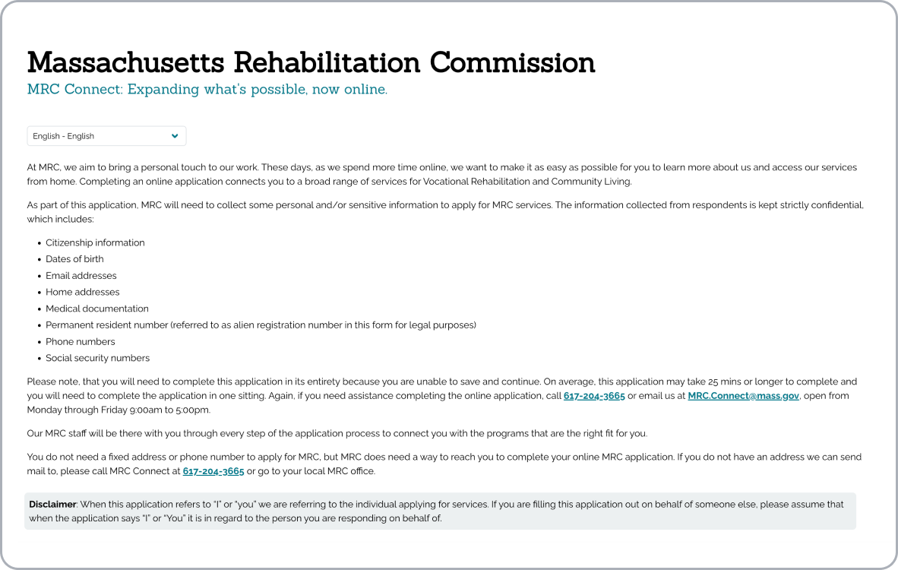
Constituent Journey – 1. Application Submission
Applicant Steps
Visit the MassAbility “Apply for Services” page.
Complete and submit the online application form.
Applicant Goals
Initiate the application process for MassAbility services.
Provide necessary personal and demographic information.
Process
The system receives the application and stores in the database.
A case worker is assigned to review application.
Channels and Systems
Notes:
Applicant Steps
Visit the MassAbility “Apply for Services” page,
Complete and submit the online application form.
Applicant Goals
Initiate the application process for MassAbility services
Provide necessary personal and demographic information.
Process
-The system receives the application and stores it in the database
- A case worker is assigned to review the application.

Slide 11
Constituent Journey – 2. Application Review
Applicant Steps
Applicant watches for communication from MassAbility regarding the status.
Applicant checks email or other provided contact methods for updates.
Applicant Goals
Maintain awareness about the next steps in the process.
Receive confirmation that the application has been received and is under review.
Process
Case worker reviews submitted application.
System creates a Mass.gov account for the applicant.
MassAbility sends email invitation to applicant to begin the intake process.
Channels and Systems
Notes:
Applicant Steps
- Applicant looks out for communication from MassAbility regarding the application status,
- Applicant checks email or other provided contact methods for updates.
Applicant Goals
- Maintain awareness about the next steps in the process,
- Receive confirmation that the application has been received and is under review.
Process
- case worker reviews the submitted application
-The system creates a Mass.gov account for the applicant
-MassAbility sends an email invitation to the applicant to begin the intake process

Slide 12
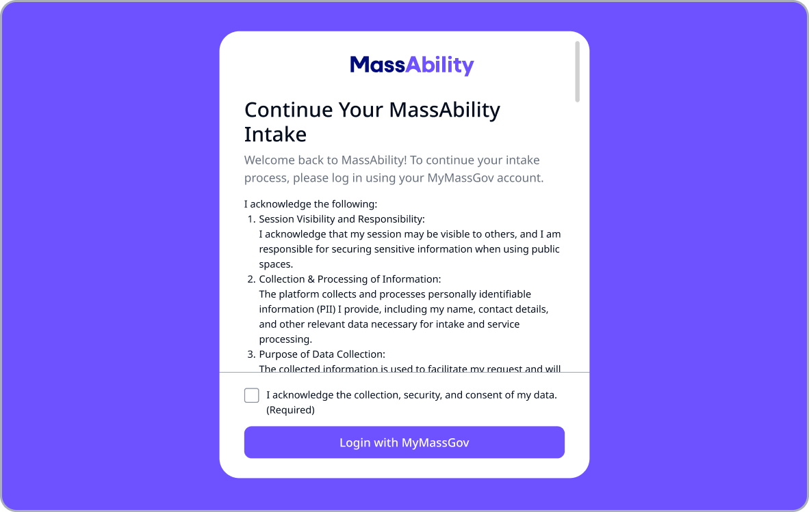
Constituent Journey – 3. Intake Process
Applicant Steps
Applicant follows link in email to access the intake form.
Applicant fills out the intake form with required information and submits it.
Applicant Goals
Complete submit intake for eligibility determination.
Ensure all required data is provided for accurate assessment.
Process
System processes the submitted intake form and stores the data.
System performs initial check for completeness and validity.
Submitted intake data transfers to OnBase via API for processing.
Channels and Systems
Notes:
Applicant Steps
-Applicant follows the link in the email to access the intake form,
-Applicant fills out the intake form with re quired information and submits it.
Applicant Goals
- Complete the intake process and submit all necessary information for eligibility determination
- Ensure all re quired data is provided for accurate assessment.
Process
- The system processes the submitted intake form and stores the data
- The system performs an initial check for completeness and validity of the information provided
-Once the intake is submitted , the data is sent to OnBase via API for further processing.

Slide 13
Constituent Journey – 4. Review & Follow-Up
Applicant Steps
Applicant waits for the case worker’s feedback or decision regarding eligibility.
Applicant provides requested additional information when contacted.
Applicant Goals
Receive a decision regarding eligibility for services.
Process
Case worker reviews OnBase intake data for completeness and accuracy.
Case worker evaluates eligibility using intake data and internal policies.
Applicant is notified of their eligibility, either confirming acceptance or requesting more information.
Channels and Systems
Notes:
Applicant Steps
- Applicant waits for the case worker ’ s feedback or decision regarding their eligibility,
- Applicant responds to any follow-up re quests for additional information if contacted by the case worker.
Applicant Goals
-Receive a decision regarding eligibility for services.
Process
- The case worker reviews the submitted intake data in the OnBase and checks for missing information or discrepancies in the intake submission,
- The case worker assesses the eligibility based on the intake data and follows internal policies for decision-making,
-The applicant is notified of their eligibility , either confirming acceptance or re questing more information.

Slide 14
Live Demo Of Assisted Intake Form
Test Link for Assisted Intake Form
https://chatbot.dev.neurosoph-cloud.com/mrc-uat-1/login
Notes:
Applicant Steps
- Applicant waits for the case worker ’ s feedback or decision regarding their eligibility,
- Applicant responds to any follow-up re quests for additional information if contacted by the case worker.
Applicant Goals
-Receive a decision regarding eligibility for services.
Process
- The case worker reviews the submitted intake data in the OnBase and checks for missing information or discrepancies in the intake submission,
- The case worker assesses the eligibility based on the intake data and follows internal policies for decision-making,
-The applicant is notified of their eligibility , either confirming acceptance or re questing more information.

Slide 15
Benefits & Expected Impact
For applicants:
Faster eligibility determination.
Easier, more accessible application process.
Reduced need for manual follow-ups.
For Staff & Operations:
Less administrative burden.
Improved accuracy and consistency.
Enhanced tracking and reporting capabilities.
Early Metrics & Feedback:
Reduction in process time.
Increase in successful first-time applications.
Positive feedback from user and staff.
Notes:
4. Benefits & Expected Impact (8 min)
For Applicants
Faster eligibility determination
Easier, more accessible application process
Reduced need for manual follow-ups
For Staff & Operations
Less administrative burden
Improved accuracy and consistency
Enhanced tracking and reporting capabilities
Early Metrics & Feedback
Reduction in processing times
Increase in successful first-time applications
Positive feedback from users and staff

Slide 16
Implementation
Current Rollout Status:
Soft Launched March 7, 2025.
Reduced wait times and increases in self-service adoption.
Empowers staff to focus on human-centered interactions.
Enhanced accessibility with guided voice-overs and speech-to-text.
Completed intake from 90 minutes to 15 minutes.
Significantly reduces contacts to staff.
Faster, more efficient delivery of MassAbility services.
Notes:
Current Rollout Status
Pilot phase outcomes
Adjustments based on initial user feedback
Next Steps
Full implementation timeline
Training and support for staff
Ongoing monitoring and optimization

Slide 17
Overview of the Assisted Intake Form
INSERT VIDEO DEMO HERE

Slide 18
Next Steps
Full Launch
Review user feedback , improve with insights gained, scale up, and prepare for next full launch
Training & Support for Staff
Comprehensive training is essential to effectively utilize new Assisted Intake Form to improve services to users.
Monitoring & Optimization Ongoing monitoring and optimization is critical to maintain efficient operations, enhance security, and improve.
Notes:
Next Steps
Full implementation timeline
Training and support for staff
Ongoing monitoring and optimization

Slide 19
Q&A/Discussion
Empowers people with disabilities to live life on their own terms. Their programs and services expand possibilities in careers and training, home and community life, and legal rights and benefits – including disability determination for federal programs.
Thank you!
Open Floor for Questions
Notes:
6. Q&A and Discussion (10 min)
Open floor for questions
Gather feedback from participants
Address concerns and next actions

Slide 20
Evaluation and Feedback
Complete evaluation – get your CRCC credits
Also may provide direct feedback to info@csavr.org
What’s next on the agenda?

