Slide 1
Disabled Talent in the
AI-powered Workplace
Jessica Rafuse
Director, Accessibility Strategic Partnerships & Policy

Slide 2
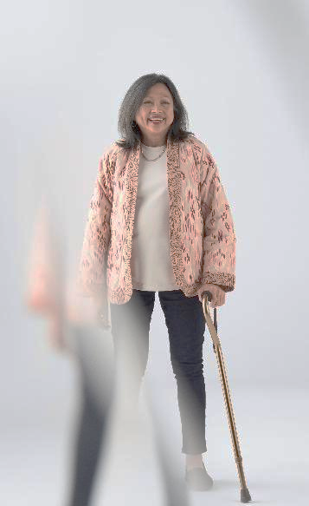
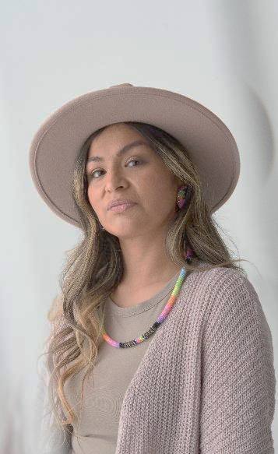
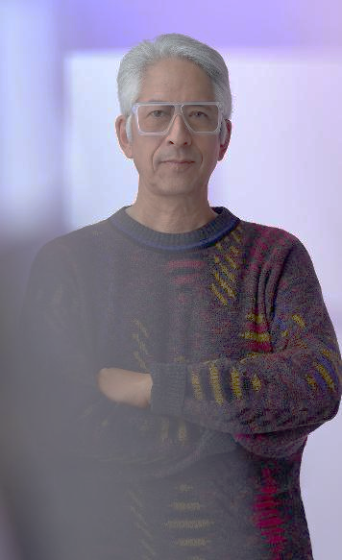
Disability Today
1.3 billion people have a disability
75% of disabilities are non-apparent
8.8% of Microsoft
employees in the US
identify as disabled

Slide 3

Accessibility is a fundamental right
Notes:
We unequivocally support the fundamental rights of all people. Just as we are committed to defending democracy and addressing systemic racial injustice, we are equally committed to ensuring people with disabilities have accessible technology.
At Microsoft, we believe Accessibility is a fundamental right. It breaks down barriers and opens doors to a more equitable future.

Slide 4
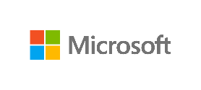

Bridging the disability divide
Policy
Partnerships
Technology
People
Disability community
Customers & partners
Employees
The world
The gap in societal inclusion for people with disabilities
Notes:
The disability divide is growing, and we have a responsibility to help close it. This ‘disability divide’ is a term from the World Bank that identifies the gap in societal inclusion that exists for people with disabilities. These gaps exists in many areas, including in education, employment, and of course, technology.
The exclusion and marginalization of persons with disabilities is a human rights issue as well as an economic issue for countries. When a significant section of society, estimated at 15 percent of the world’s population, faces obstacles in receiving an education, transitioning into the labor market, and becoming economically self-sufficient, it not only undermines their rights and dignity but adds significantly to a country’s welfare burden (WHO and World Bank 2011).
This divide has been around for a long time and progress has been far too slow.
Disability numbers are growing
We’ve seen a growing number of longer-term health consequences from COVID-19, with some ‘long-haulers’ having symptoms for months.
Mental health conditions are increasing. Depression screens are up since 2020, almost 900% in the US
The population around the world is aging
The employment divide is worsening
In the US, the unemployment rates for people with disabilities is twice that of those without disabilities. A trend that is reflected around the world.
Education gaps are increasing
People with disabilities consistently have lower levels of education than their peers.
In the US, the average high school graduation rate for students with disabilities–those served by IDEA–was 67.1 percent, according to the latest data. That’s 17.5 percentage points lower than the 84.6 percent rate at which all students graduated.
We have a responsibility to help close this divide. At Microsoft, we take this responsibility very seriously, and we also see this as a tremendous opportunity.
Sources:
Disability and Employment | United Nations Enable
Table 1. Public high school 4-year adjusted cohort graduation rate (ACGR), by race/ethnicity and selected demographic characteristics for the United States, the 50 states, the District of Columbia, and Puerto Rico: School year 2018–19
Data on Disabilities (nsba.org)
Persistent Symptoms in Patients After Acute COVID-19 - PubMed (nih.gov)
WDR16-BP-Bridging-the-Disability-Divide-through-Digital-Technology-RAJA.pdf (worldbank.org)

Slide 5
Our accessibility journey
Building a culture of inclusion
New commitment to bridge disability divide
Windows
‘95
Screen
reader
Disability Answer Desk
Autism Hiring Program
New Inclusive Tech Lab
Sticky keys
Seeing AI
1994
1995
2000
2012
2015
2017
2020
2022
Technical
People
1998
2008
2010
2015
2016
2018
2021
Microsoft commitment
Disability
ERG established
1st Ability Summit
New company mission
New approach to manage accessibility
Xbox Adaptive Controller
Windows 11, most inclusive version yet
Notes:
At Microsoft, we’ve been on an accessibility journey since the 1990s, starting with our introduction of Sticky Keys for Windows → To Bill Gates’ 1998 commitment to make our products accessible. We’ve had great technical achievements (shown on top) and important people milestones (shown on bottom).
But our approach has changed in the last few years because we’ve learned that you cannot separate the two. Starting in 2015 under CEO, Satya Nadella’s leadership, accessibility has become core to Microsoft’s mission to empower individuals and organizations on the planet to achieve more.
By embracing accessibility, we have begun to build a culture of inclusion that extends across all teams (HR, Dev, Marketing, Finance…) and into our hiring efforts. And by hiring talent with disabilities, we are creating more innovative products that help meet the needs of everyone, with accessibility embedded into those products and not just bolted on as an afterthought
2016: Rebuilt our company-wide accessibility program with a more systematic way to measure progress and set targets with our Accessibility Evolution Model. We began to measure and manage accessibility like a business. And this has helped accelerate some great innovations.
2018: Microsoft Xbox Adaptive Controller
2020: Announced a new 5-year commitment to help close the Disability Divide.
2021: Windows 11, our most inclusive Windows yet.
2022: Re-launched Inclusive Tech Lab (which I’ll talk more about later in the presentation)
More dates to consider
2014: 1st Ability Hackathon
2015: First Inclusive Design Toolkit (second in 2023)
2016: Learning Tools Immersive Reader
2018: AI for Accessibility

Slide 6
How can AI help?

Slide 7
Platforms
Accessible AI is Responsible AI
Build inclusively
Include
disability data
Foster
innovation
Notes:
Responsible AI principles:
Privacy and security
Reliability and safety
Fairness
Transparency
Accountability
inclusiveness
Key Takeaway: AI should be accessible from the get go. To get there, we’ve developed the following Accessible AI Principles:
Build accessibly: Microsoft is committed to developing technology that empowers everyone, including people with disabilities, and helping customers address global accessibility requirements
Include representative data: LLM's are trained on specific datasets. To produce, inclusive outputs that empower people with disabilities and avoid ableism, they need to include disability data.
Innovate: AI has the power to drive innovation beyond anything we have seen to date. Let’s leverage this moment in time to drive paradigm shifting innovation for accessibility and beyond.

Slide 8
Accessibility is innovation
Practice inclusive design
Collaborate with the community
Empower
others
Notes:
Throughout history, the right tool, in the right hands has always sparked transformation.
From moving water across hundreds of miles via ancient aqueducts to putting the world’s knowledge at our fingertips with the advent of smartphones, these tools change our lives.
And now we’re seeing the potential of the next great shift: the new era of AI.
This shift isn’t coming a few years down the road, or even in a few months. Your opportunity to lead in this new era of AI is right now.
It’s one of the most exciting shifts of our generation, and we, along with other leaders are seeing this impact take shape across three key dimensions -- for individuals, entire teams, and across every industry.

Slide 9
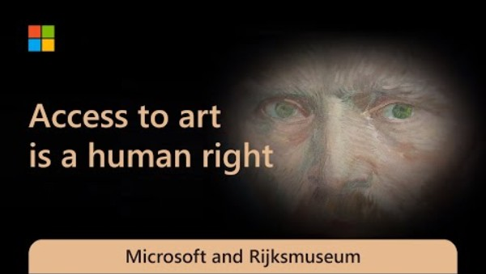
Rijksmuseum

Slide 10



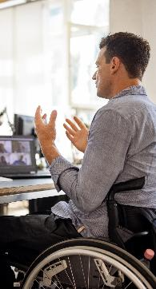
Technology pillar
Technology
Develop inclusively-designed, accessible technology
People
Partnership
Policy
Notes:
We strive to accelerate paradigm-shifting innovation, discoverability, and affordability to empower people across the global spectrum of disability, while maintaining durable product conformance.

Slide 11
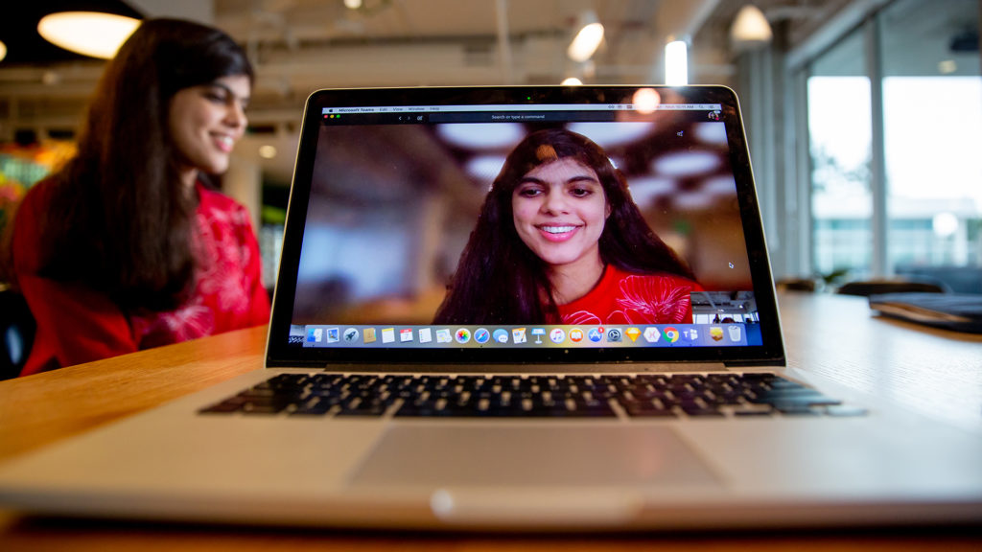
Swetha

Slide 12
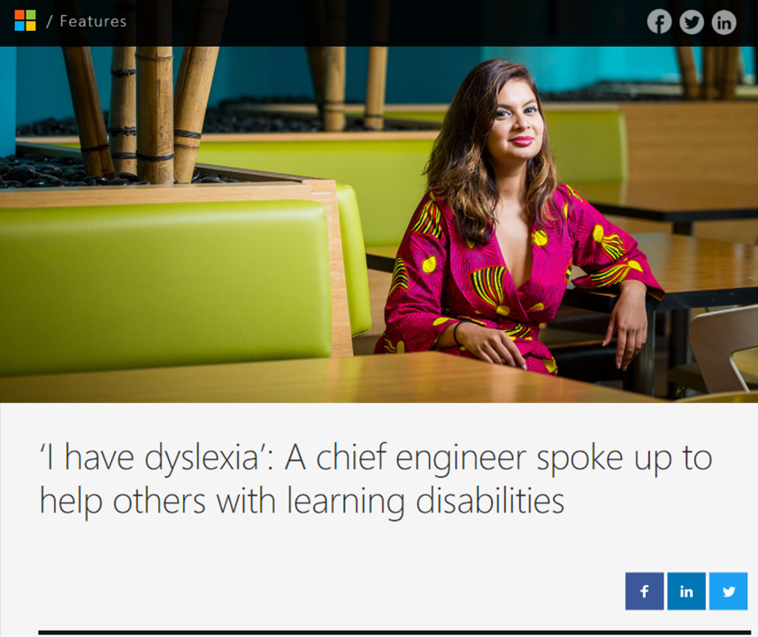
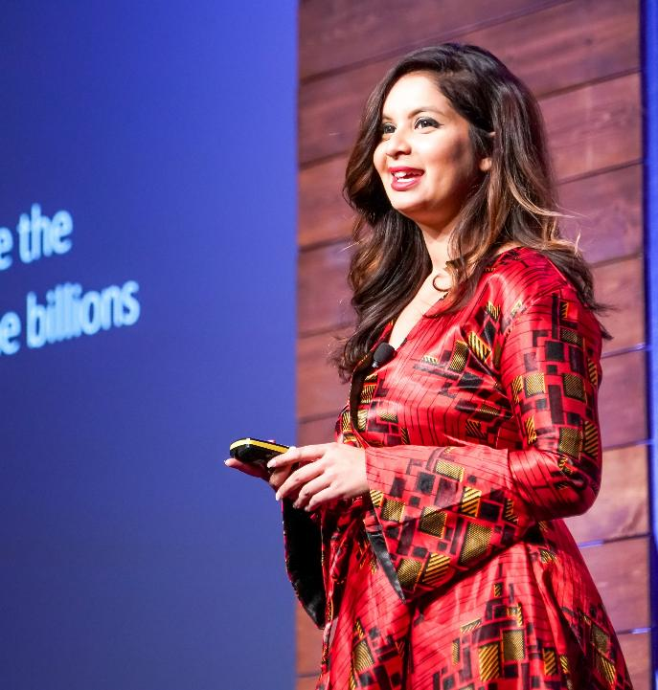
Disability is innovation

Slide 13
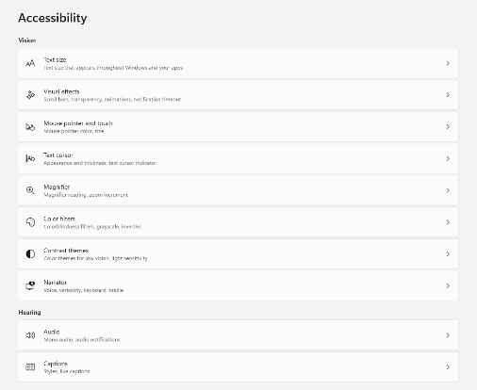

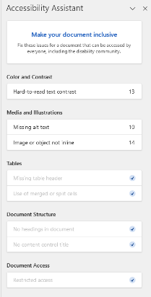
Built-in accessibility features
Windows accessibility settings
Accessibility Assistant
Notes:
Windows 11 and M365 accessibility features

Slide 14

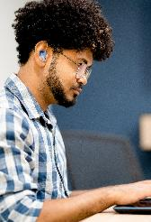
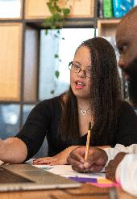
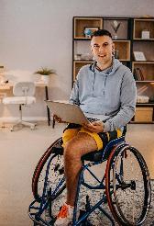



Microsoft Copilot
Empowering the disability community
Enhanced productivity
Improved focus and attention
Increased organization
Improved content generation
Increased discoverability
Elevated
creativity
Notes:
Each image is linked to a “This is my Copilot” video

Slide 15
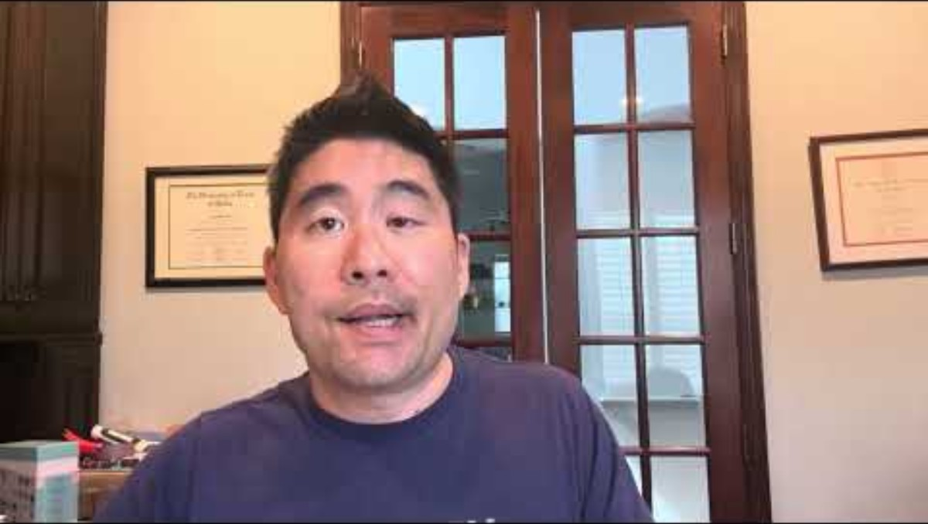
Copilot Employee Video

Slide 16



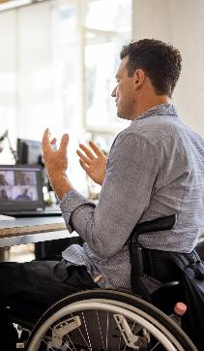
People pillar
2
People
Expand opportunities for people with disabilities to thrive at work, school, and home.
Technology
Partnership
Policy
Notes:
We are a technology company, so we lead with technology, but in order to raise the bar on accessibility, you also must build a culture of inclusion. And that starts with people.
We want to empower people with disabilities to thrive by fostering cultures of inclusion and investing in programs that address skilling, hiring, and the advancement of disabled talent.

Slide 17
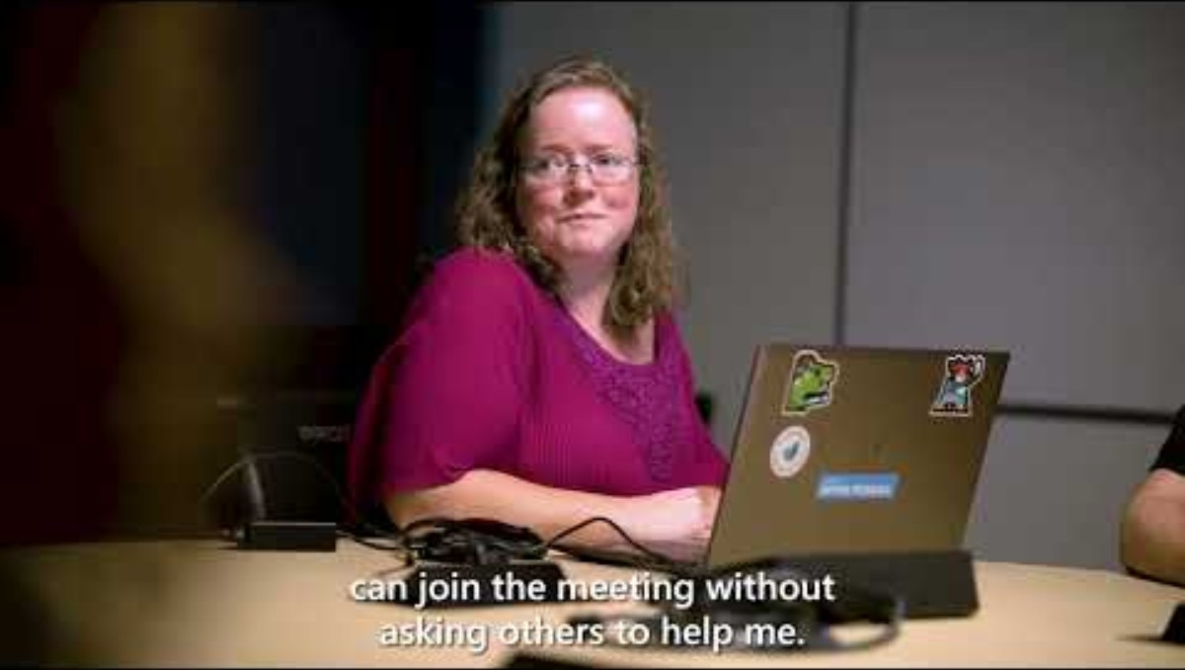
New campus accessibility

Slide 18

People
Disability is a strength. Disability is talent.
Inclusive Hiring
Microsoft.com/InclusiveHiring
Employee Resource Group
Self-Identification
Storytelling
Accommodations
Benefits

Slide 19

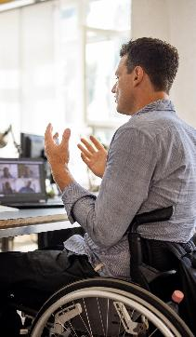
Partnership Pillar
2
Partnership
Accelerate awareness and usage of accessible technology
Technology
People
Policy
Notes:
The challenges facing people with disabilities are complex and no single company or sector can solve them alone. We’ll continue to prioritize partnerships to drive usage and awareness globally, and operational efficiency to scale accessibility support.

Slide 20
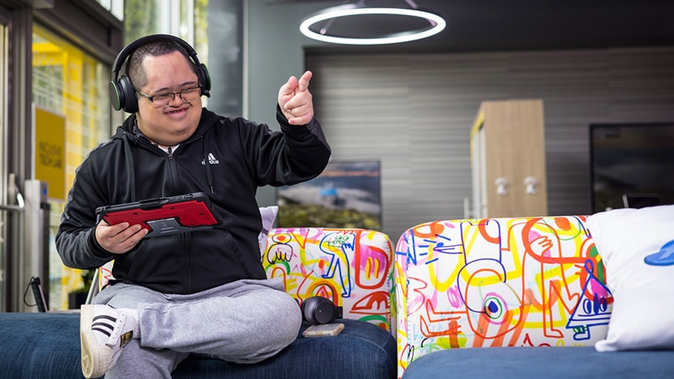
Microsoft Inclusive Tech Lab

Slide 21
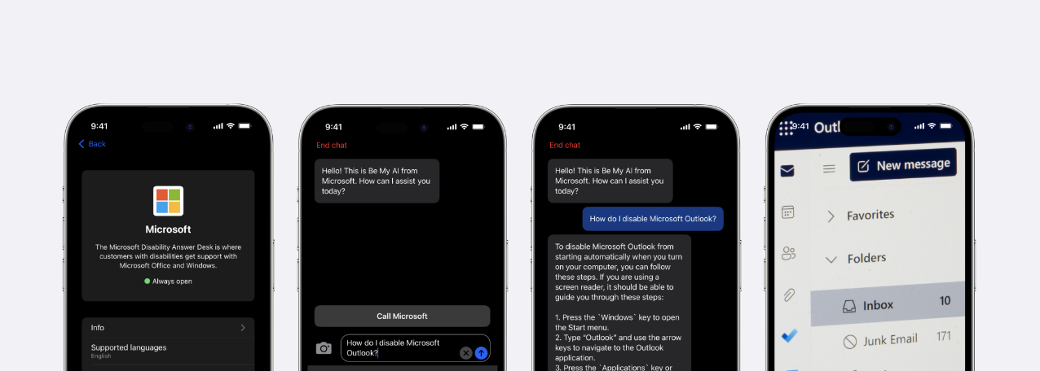
Disability Answer Desk
+
Be My AI
How do I enable Microsoft Outlook?
To enable Microsoft Outlook to start when your Windows 11 computer boots up, follow these steps:
Press the Windows Key + R to open the Run dialog.
In the Run Command window, type shell:startup and click OK. This will open the Startup Folder on your computer.
Right-click on the Outlook icon (or the shortcut to Outlook) and select Copy (or press Ctrl + C).
Navigate to the Startup folder you
How do I enable Microsoft Outlook?
Notes:
Partner: Be My Eyes video.
Blind/Low Vision | Rich image description via Virtual Volunteer (GPT-4)
App is free, and integrated into Microsoft’s Disability Answer Desk with good results
Across more than 2,000 contacts in February:
40% of tickets are resolved without human escalation.
80% Customer Satisfaction with Be My Eyes AI Support

Slide 22

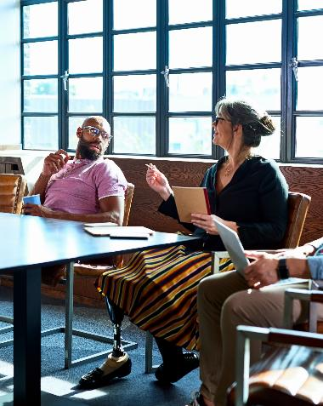

Accessibility is an opportunity
1+ billion people have a disability
1.3 billion people will need accessible technology by 2050
Only 4% of businesses focused on making accessible offerings
28%
higher revenue
2x
net income
30%
higher margins
Companies that hire, support, and promote disability talent financially outperform their peers
https://www.gettyimages.in/detail/photo/mature-woman-leading-team-meeting-in-board-room-royalty-free-image/1084170908
Notes:
Accessibility has never been more important, and we see this is an opportunity:
By 2050, 1.3 billion people will need AT, including 2/3 global population age 60+
Only 4% of businesses are focused on making offerings inclusive of disabled people.
Companies that hire, support, and promote disability talent financially outperform their peers
Outperform peers
In a 2018 study done in partnership by Accenture, Disability: IN, and the American Association of People with Disabilities, they found that the 45 companies identified as standing out for their leadership in areas specific to disability employment and inclusion had, on average, over the 4-year period, 28 percent higher revenue, double the net income, and 30 percent higher economic profit margins than their peers.
Sources
https://www.who.int/publications/i/item/9789240049451
https://www.weforum.org/impact/disability-inclusion/
https://www.accenture.com/content/dam/accenture/final/a-com-migration/pdf/pdf-89/accenture-disability-inclusion-research-report.pdf

Slide 23
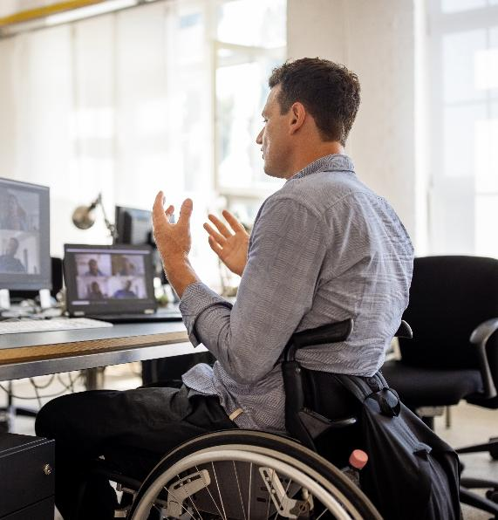

Policy Pillar
2
Policy
Advocate for policies that advance accessibility as a fundamental right
Technology
People
Partnership
Notes:
We advocate for policies that advance accessibility as a fundamental right, promote skills development, education, and employment. Autism Hiring Programs and Roundtable. Convening employers to help to move forward the Autism Cares Act in Congress.

Slide 24
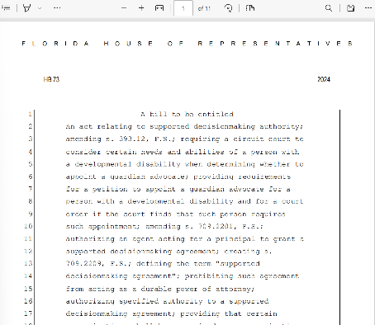
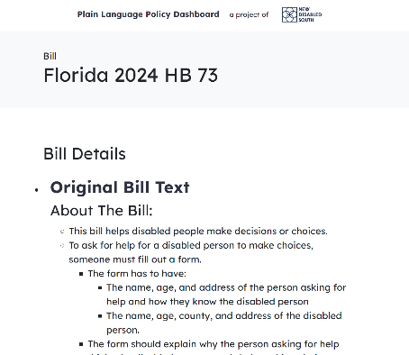
Azure Maia rack
New Disabled South
Powered by Azure Open AI
Notes:
The Plain Language Policy Dashboard breaks down complex legislation into plain language, making it easier to understand and making it more accessible to people with learning disabilities, blind/low vision, or other print disabilities. Built on Microsoft Azure and powered by AI, the goal of this dashboard is to have plain language versions of bills in states across the Southern United States.
Home - Dashboard (newdisabledsouth.org)

Slide 25
Accessibility is an opportunity and a responsibility.

Slide 26
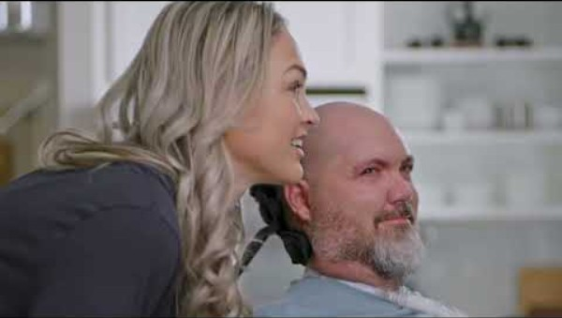
Azure Maia rack

