Slide 1
Getting our VR House in Order David Doukas, Connecticut General, CSAVR Immediate Past President Dacia Johnson, Oregon Blind

Slide 2
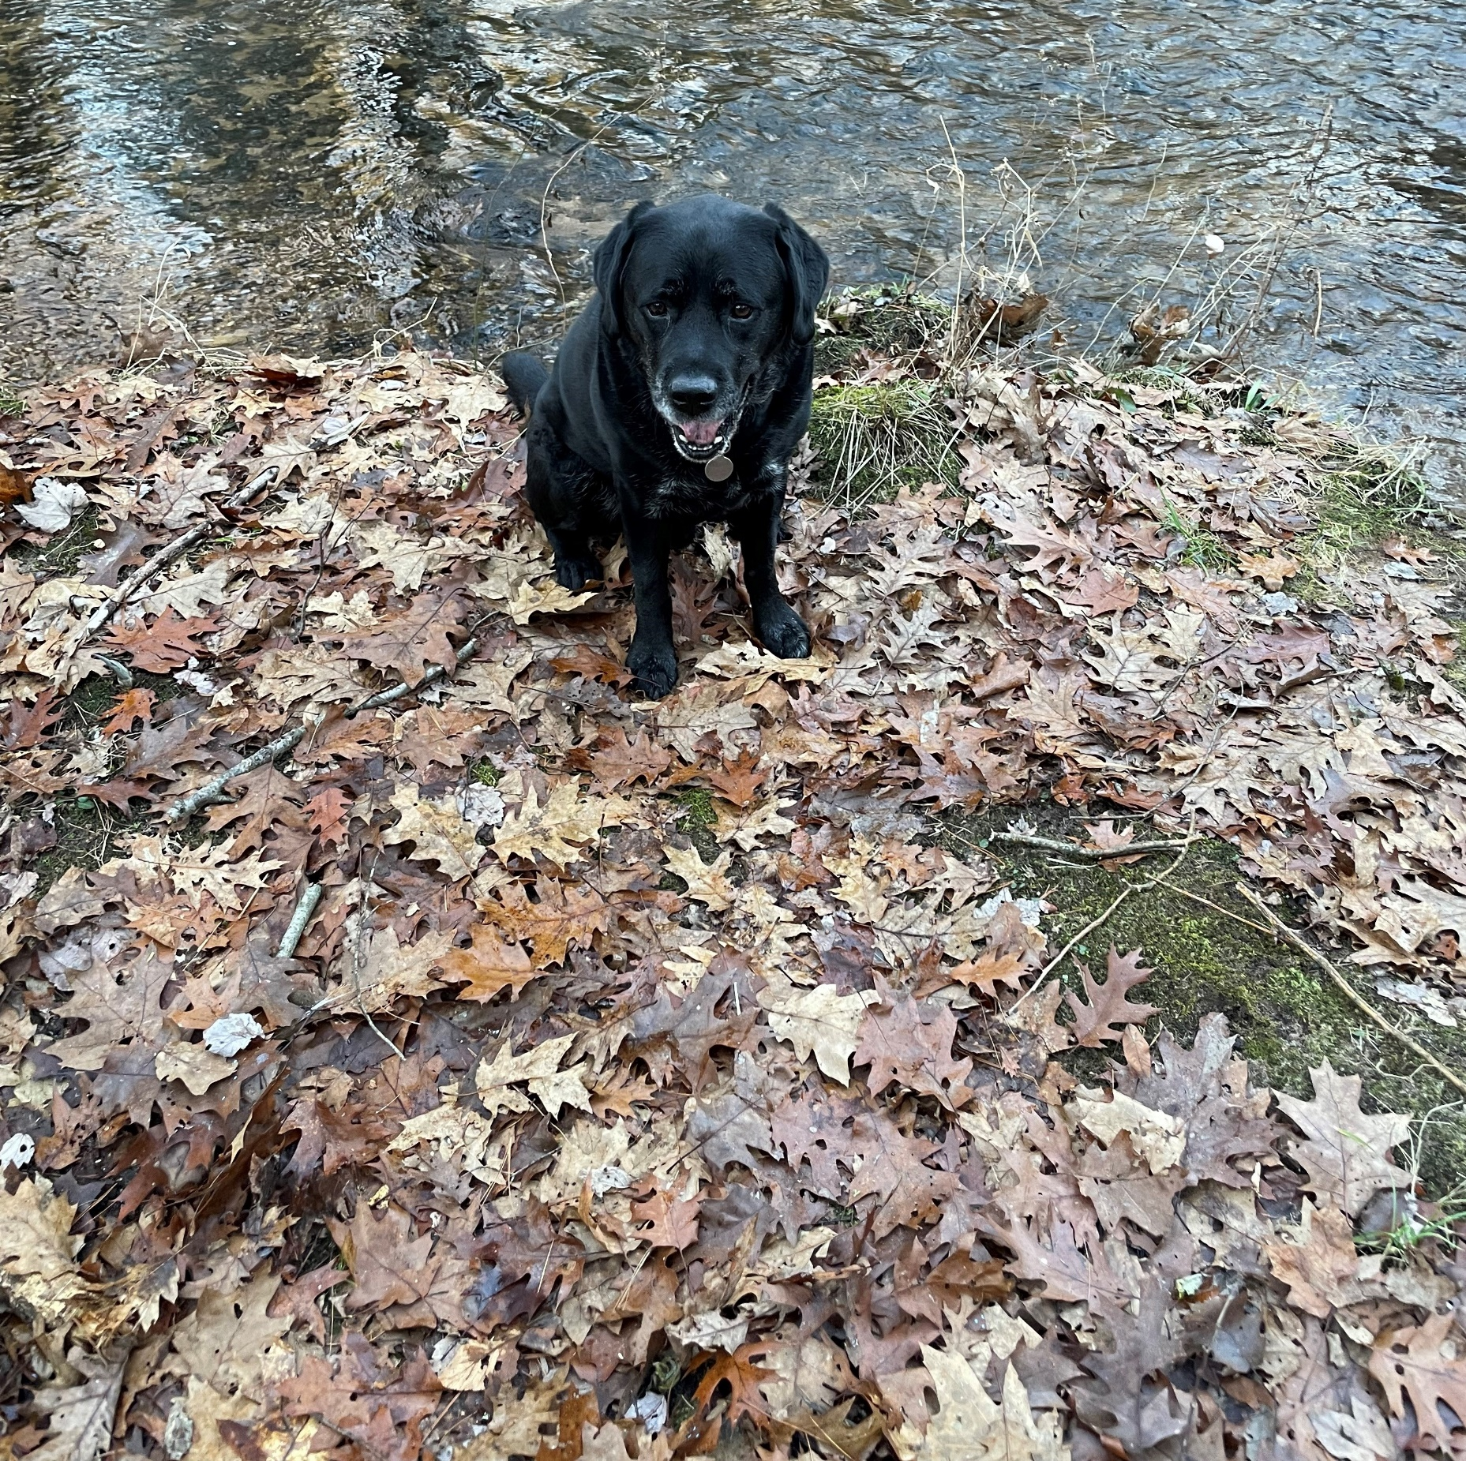
Omar’s Trail Continued
Where we have been since Spring Conference:

Slide 4
What is your best message to define the value of the public VR Program?
Write it down and contribute to the VR Message House!

Slide 6
CSAVR Strategic Priorities
How did we get here?

Slide 7
CSAVR Strategic Priorities
We got to work!

Slide 8
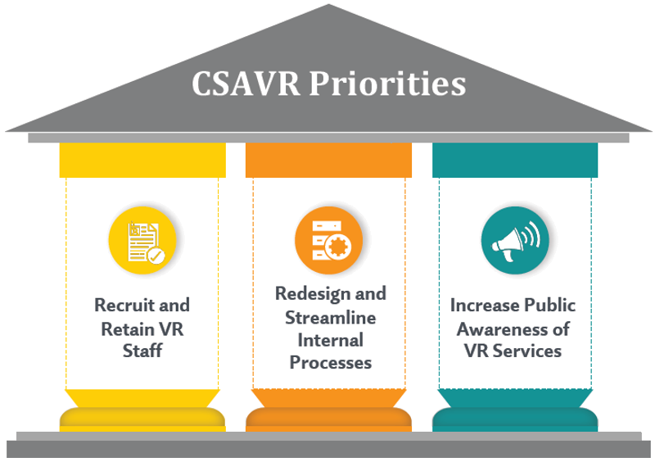
CSAVR Strategic Priorities
We Made Things Happen!
Strategic Priority 1:
Recruit and Retain VR Staff
Recruitment of new graduates
Promote/Advertise Job Opportunities
Increase salary of VR Staff
Share retention strategies

Slide 9
We Made Things Happen!
Strategic Priority 2:
Redesign and Streamline Internal Processes
Expedited Eligibility
Rapid Engagement
Provider Capacity
Fiscal Administration

Slide 10
We Have More
Work To Do!
Strategic Priority 3:
Increase Awareness of VR Services
Policy Briefs
VR Message House
Communication/Outreach
Success Stories

Slide 11
1973 Public VR House: There’s a story…. But it isn’t ours

Slide 12
VR House of the Future: Our Story
Energy Efficient
Accessible for everyone
Future prepared
Agile and flexible

Slide 13
DESIGNING FOR THE FUTURE: CSAVR’s POLICY POSITIONS:
Equitable Access from Education to Employment
VR customizes services that prioritize competitive, integrated employment.
Employment is a Human Right
VR champions equitable access to opportunities for advancements and careers that align with individuals’ skills, abilities, and passions.
Financial Empowerment and Security
VR empowers individuals with disabilities to achieve financial security
Inclusive and Innovative Workforce
VR advocates innovative solutions to advance diverse labor force participation.
Fully Funding the Employment Service System
Vocational rehabilitation services when fully funded amplify the return on investment in disability employment.

Slide 14
Policy Briefs:
CSAVR partnered with The Harkins Institute to create Non-Partisan Policy Briefs to highlight key policy issues
Funding Formula
Maximizing Interagency Funds
Workforce Participation Rates
Pre-Employment Transition Services

Slide 15
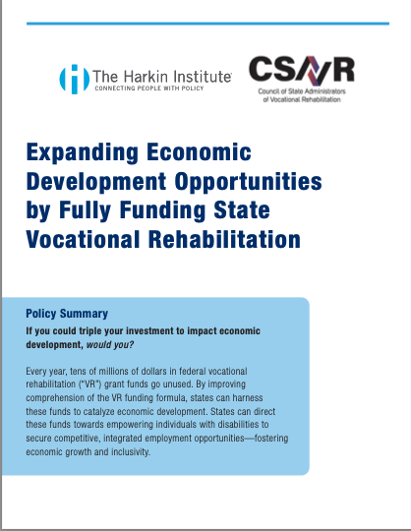
Policy Brief #1 - Funding Formula
We believe in people.
Everyone has the ability to work and contribute to our economy.
Employment.
Vocational Rehabilitation supports people along their career path, from their first job throughout their chosen profession.
Scaling Impact.
Vocational Rehabilitation scales its impact and drives results through collaboration with individuals, their families, businesses, and partners.
Talent Innovation.
Vocational Rehabilitation futureproofs the evolving workforce by ensuring businesses have a diverse talent pool to meet their needs.
States that reach full match will maximize the number of services that VR can provide to working age individuals with disabilities, and in turn maximize the number of qualified employees in their workforce.
Audience:
Primary audience: State policy makers, staffers, appropriations, and budget committees.
Secondary audience: VR Counselors and Staff and other interested parties

Slide 16
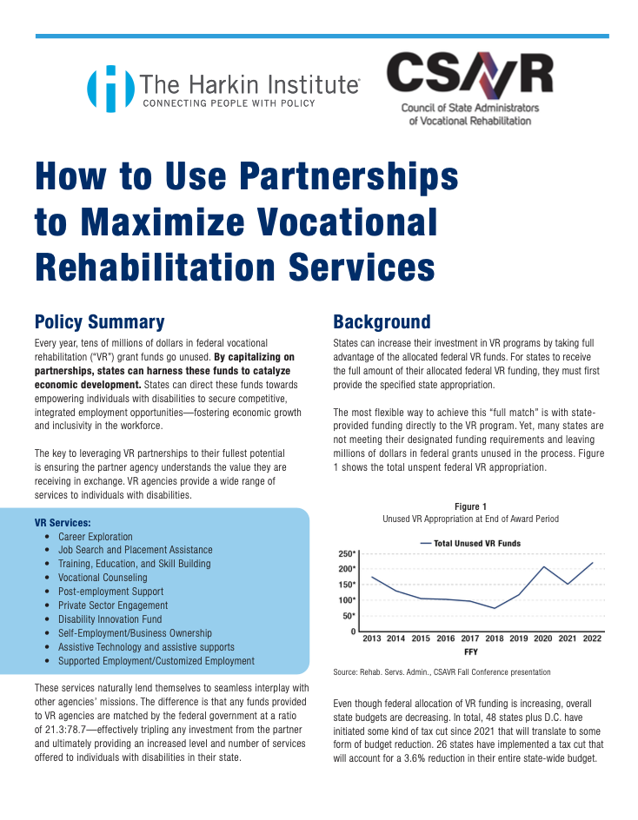
Policy Brief #2 – Maximizing Interagency Funds
Summary:
The intent of the “How to use Partnerships to Maximize Vocational Rehabilitation Services” policy brief is to educate state agency partners on the opportunity for interagency transfers to maximize collaboration for service delivery. By capitalizing on partnerships, states can harness these funds to catalyze economic development.
State Vocational Rehabilitation Agencies (SVRA’s) can use partnerships and interagency transfers to increase their state budget and therefore helping states maximize drawing down federal funds that can be used to help build SVRA capacity. The key to leveraging VR partnerships to their fullest potential is ensuring the partner agency understands the value they are receiving in exchange.
Audience:
Primary audience: State partners (such as Department of Education, State Medicaid and Human Service Partners)
Secondary audience: VR Counselors and Staff and other interested parties including policy makers and staffers
Data Referenced:
Figure 1: Unused VR Appropriations at End of Award Period
Figure 2: State Revenues Declining from Spike
Figure 3: Illustration of Increased funding from partnerships leveraging federal VR funds

Slide 17
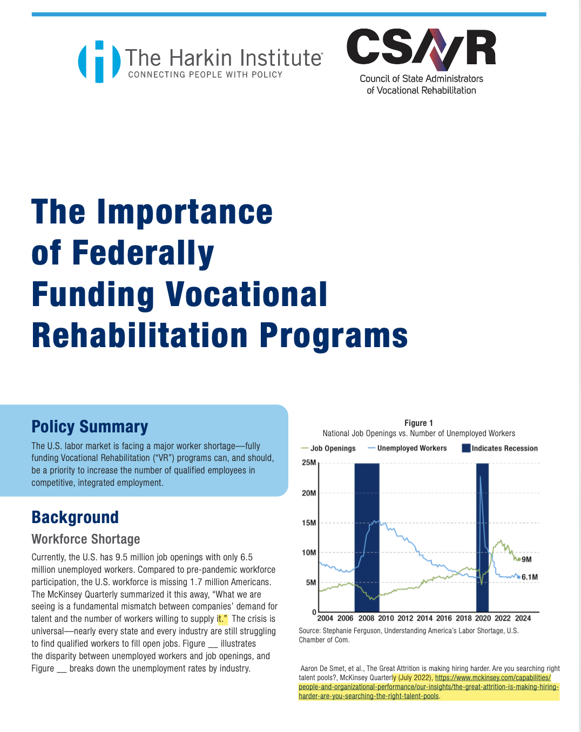
Policy Brief #3 – Workforce Participation Rates
Summary:
The intent of the “The Importance of Federally Funding Vocational Rehabilitation Programs” policy brief is to educate policy makers on the value proposition of the public Vocational Rehabilitation service system.
This policy brief was in collaboration with the Kessler Foundation and University of New Hampshire Institute on Disability. The contributions of the Kessler Foundation and NHI were essential in capturing the data. Continue to follow their work on National Trends in Disability Employment (nTIDE) here https://kesslerfoundation.org/ntide-press-releases
The U.S. labor market is facing a major worker shortage – fully funding Vocational Rehabilitation programs can, and should, be a priority to increase the number of qualified employees in competitive, integrated employment. This policy brief outlines national data trends and communicated the value of fully funding the vocational rehabilitation system.
Noting to audiences, the U.S. has 9.5 million job openings with only 6.5 million unemployed workers. This is an important distinction to communicate to the audience. There are not enough people in the workforce to cover the shortage of workers the U.S. economy is facing. The 6.5 million unemployed workers only account for those in the workforce who have been laid off or furloughed and looking for work. Noting it is important to consider the number of working aged individuals who are “not in the labor force” but want to be. Figure 5 highlights there are over 9 million people with a disability not in the workforce and 68.4 of all people with disabilities are striving for work (Figure 6). VR services is, can be and will be one of the most effective solutions to bridging that gap and therefore, fully funding the VR service system is imperative to the workforce crisis.
The workforce participation rate has increased up to 40.1% in February of 2024, as compared to those without disabilities at 77.7 % (Figure 3), highlighting the disparity between those with and without disabilities in the labor force.
VR is uniquely positioned to help fill the workforce gap!
Audience:
Primary audience: Policy makers
Secondary audience: VR Counselors and Staff and other interested parties

Slide 18
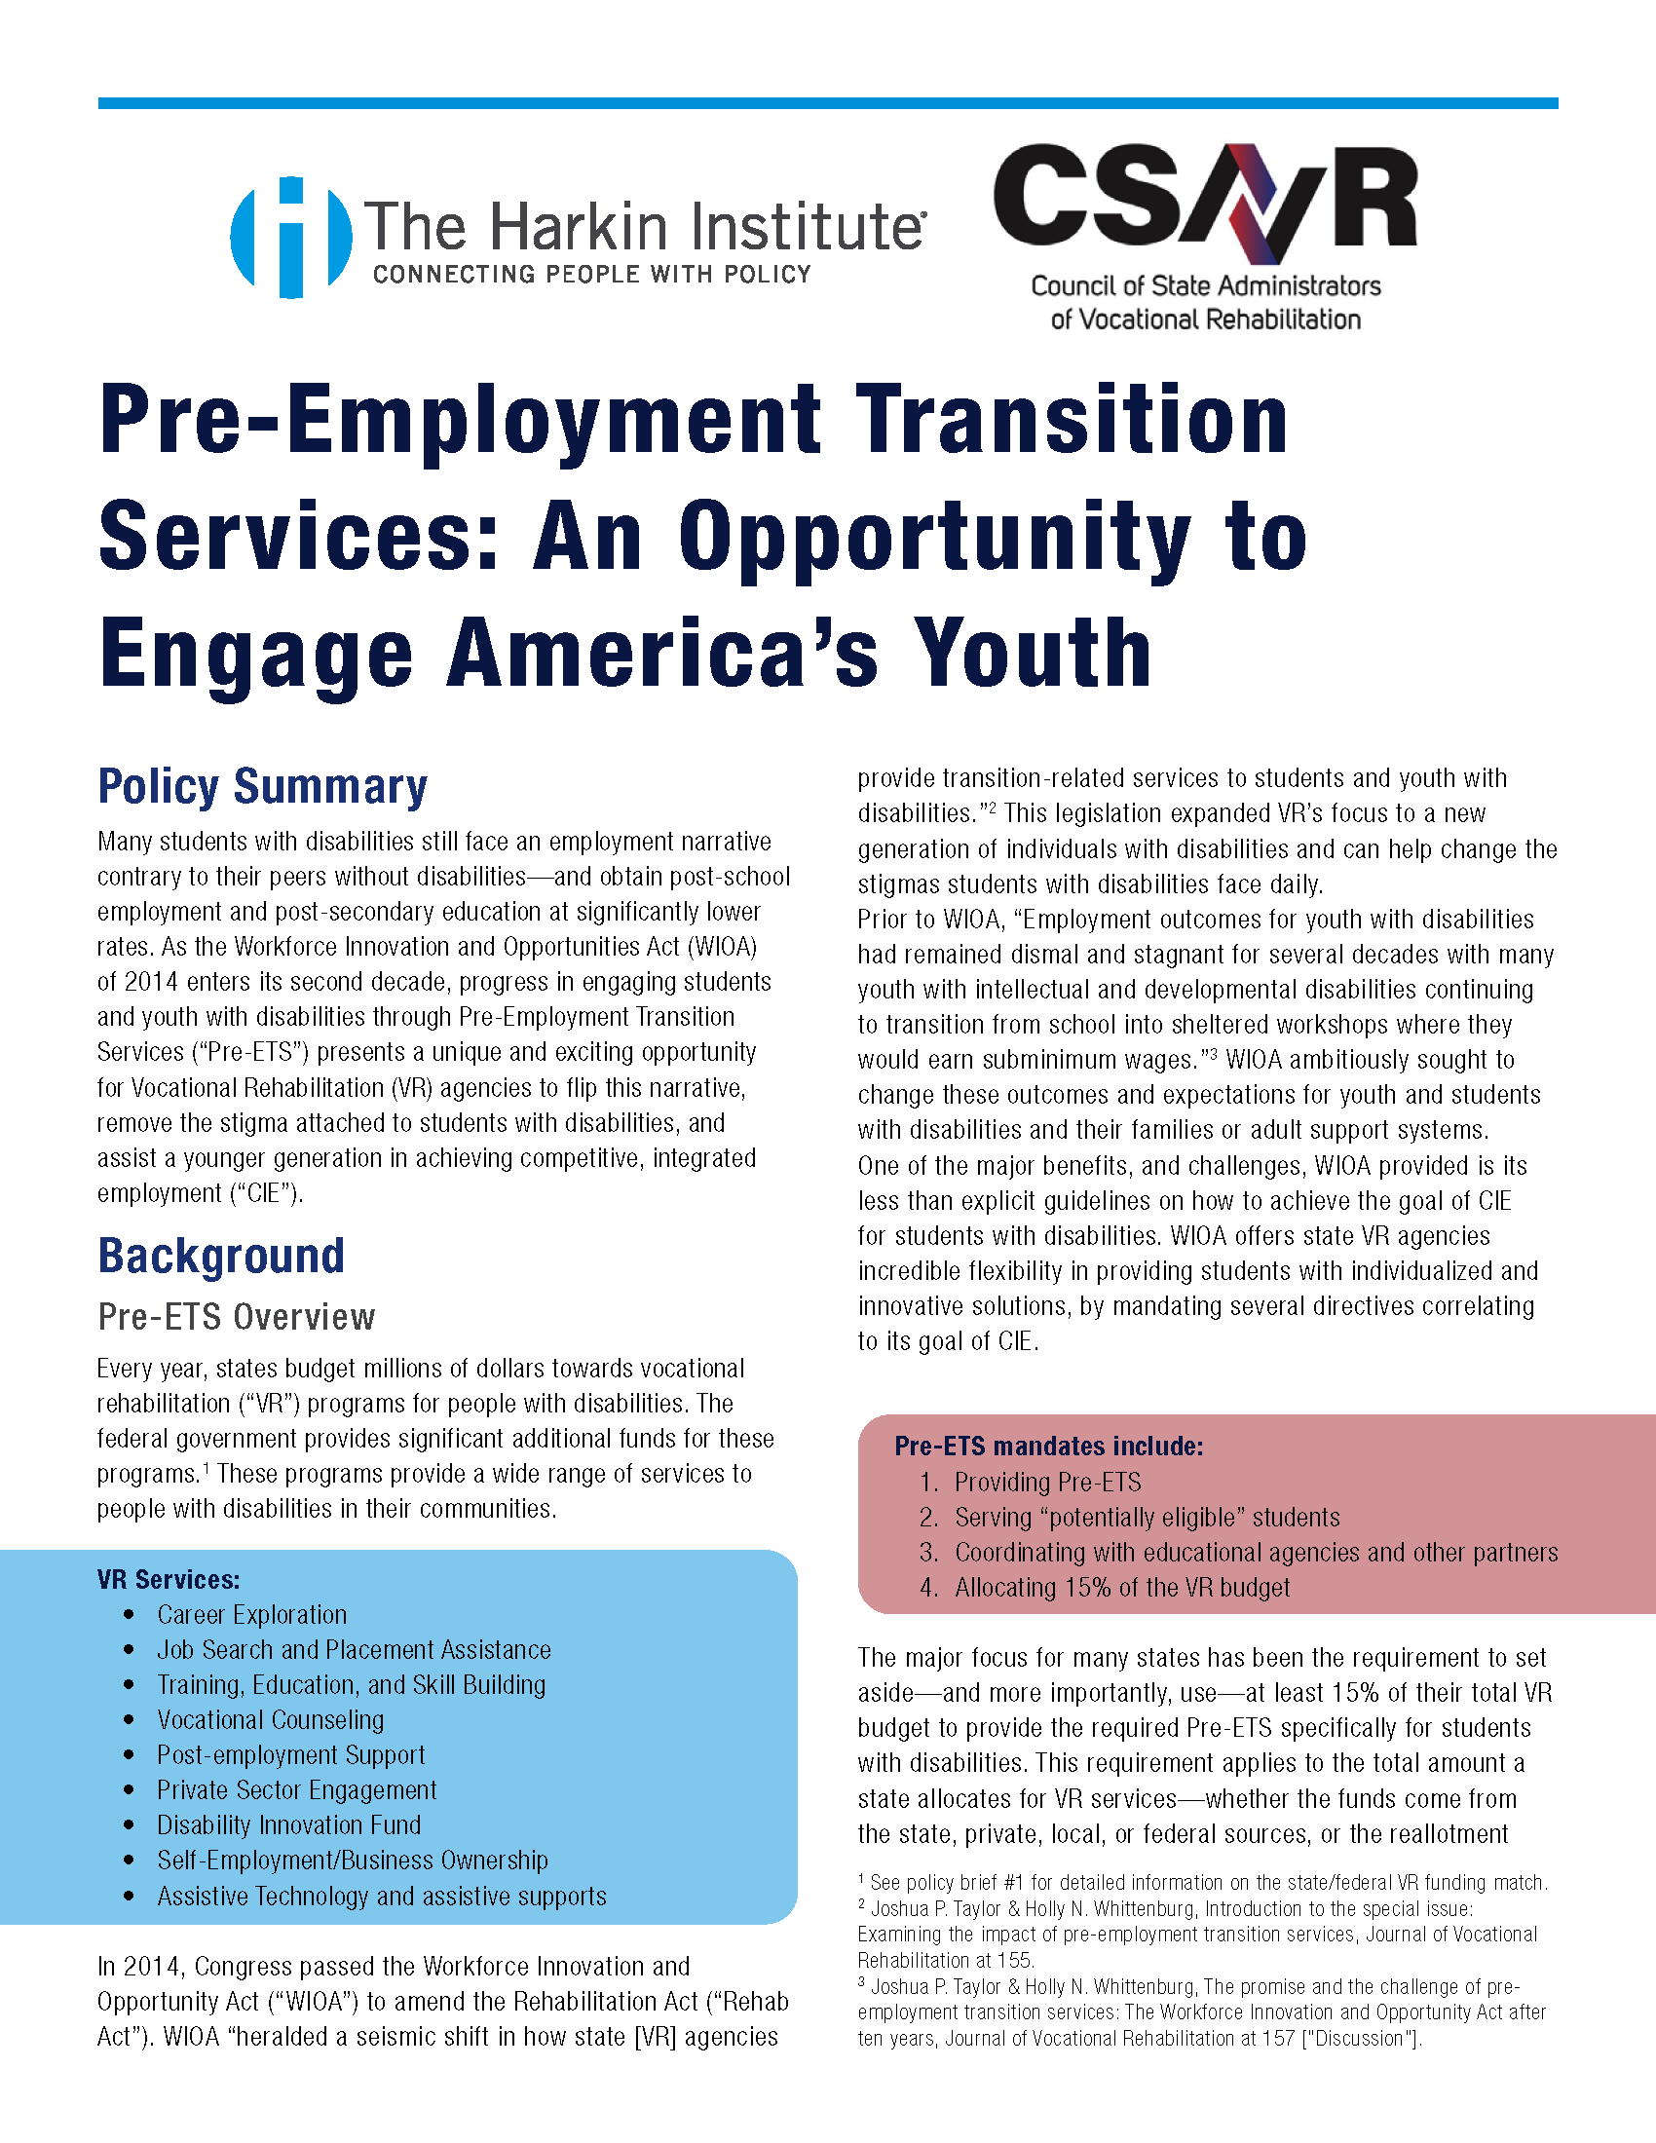
Policy Brief #4 – Pre-ETS
Summary:
The intent of the “Pre-Employment Transition Services: An Opportunity to Engage America’s Youth” is to be a leave behind and introductory document for the CSAVR and SVRA’s to educate policy makers and audiences who are not as well versed on the public VR system. This policy brief communicates the value the Workforce Innovation and Opportunities Act (WIOA) of 2014 has had on increasing access of the VR system for transition age youth under the Pre-Employment Transition Services (Pre-ETS) as required by WIOA.
In addition, this policy brief can be used to educate state policy makers and interested parties on the value of WIOA and Pre-ETS and the immense amount of work SVRA’s have done to implement WIOA in the past decade. This policy brief is not intended to articulate barriers; however, it is a tool to introduce the topic of WIOA and Pre-ETS allowing each SVRA to articulate their own specifics about how implementing WIOA in their state as presenting opportunities and challenges.
Data Referenced:
Figure 1: 2023 Youth Force Participation Rate
Figure 2: Increase in Pre-ETS Budget
Figure 3: State Allocation of VR Budget to Pre-ETS in 2021 and 2022
Figure 4: Increased Reach of Pre-ETS
Figure 5: Better WIOA Performance Outcomes
Pre-ETS state specific data:
https://rsa.ed.gov/wioa-resources/wioa-annual-reports

Slide 19
DESIGNING FOR THE FUTURE: We sought input!
The Harkin Institute conducted interviews with stakeholders directly relevant to CSAVR and its mission of maintaining a strong national program of vocational rehabilitation (“VR”) so that persons with disabilities can achieve competitive, integrated employment.

Slide 20
We have work to do! Key Take Aways when Harkins Institute Interviewed Key Stakeholders:
Communicate as often as possible that VR services are making a difference.
Communicate
Focus on building, strengthening, and improving relationships with the people and organizations that decide the future of VR.
Focus
Take advantage of opportunities of meeting the workforce needs with creativity and responsiveness.
Opportunity
Target communications to high priority audiences such as policy makers, federal partners, employers, people with disabilities, and disability advocates
Target

Slide 21
We have work to do! Key Take Aways when Harkins Institute Interviewed Key Stakeholders:
Talk directly with key audiences to amplify the work of VR in your state
Increase awareness of how the VR system works in your state through a combination of success stories and data
Create a social media presence that is connected to the broader VR community
Talk
Awareness
Create

Slide 22
SO WHAT? NOW WHAT? IT’S TIME FOR ACTION!
Key stakeholders shared there is a sense of urgency.
We need to come together to communicate locally and nationally.
This is a call for action for all of us.

Slide 23
Getting the Word Out: Yes, We Can!
When in doubt, ask RSA- You may be surprised of the answer you receive!
SO- WE ASKED RSA…….
There is a lot that we can do with VR Funds!
Assuming that it is appropriately cost allocated proportionate to the VR Program benefit:

Slide 24
Getting the Word Out: Yes, We Can!
A communications position dedicated to the VR program
Outreach material development and distribution- both written/printed and video/social media.
Success stories/testimonials from job seeker/business customers – gathering, publishing, distributing.

Slide 25
Getting the Word Out: Yes, We Can!
Outreach activities for potential service providers/CRPs.
Media campaigns (purchasing media time/TV, Radio, Google Ads, Facebook, etc.)
Purchasing outreach professional services- development of a plan and professional services to implement on a contractual basis (not a VR staff person).

Slide 26
Getting the Word Out: Yes, We Can!
Materials for agency to participate in outreach events/job fairs (signs, banners, tablecloths)
Non-Lobbying related costs for joining or participating in a Chamber of Commerce.

Slide 27
Dog biscuits, marrow bones, and a stuffed lamb for my birthday.
Getting the Woof Out: Yes, We Can!

Slide 28
SO WHAT? NOW WHAT? ITS TIME FOR ACTION
Progress on the CSAVR Strategic Priorities is because of you! CSAVR and VR Agencies working together with RSA made it happen
Everyone in this room has a role in strengthening and improving the public VR Program
There is so much that can be done to get our message out- if we all contribute; we can fill the space

Slide 29
HOW DID WE DO?
What is your best message to define the value of the public VR Program?

Slide 30
YES WE CAN!

