Slide 1


Beyond Subminimum Wage:
Vocational Rehabilitation as a Gateway to Equitable Employment
CSVAR Fall 2024
Donna Bonessi, Director of Employment Services & Special Programs, VA-G
Michelle Yin, Associate Professor, Northwestern University
James Knauf, Director of Field Operations
Illinois Institute for Rehabilitation & Education Research, SWTCIE Project Manager
Robyn Lewis, Policy Advisor, Division of Rehabilitation Services, SWTCIE Project Manager IL-C

Slide 2
The contents of this presentation were developed under a grant number H421D220009 & H421D220008 from the Department of Education. However, those contents do not necessarily represent the policy of the Department of Education, and you should not assume endorsement by the Federal Government. (Authority: 20 U.S.C. §§ 1221e-3 and 3474)

Slide 3


Mr. Jim Knauf
UIUC SWTCIE IL Project Manager
Robyn Lewis, PhD.
IDHS-DRS Policy Advisor
IDHS-DRS SWTCIE IL Project Manager
Fall 2024
Notes:
Background and personal info

Slide 4
Illinois Subminimum Wage Reach
As of July 2024
65 applications for 14(c) certificates
7% of the Nation’s certificates
Approximately 3,175 employed under Active 14c Certificates earning SMW
Notes:
Last year 120,000 nationwide
2023- Illinois 72 certificate holders
2023- IL held 7.5% of certificates
2023- 4,090 employed

Slide 5
Subminimum Wage to Competitive Integrated Employment (SWTCIE) Illinois Innovative Model Demonstration Project
Awarded $14,193,946.00, the second highest dollar amount
Purpose:
  increase the opportunity for adults, students, and youth with disabilities who are currently earning or contemplating subminimum wage work to obtain competitive integrated employment (CIE).
  Assist 14c certificate holders in business model transformation
Partners:
  Project Implementation and Evaluation: University of Illinois- Urbana-Champaign
  Training and Technical Assistance: Virginia Commonwealth University
  14c Certificate Holders: The Workshop, Kreider Services, AID, CTF Illinois, Human Support Services, Centerstone

Slide 6
Foundational Team
Agency:
  Two, 100% dedicated, Employment Specialists
  Administrative/Supervisory Staff
DRS
  VR Counselors (Youth, Adult, RCD/BBS)
  Business Employment Consultant
  Benefits Planner (DRS and WIPA affiliates)
  Supervisors and ABC’s
  Project/Grant Manager
UIUC
  Community Research Specialists
  Project Manager
  Project evaluation team and Communications team
VCU
  Two Consultants to provide Training and Technical Assistance per agency

Slide 7
Pilot Year Highlights
Capacity building
  ACRE Training (50 to date; 20 enrolled in current session)
  Community research specialist to focus solely on youth engagement
Statewide Innovative Model
  Gained attention of Government officials—we are a model program for Illinois Dignity in Pay legislation
  Model recognized by Rehabilitation Services Administration for our innovation
Coordinated and Collaborative Partnerships
  Collaboration with Silfies media
  Hired benefits planning consultant to develop a benefits planning framework for Illinois

Slide 8
Pilot Year Highlights (cont.)
Transformative Business Models
  Monthly Community of Practice for field-level staff
  Quarterly Community of Practice for Executive staff
  On-Site, targeted technical assistance and training
  Increase use of DRS VR employment contracts, decrease/eliminate 14(c) SMW work
Information Dissemination
  Website development,
  regular communications email,
  social media presence, and
  10 presentations to spread the word about the project.

Slide 9
Pilot Year Summary as of 9/30/24
75 engaged; 71 enrolled
Youth
  25 Engaged
Adults
  46 Engaged
Contemplators
  29 Engaged
  31% transition to CIE
SMW earners
  42 Engaged
  52% transition to CIE

Slide 10
Demonstration Year 1 Goals
Engage 60 customers (10 per agency)
Emphasis on Transition outreach
CRP Business models
  Increase and maximize use of VR contracts
  Increase and maximize use of other State dollars
  Focus on applying CIE best practice strategies
  Organizational Change
DRS service provision; rapid engagement
Continuity of services between Division of Developmental Disabilities and DRS
Refining project data collection methods

Slide 11
CRP Business Transformation
Creating organizational change to deliver business value
Intentional investments in development, enhancement, and improvement
  Evaluating resources
  Building organizational portfolios
  Maximizing opportunities
Balancing Stakeholder Concerns
  Social, Administrative, and Economic
  Education and Awareness
Improving Efficiency
  Service delivery
  Compliance with State requirements
  Contract utilization
Planning for the Future
  Sustainability
Notes:
SWTCIE IL is the essence of balancing Human rights, Equity and equality, Community, Employment
The intent of the project is not to close facilities, we are here to make you stronger, and serve your customers better. We want SWTCIE IL facilitate the change in making competitive employment the new and better way to engage people with disabilities in work.

Slide 12
Dignity In Pay.
HB0793ham004
Passed House with 79 votes May 2024,
Will be presented to Senate in Veto session this fall.
Requires responsible and gradual 5-year phase out
Eliminates on July 1, 2029 the use of active or pending 14(c) certificates
Prohibits paying subminimum wages to employees with a disability.​
WILL NOT close day programs or sheltered work, but does mandate at least minimum wage payment for work
Addresses fair pay as both a civil rights and economic issue
Prioritizes Person-Centered planning, especially for aging adults
Increases personal needs allowances
Notes:
SWTCIE IL is the essence of balancing Human rights, Equity and equality, Community, Employment
The intent of the project is not to close facilities, we are here to make you stronger, and serve your customers better. We want SWTCIE IL facilitate the change in making competitive employment the new and better way to engage people with disabilities in work.
How can the project help??

Slide 13

“Everybody has the right to be somebody and do something they love to do.” – Pablo, Kreider Services

Slide 14
Beyond Subminimum Wage:
Vocational Rehabilitation as a Gateway to Equitable Employment
CSAVR – Fall 2024 Conference

Slide 15



The mission
EPIC Seeks to build sustainable supports and services to increase the accessibility of Competitive Integrated Employment (CIE) for all individuals with disabilities.
EPIC will serve 200 adults who
Are currently employed in 14c employment, recently exited 14c employment, at risk of being closed disability too severe to benefit from VR services, currently in a trial work plan
400 Students with Disabilities who
Are receiving education services in a self-contained classroom for any part of their day

Slide 16
The epic model
PPWD
ARC of VA
GWU
Peer & Family Mentoring
Community Academies
education
partnership development
No Wrong Door
Virginia Easy Access
individualized services
capacity building
Value Based Purchasing
VRTACQM
Integrated Resource Teams
CE/SE Technical Assistance
GWU
VCU-RRTC
GHA

Slide 17
education
–Peer & Family Mentoring resources
Peer Mentoring
Family Mentoring
The Arc of VA
Partnership for People With Disabilities
Students served in Self -contained Classrooms
Families of students
Individual in SMW
Families of Individuals in SMW

Slide 18
partnership development
No Wrong Door
George Washington University
ELIMINATING SILOS, BRAIDING AND INCREASING ACCESS TO RESOURCES
Community Academy
Community Agency
Community Agency
Community Agency
Community Agency
epic Coordinator
Local Advisory Council
Community Academy
Community Agency
Community Agency
Community Agency
Community Agency
Virginia Easy Access

Slide 19
iNDIVIDUALIZED SERVICES
DEVELOPING IRTS AS TOOL FOR VRCS AND INDIVIDUALS TO ELIMINATE CIE BARRIERS
IWD
Community Agency
Community Agency
VRC
Community Agency
Integrated Resource Team
George Washington University
epic Coordinator
VRC

Slide 20
capacity building helping providers develop resources and services to retain quality staff and facilitate quality outcomes
Supported Employment
Customized Employment
Virginia Commonwealth University-RRTC
Value Based Purchasing
Griffin- Hammis Assoc
VRTAC-QM
DARS
14 (c) employers
&
CRPs
14 (c) employers
&
CRPs

Slide 21


Closing the Gap: Reevaluating Subminimum Wages and Enhancing Earnings Equity for People with Disabilities
Michelle Yin, PhD
Associate Professor
Principal Investigator, RISEI Lab
Northwestern University

Slide 22
Labor Market Gaps of
People With Disabilities

Slide 23
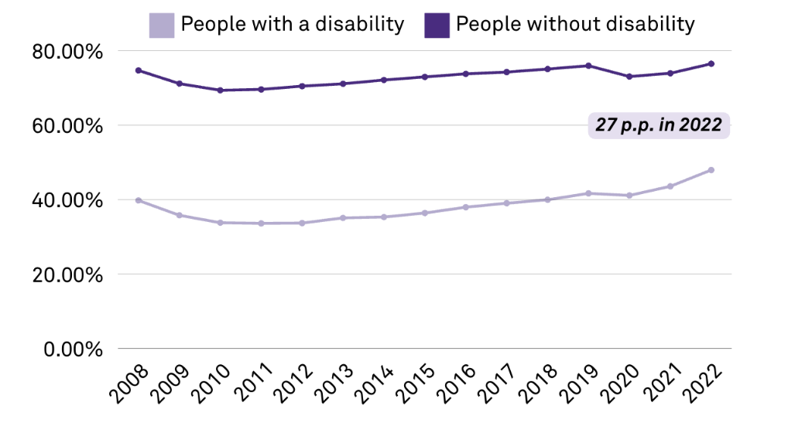
Employment Inequality in the U.S.
Notes:
The ACS started asking about disability status in 2008.
The gap in employment rates between PWD and PWOD has been consistent and has not closed in recent years, remaining at around 30 percentage points in 2022.

Slide 24
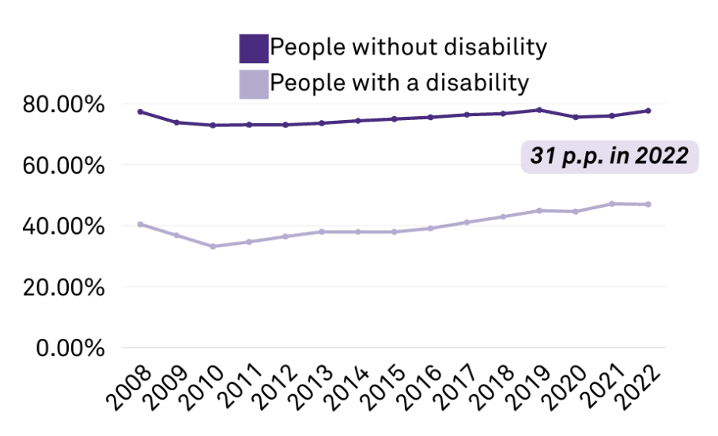
Employment Inequality in Virginia
Notes:
Graph of employment gap in Virginia
Similar to national trends (around 30pp in 2022)

Slide 25
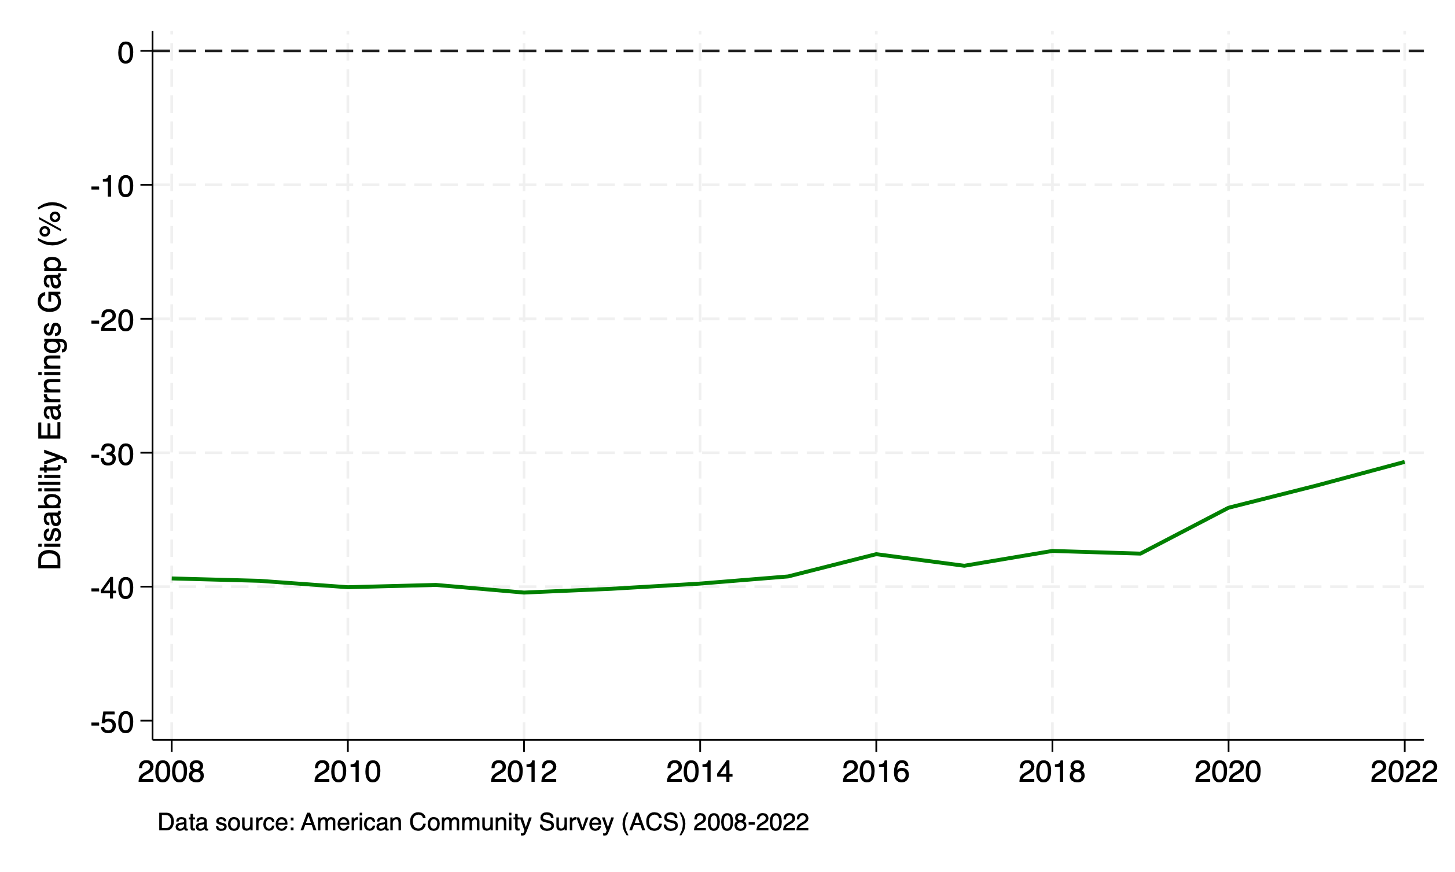
Pay Gap Inequality in the U.S.
29% in 2022
Notes:
This is the percentage difference in annual earnings between PWOD and PWD using the ACS data after controlling for demographic characteristics like age group, race and ethnicity, gender, and marital status.
In 2022, PWD earned on average 30% less wages compared to PWOD with similar demographic characteristics.
Important to note that the pay gap has also persisted throughout the decades.

Slide 26
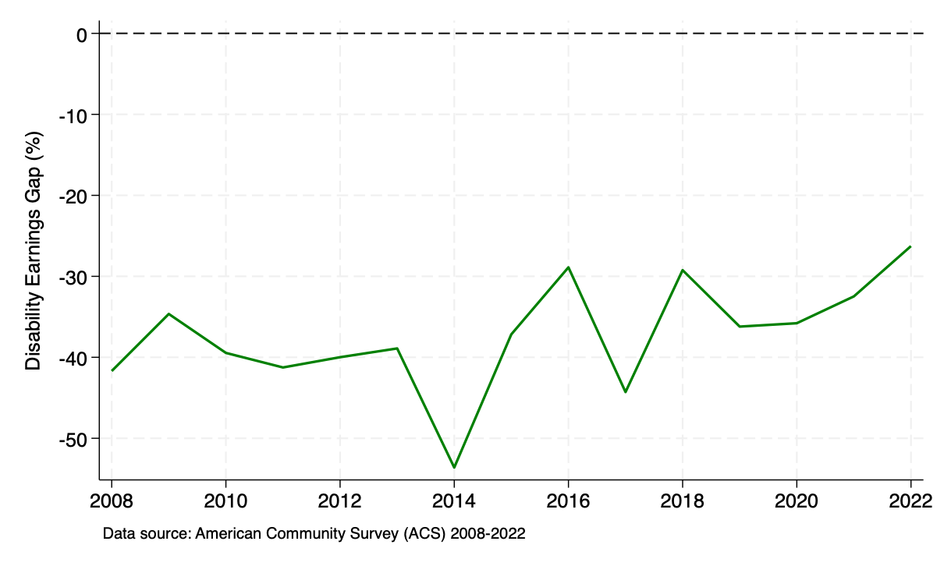
Pay Gap Inequality in Virginia
26% in 2022
Notes:
This is showing the same pay gap estimate in Virginia only. It’s not as smooth as the national trend because of the smaller sample size, but the story is the same:
Persistent disability pay gap over time
Similar pay gap estimates with national estimates (around 30% in 2022).

Slide 27
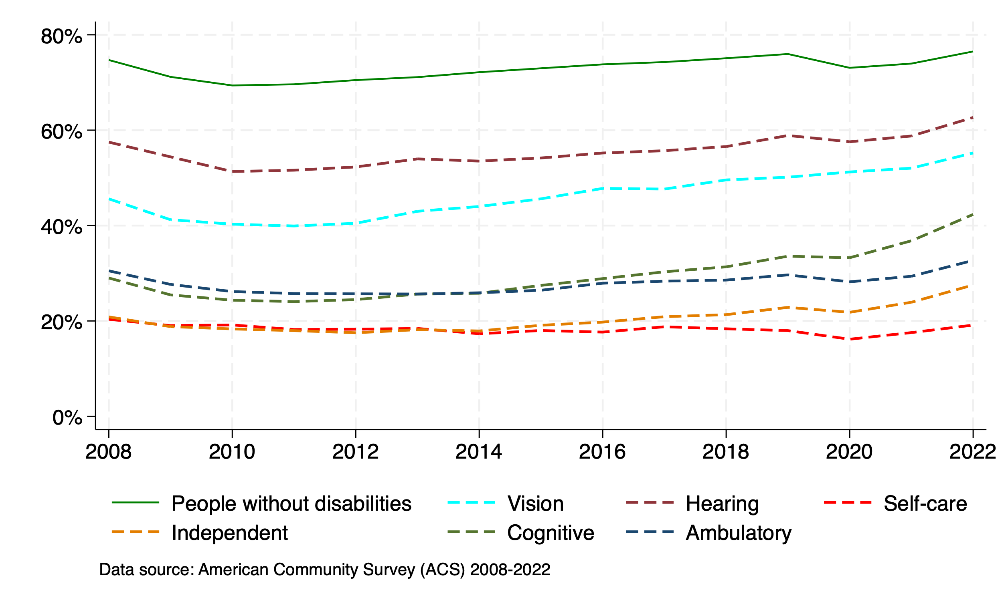
Employment Inequality in the U.S. by Disability Type
Notes:
This graph plots employment rates by disability type. The green line indicates employment rates for PWOD.
Among PWD, people with sensory disabilities (haring, vision) had the smallest gap in employment with PWOD.
Those with cognitive or independent living disabilities had the largest employment gap.

Slide 28
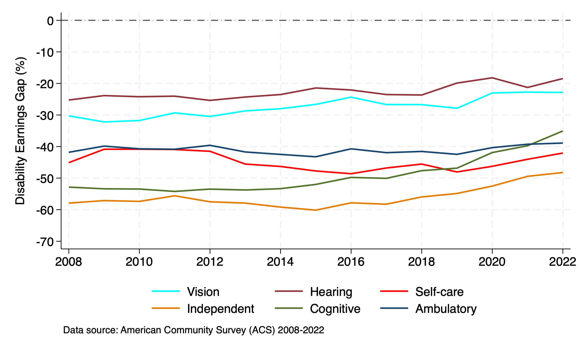
Pay Gap Inequality in the U.S. by Disability Type
Notes:
This is showing the same pay gap estimates by disability type.
Similar to the employment gap, those with sensory disabilities (vision and hearing) had the smallest gap, while those with cognitive and independent living disabilities had the lagest pay gaps.
Pay gaps persisted across decades in all disability types.

Slide 29
Landscape of Subminimum Wage Employment

Slide 30
Subminimum Wage Employment (SWE)
The Fair Labor Standards Act (FLSA) was signed into law in 1938.
Section 14(c) of FLSA permitted a subminimum wage for certain individuals with disabilities.
To pay a subminimum wage under Section 14(c), employers must obtain a certificate from the U.S. Department of Labor.

Slide 31
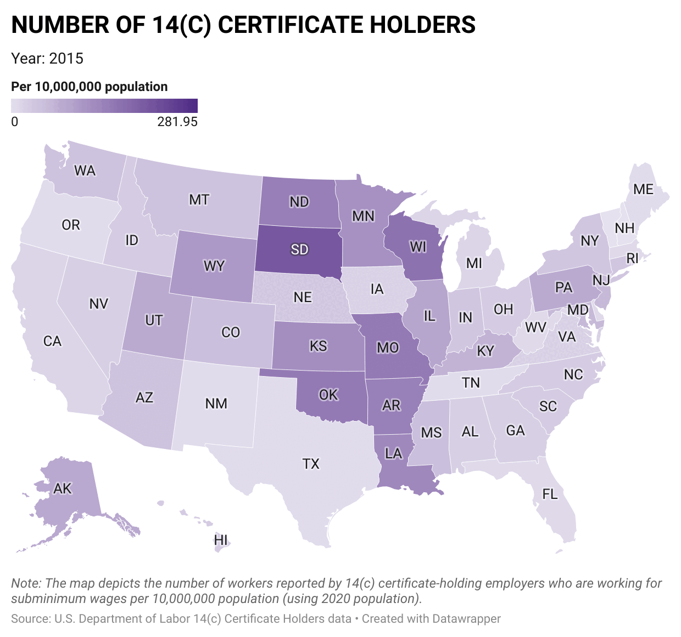
Decline in 14(c) Certificate Holders
Year | Number of 14(c) Certificates
2015 | 2,088
2016 | 2,368
2017 | 1,888
2018 | 1,571
2019 | 1,377
2020 | 989
2021 | 668
2022 | 689
2023 | 781
2024 | 748
Notes:
This map shows a transition of the number of 14(c) certificate holders by state over time from 2015 to 2024.
Although the year to year changes are not linear, the overall trend in this time frame is a decline of subminimum wage employers.

Slide 32
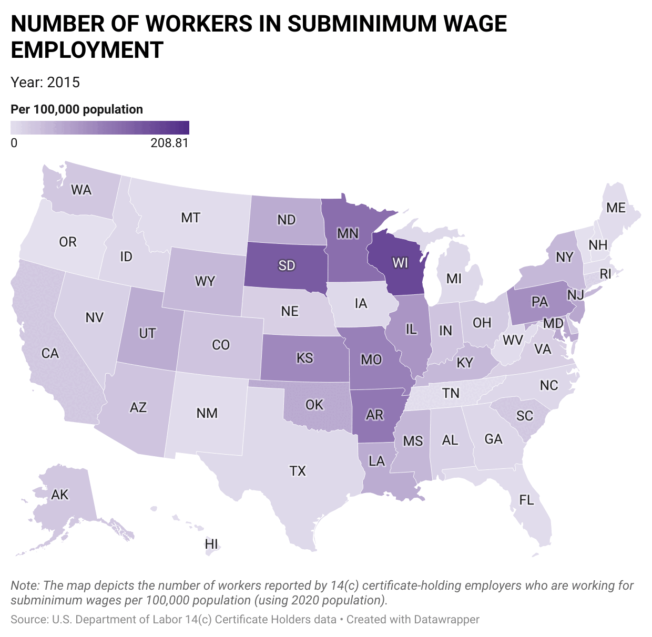
Decline in Subminimum Wage Workers
Year | Number of Workers Paid Subminimum Wage
2015 | 201,906
2016 | 219,749
2017 | 174,117
2018 | 136,229
2019 | 107,337
2020 | 75,333
2021 | 42,434
2022 | 37,696
2023 | 41,626
2024 | 40,579
Notes:
This is a map showing the number of employees paid subminimum wages by 14(c) certificate holders by state from 2015 to 2024.
The trend is similar to the number of subminimum wage employers, a decline over time.

Slide 33
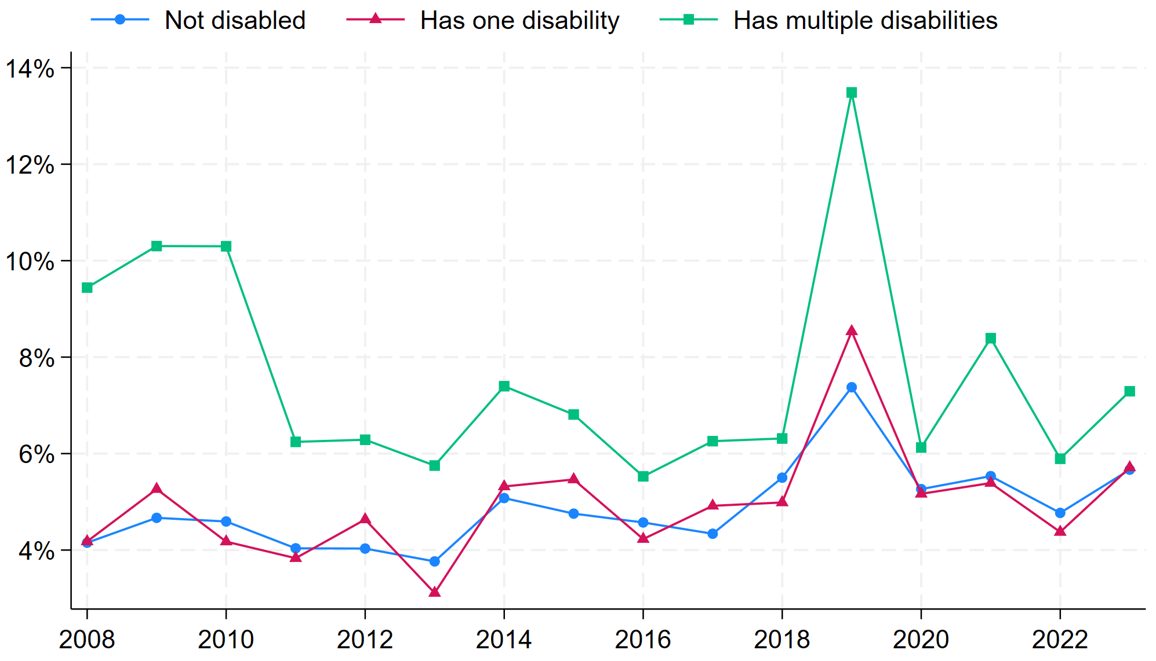
Share of Workers in SWE by Disability
Data source: Current Population Survey (CPS) Outgoing Rotation Group (ORG) Earnings Data, 2008-2023
Notes:
This graph shows the share of workers that are paid subminimum wages by disability status: PWOD, people with one type of disability, and people with multiple types of disabilities.
The types of disabilities are: hearing, vision, cognition, physical activities, mobility, and personal care.

Slide 34
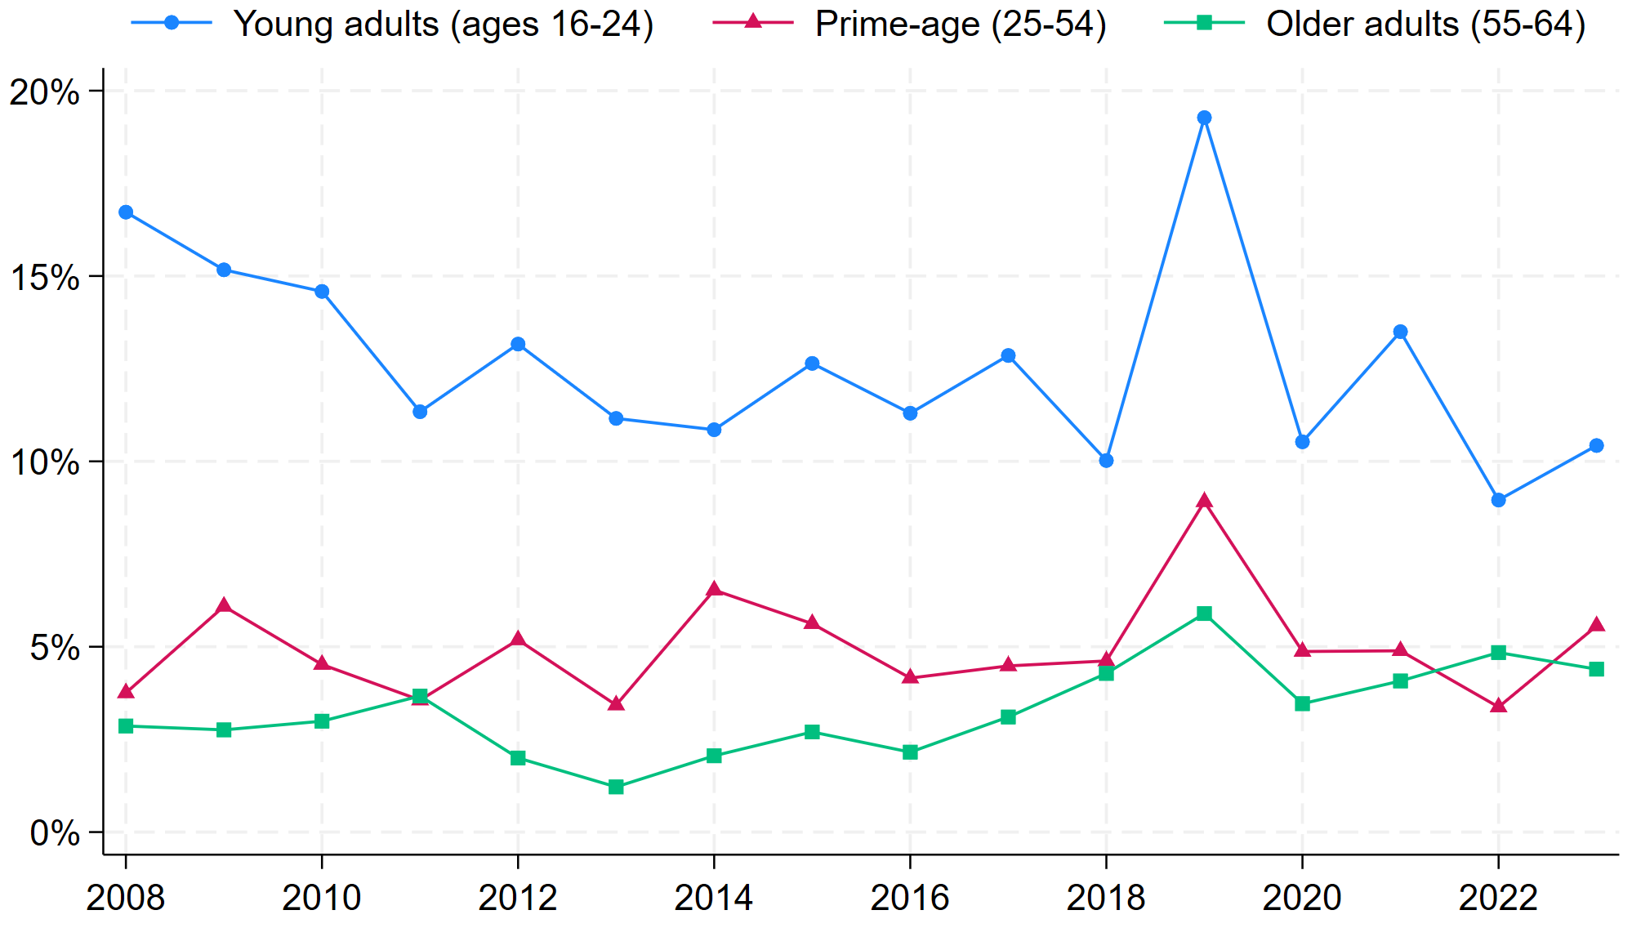
Share of PWD in SWE by Age Group
Data source: Current Population Survey (CPS) Outgoing Rotation Group (ORG) Earnings Data, 2008-2023
Notes:
This graph shows the percentage of PWD in SWE by different age groups.
The share of young adults aged 16-24 are the most likely to be paid subminimum wages.

Slide 35
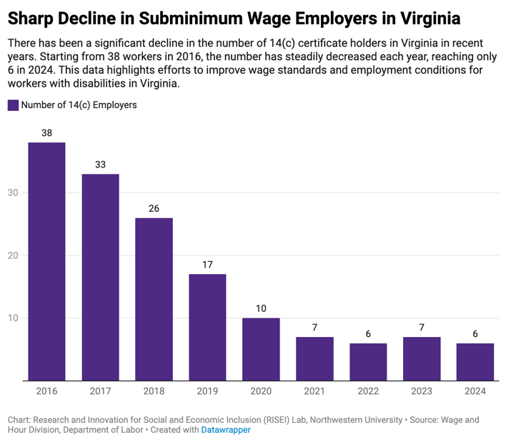
Trends in Virginia:
Subminimum Wage Employers
Notes:
There has been a significant decline in the number of subminimum wage employees reported under 14(c) certificates in Virginia in recent years.
Starting from 3,795 workers in 2016, the number has steadily decreased each year, reaching only 129 in 2024.
This data highlights efforts to improve wage standards and employment conditions for workers with disabilities in Virginia.

Slide 36
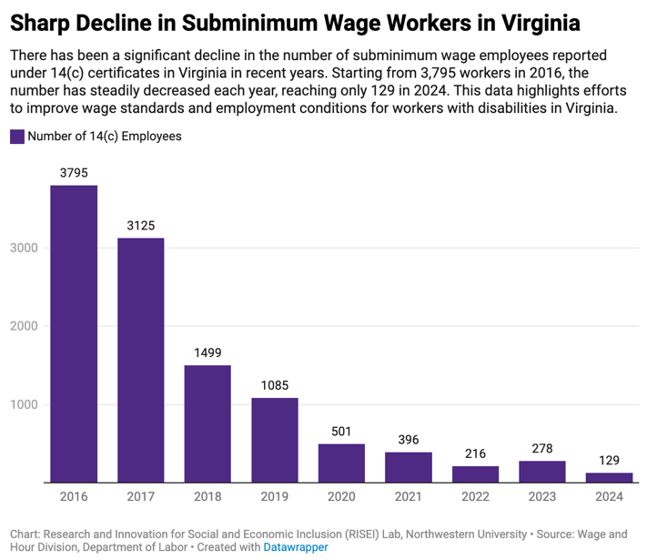
Trends in Virginia:
Subminimum Wage Employees
Notes:
There has been a significant decline in the number of subminimum wage employees reported under 14(c) certificates in Virginia in recent years.
Starting from 3,795 workers in 2016, the number has steadily decreased each year, reaching only 129 in 2024.
This data highlights efforts to improve wage standards and employment conditions for workers with disabilities in Virginia.

Slide 37
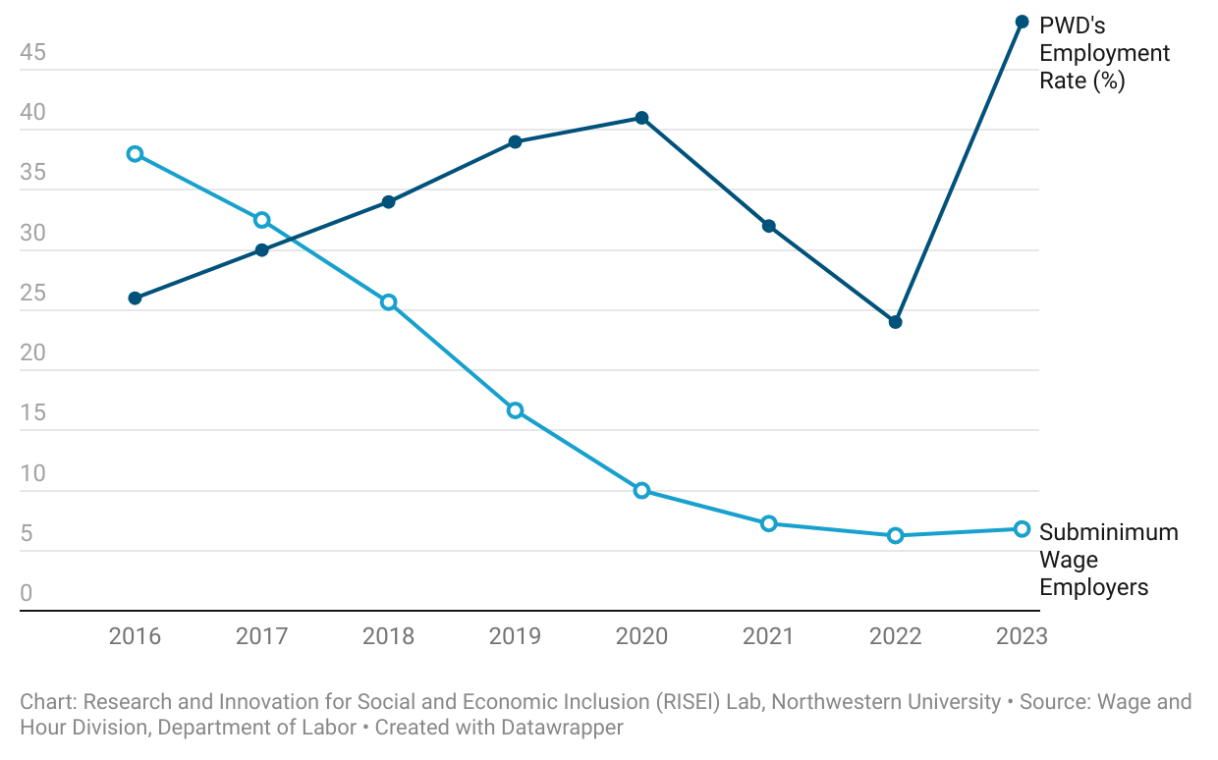
Trends in Virginia:
Subminimum Wage Employers and PWD Employment
Notes:
Virginia has had a steady decline in the number of subminimum wage employers with 14(c) certificates.
The employment rates of PWD have generally been on the rise, except for a temporary decline during the COVID-19 pandemic, from which they have recovered.

Slide 38
Effects of Eliminating Subminimum Wage Employment

Slide 39
SWE Elimination Across States
Vermont eliminated SWE without legislation in 2002.
Subsequently, 10 states have eliminated 14(c) certificates through legislations.
6 other states have enacted legislations and are in the process of phasing out SWE.
Eliminated | Phasing Out | Still in Effect
Alaska Delaware Hawaii Maine Maryland New Hampshire Oregon Rhode Island Tennessee Vermont Washington | California (2025) Colorado (2025) Massachusetts (2024) Nevada (2028) South Carolina (2024) Virginia (2030) | Other 35 states
Notes:
We have validated the timing of the law changes by utilizing data on 14(c) certificate holders obtained through the FOIA.

Slide 40
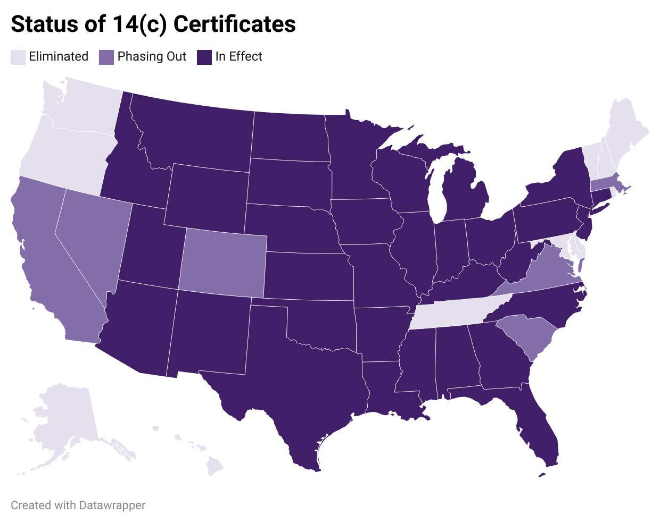
Notes:
- This is a map of the current status of 14(c) certificates across the nation.

Slide 41
Difference-in-Differences (DiD) Design
Treatment States:
2015 | 2020 | 2021 | 2022 | 2023
New Hampshire | Maine Maryland | Hawaii Washington | Rhode Island Tennessee | Oregon South Carolina
Control States: all other states except Vermont, Texas, and Illinois
 | Before Elimination | After Elimination
Treatment States | A | B
Control States | C | D
DID = (B - A) - (D - C)
Notes:
Difference-in-differences (DID) to compare changes in labor supply of:
PWD in states that eliminated SWE vs. states where SWE is still in effect (first difference)
Relative to the period before and after the policy went into effect (second difference)
Control states: all other states except Vermont, Texas, and Illinois
Exclude TX and IL since these states have eliminated subminimum wage related to state use contracts

Slide 42
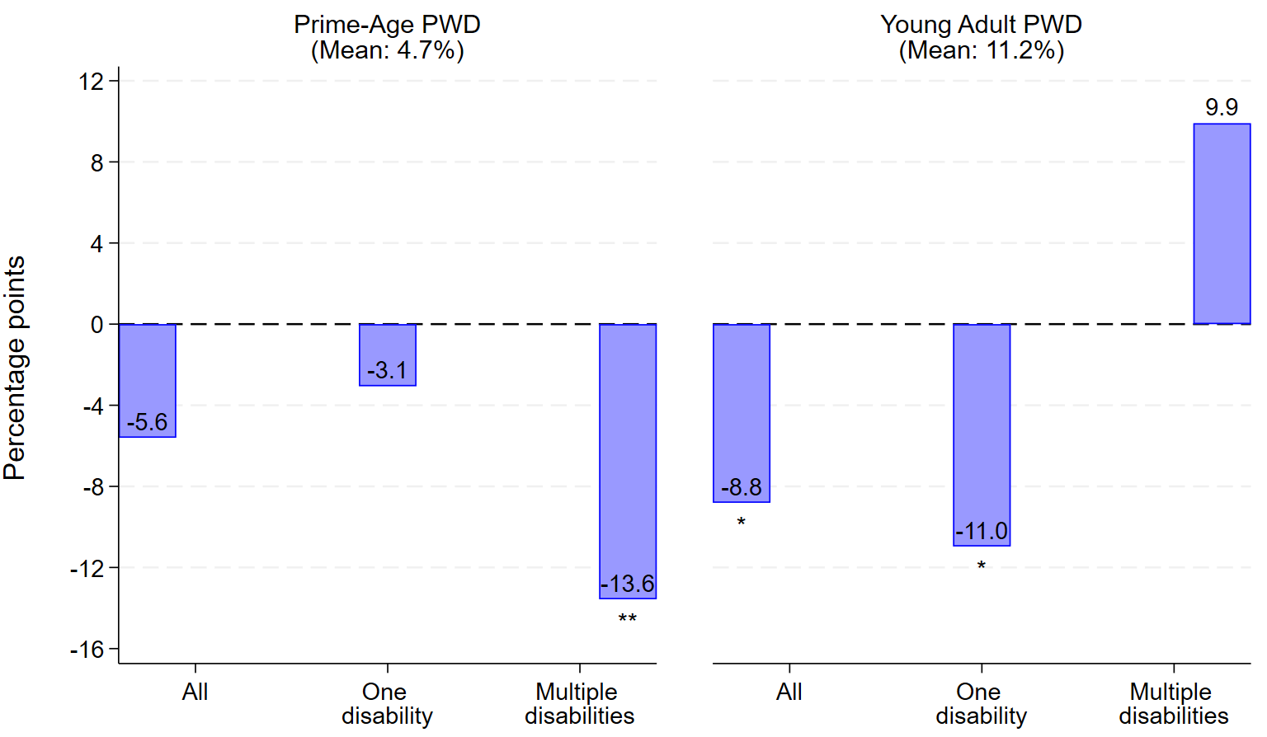
Legislations Reduced SWE for PWD
Notes:
From our analysis, we find that the legislations indeed reduced the likelihood of PWD being in SWE. In particular, it reduced SWE status for prime-aged adults with multiple disabilities and for young adults with a single type of disability.

Slide 43
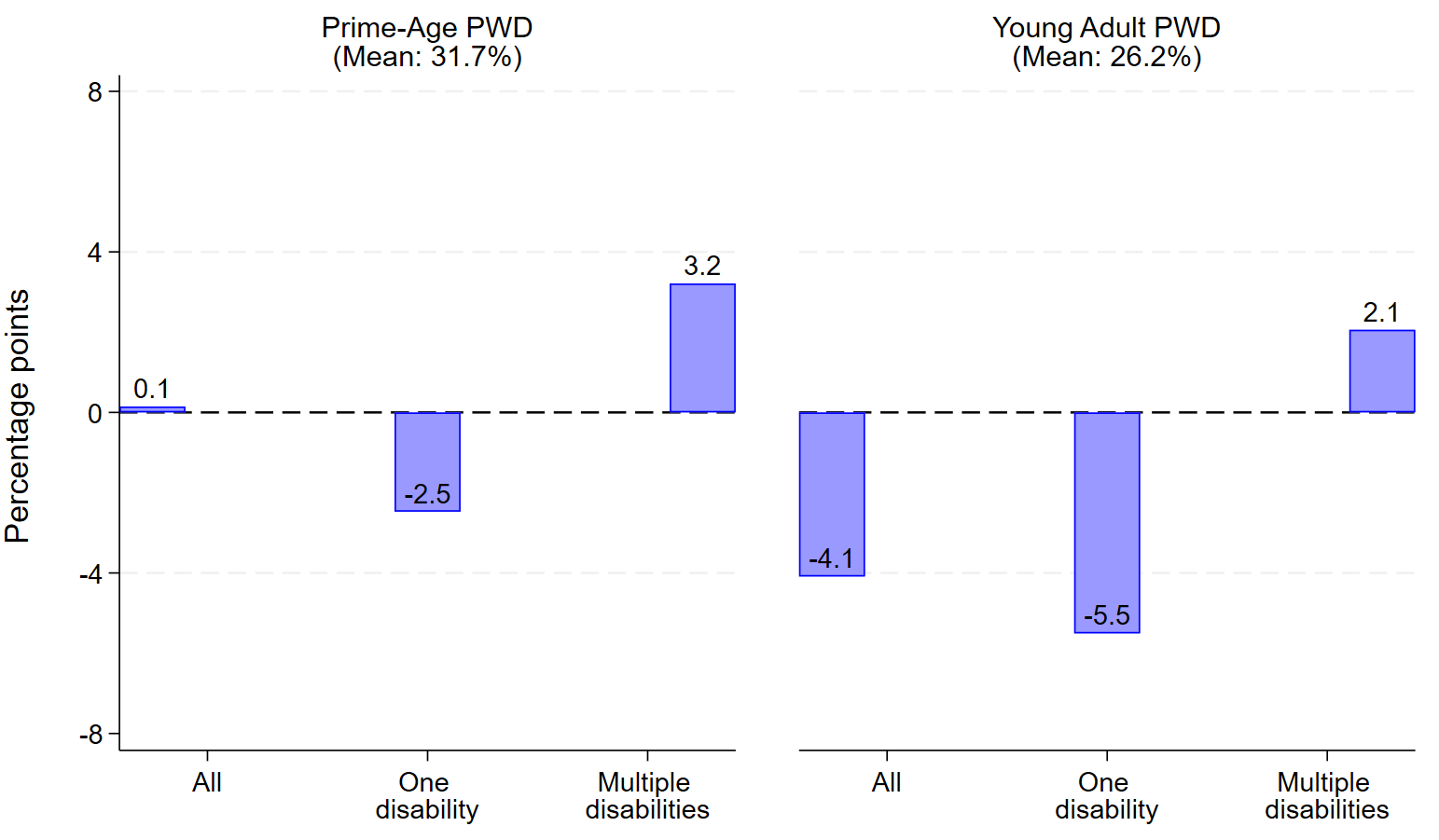
Legislations Did Not Affect PWD Employment
Notes:
However, we find that the legislations did not impact the overall employment rates of PWD. We also find that legislations did not impact employment rates of PWOD.
Suggests that there are no negative spillover effects on PWOD, but the legislations are not enough to produce positive results for the entire PWD population.

Slide 44
Beyond Subminimum Wage Law –
Disability Employment Inequality
Notes:
The removal of subminimum wage laws marks a significant step towards equality.
However, it's just the beginning of the journey towards true employment equality for individuals with disabilities.

Slide 45
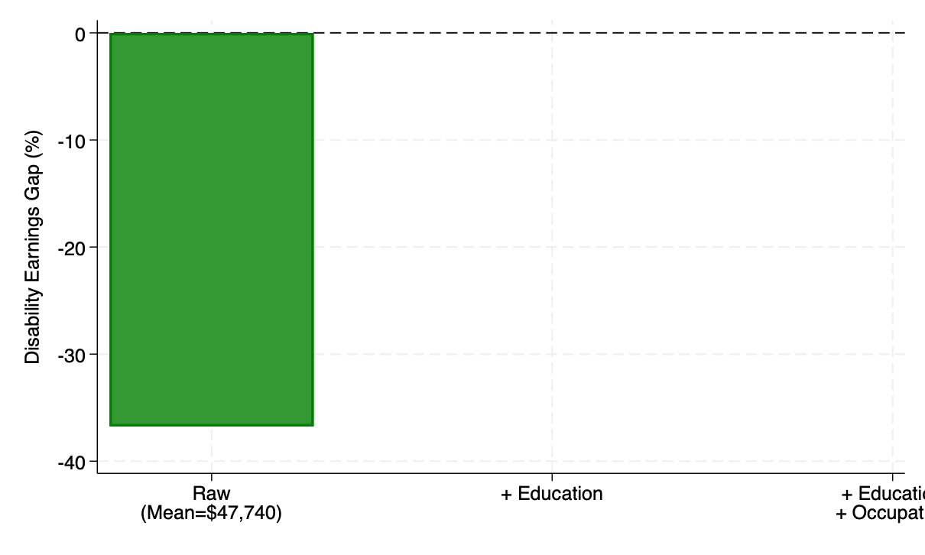
Why Pay Inequality in the US?

Slide 46
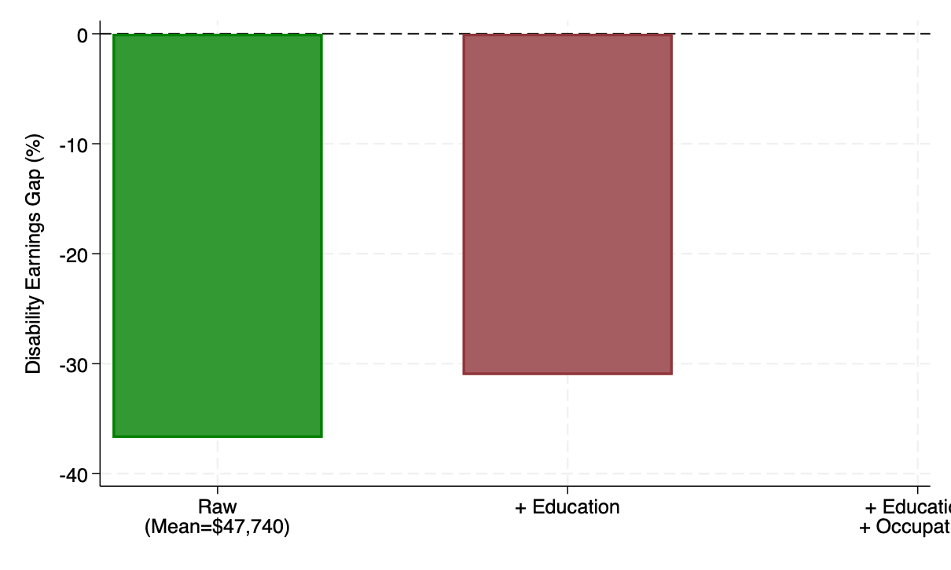
Why Pay Inequality in the US?

Slide 47
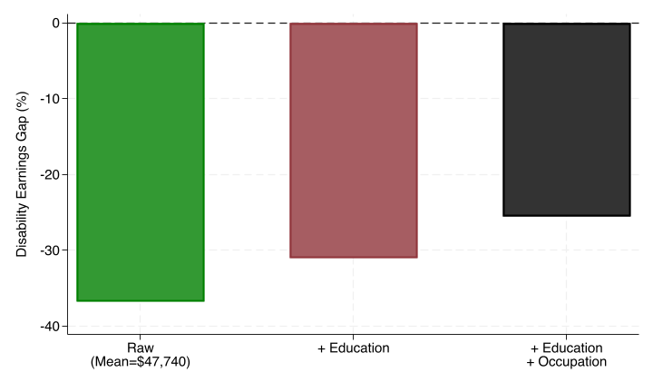
Why Pay Inequality in the US?

Slide 48
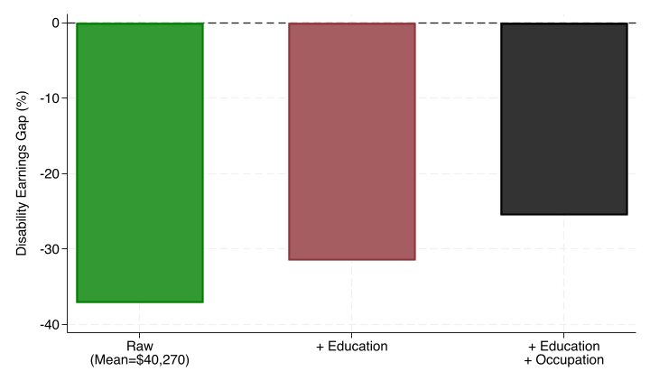
Pay inequality in Virginia
Notes:
This issue is not only occurring at the national level. We have the same patterns if we look at Virginia.

Slide 49
Why Pay Inequality?
What explains this gap?

Slide 50
Challenging Assumption:
Pay gap=Skill gap?
Employers might think that a worker with a disability possesses fewer abilities to perform a job and not hire them.
Experimental evidence is consistent with this view.
Fake applicants’ resumes mentioning a disability sent to employers receive fewer callbacks

Slide 51
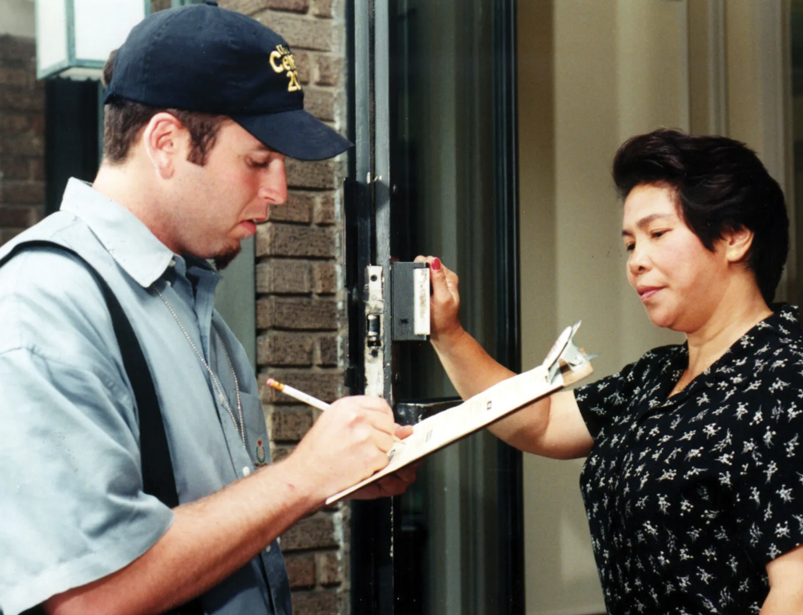
Data
National Longitudinal Survey of Youth 1997 (NLSY97):
  Representative panel of youth aged 12-16 in 1997 (born 1980-1984)
  Captures annual earnings and hours worked
  Collects information on the severity and type of disability in the first round: physical, chronic, sensory, and learning impairments
Notes:
Motivation for this analysis: Econ literature has shown that pre-market skills are relevant to explain later outcomes.
Moreover, recent occupational choice models conceptualize occupations as task vectors: higher-paying occupations
Physical Impairments: Disabilities that affect the body, such as mobility impairments, chronic health conditions that limit physical functioning, or other conditions that affect physical capacity.
Chronic Impairments: Long-term or persistent conditions that may limit a person's daily activities or work ability over an extended period.
Sensory Impairments: Disabilities that affect the senses, such as visual or hearing impairments.
Mental Impairments: Conditions that affect mental health or cognitive function, such as learning disabilities, developmental delays, or mental illness.

Slide 52
How we measure skills
  Cognitive skills:
  - Math and language percentile scores (Armed Services Vocational Aptitude Battery)
  Non-cognitive skills (“soft” skills):
  - Discipline and self-care (Ten Item Personality Inventory Scale)
  - Conscientiousness (Big Five assessment)
  Social skills:
  - Extroversion (Big Five assessment)
Notes:
ANIMATE
The Armed Services Vocational Aptitude Battery (ASVAB) is a multiple-aptitude battery that measures developed abilities and helps predict future academic and occupational success in the military. It is administered by the United States Military Entrance Processing Command and is used for both military entrance qualification and assigning new recruits into military occupations.

Slide 53
Summary Statistics (N=8,980)
Unit of observation |  | No disability | Any disability in 1997
Person | Female | 0.52 | 0.46
 | Hispanic | 0.21 | 0.16
 | Black | 0.29 | 0.24
 | Disability in 1997: Physical |  | 0.05
 | Disability in 1997: Chronic |  | 0.33
 | Disability in 1997: Sensory |  | 0.51
 | Disability in 1997: Learning |  | 0.38
 | Years of education | 14.31 | 13.76
Person-year | Annual income (US$2017) | 40,882 | 37,550
 | Hourly wage (US$2017) | 22.6 | 20.7
 | Weekly hours | 38.5 | 38.1
Notes:
Point to the numbers too,

Slide 54
Distribution of cognitive skills between people with and without disabilities
Except for learning impairments, all groups have a
similar distribution to people without disabilities
Notes:
Motivation for this analysis: Econ literature has shown that pre-market skills are relevant to explain later outcomes.
Moreover, recent occupational choice models conceptualize occupations as task vectors: higher-paying occupations
We find small differences in the estimates of the wage gap after accounting for education and occupational sorting (proxied by industry fixed effects)
Physical Impairments: Disabilities that affect the body, such as mobility impairments, chronic health conditions that limit physical functioning, or other conditions that affect physical capacity.
Chronic Impairments: Long-term or persistent conditions that may limit a person's daily activities or work ability over an extended period.
Sensory Impairments: Disabilities that affect the senses, such as visual or hearing impairments.
Mental Impairments: Conditions that affect mental health or cognitive function, such as learning disabilities, developmental delays, or mental illness.
Cognitive skills: Average math-language percentile scores in Armed Services Vocational Aptitude Battery (ASVAB).
Non-cognitive skills: Discipline and self-care from the Ten Item Personality Inventory Scale + conscientiousness from Big Five assessment
Social skills: Two questions from extroversion factor from Big Five Personality Assessment. Constructed following Deming (2017).

Slide 55
Distribution of non-cognitive skills between people with and without disabilities
All groups have a similar distribution relative to people without disabilities
Notes:
Motivation for this analysis: Econ literature has shown that pre-market skills are relevant to explain later outcomes.
Moreover, recent occupational choice models conceptualize occupations as task vectors: higher-paying occupations
We find small differences in the estimates of the wage gap after accounting for education and occupational sorting (proxied by industry fixed effects)
Physical Impairments: Disabilities that affect the body, such as mobility impairments, chronic health conditions that limit physical functioning, or other conditions that affect physical capacity.
Chronic Impairments: Long-term or persistent conditions that may limit a person's daily activities or work ability over an extended period.
Sensory Impairments: Disabilities that affect the senses, such as visual or hearing impairments.
Mental Impairments: Conditions that affect mental health or cognitive function, such as learning disabilities, developmental delays, or mental illness.
Cognitive skills: Average math-language percentile scores in Armed Services Vocational Aptitude Battery (ASVAB).
Non-cognitive skills: Discipline and self-care from the Ten Item Personality Inventory Scale + conscientiousness from Big Five assessment
Social skills: Two questions from extroversion factor from Big Five Personality Assessment. Constructed following Deming (2017).

Slide 56
Finding 1

Slide 57
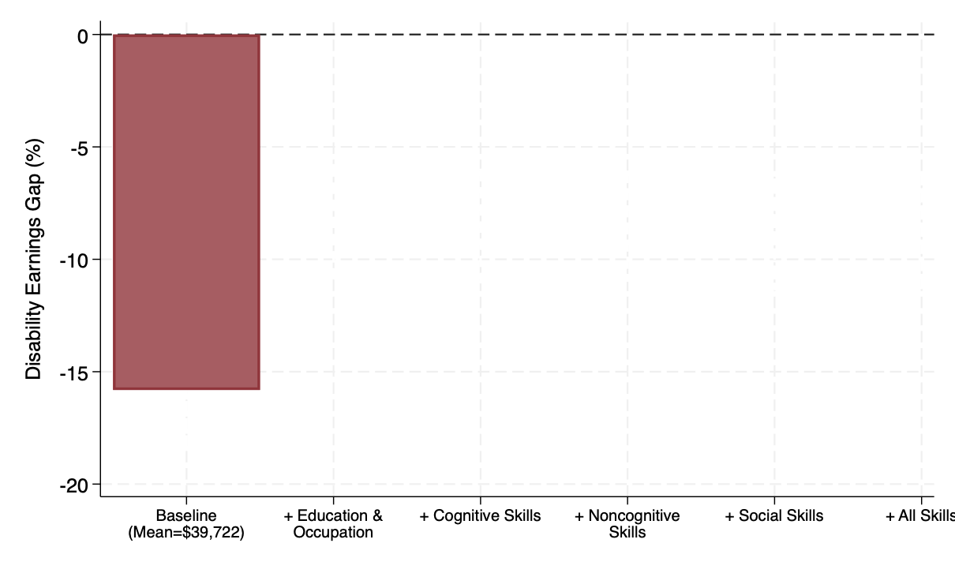
The disability earnings gap
Notes:
Triplicate, first bar, first and second bar, 1-3 bars, all bars and box-
Average earnings for people without disabilities: $16 (averaged across 2017-2019)
Figure: each bar corresponds to the estimated % under different specifications:
- "baseline" (1): controls only for background characteristics
- "+ educ & industry" (2): includes education years and industry fixed effects
"+ cognitive": (2) + proxy of cognitive skills
"+ noncognitive": (2) + proxy of noncognitive skills
"+ social": (2) + proxy of social skills
"+ all skills": (2) + 3 measures of skills at the same time
Takeaway: Small differences between specifications adding skills after accounting for education/industry FE.
Interpretation: Skills might play a role on educational choices but do not account for wage differences ---> Other unobserved factors explain the gap
First, when looking at stocks, the distributions look similar (with the exception of cognitive disability)
Second, in terms of differential returns, when we include skills x disability interactions we do not find evidence of differential returns

Slide 58
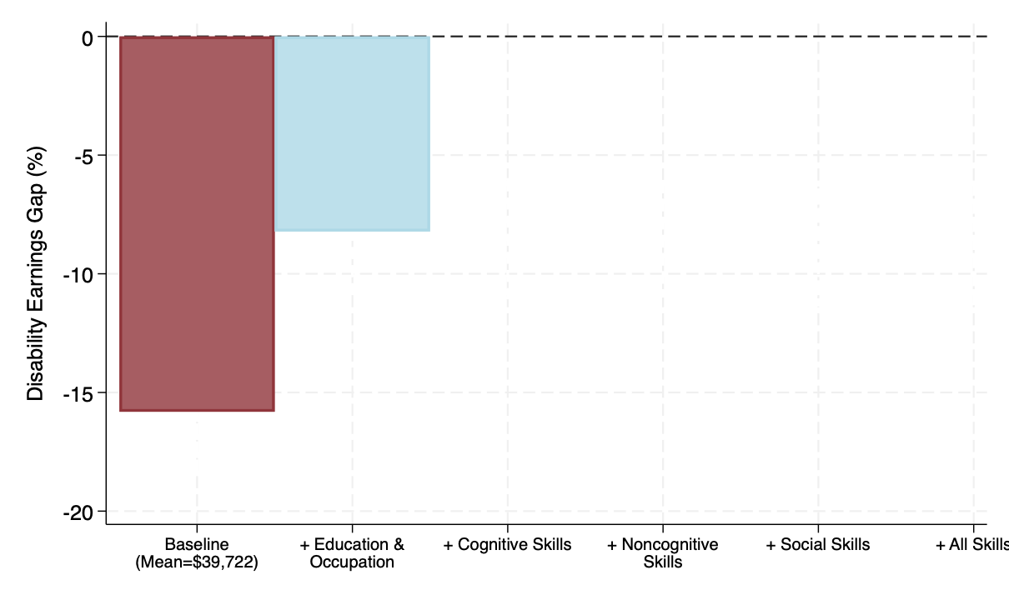
The disability earnings gap
Notes:
Triplicate, first bar, first and second bar, 1-3 bars, all bars and box-
Average earnings for people without disabilities: $16 (averaged across 2017-2019)
Figure: each bar corresponds to the estimated % under different specifications:
- "baseline" (1): controls only for background characteristics
- "+ educ & industry" (2): includes education years and industry fixed effects
"+ cognitive": (2) + proxy of cognitive skills
"+ noncognitive": (2) + proxy of noncognitive skills
"+ social": (2) + proxy of social skills
"+ all skills": (2) + 3 measures of skills at the same time
Takeaway: Small differences between specifications adding skills after accounting for education/industry FE.
Interpretation: Skills might play a role on educational choices but do not account for wage differences ---> Other unobserved factors explain the gap
First, when looking at stocks, the distributions look similar (with the exception of cognitive disability)
Second, in terms of differential returns, when we include skills x disability interactions we do not find evidence of differential returns

Slide 59
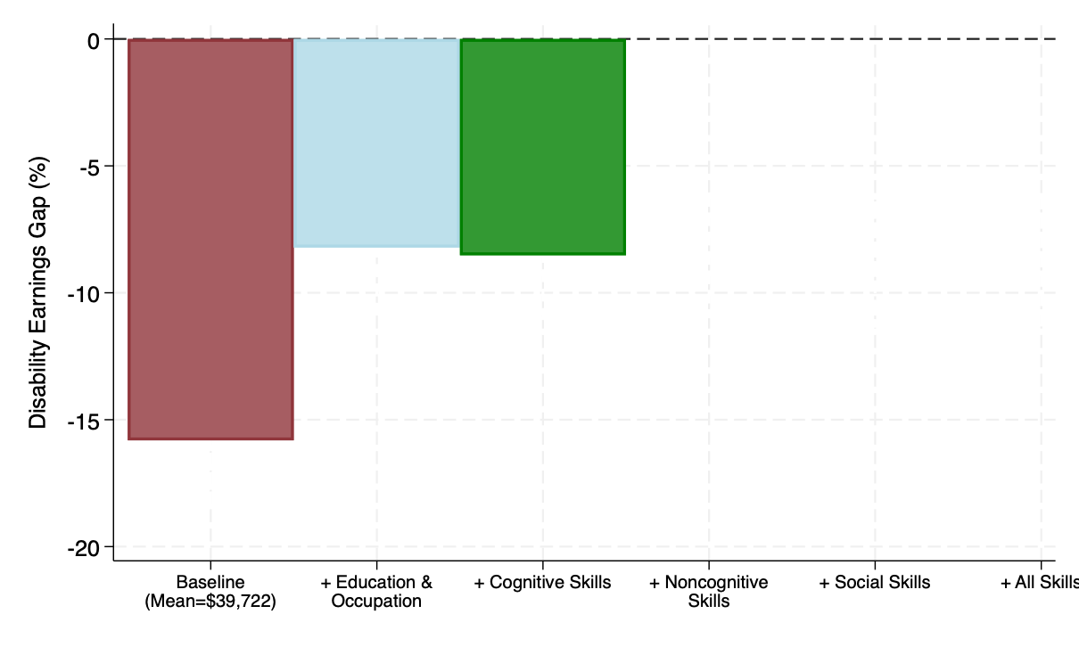
The disability earnings gap
Notes:
Triplicate, first bar, first and second bar, 1-3 bars, all bars and box-
Average earnings for people without disabilities: $16 (averaged across 2017-2019)
Figure: each bar corresponds to the estimated % under different specifications:
- "baseline" (1): controls only for background characteristics
- "+ educ & industry" (2): includes education years and industry fixed effects
"+ cognitive": (2) + proxy of cognitive skills
"+ noncognitive": (2) + proxy of noncognitive skills
"+ social": (2) + proxy of social skills
"+ all skills": (2) + 3 measures of skills at the same time
Takeaway: Small differences between specifications adding skills after accounting for education/industry FE.
Interpretation: Skills might play a role on educational choices but do not account for wage differences ---> Other unobserved factors explain the gap
First, when looking at stocks, the distributions look similar (with the exception of cognitive disability)
Second, in terms of differential returns, when we include skills x disability interactions we do not find evidence of differential returns

Slide 60
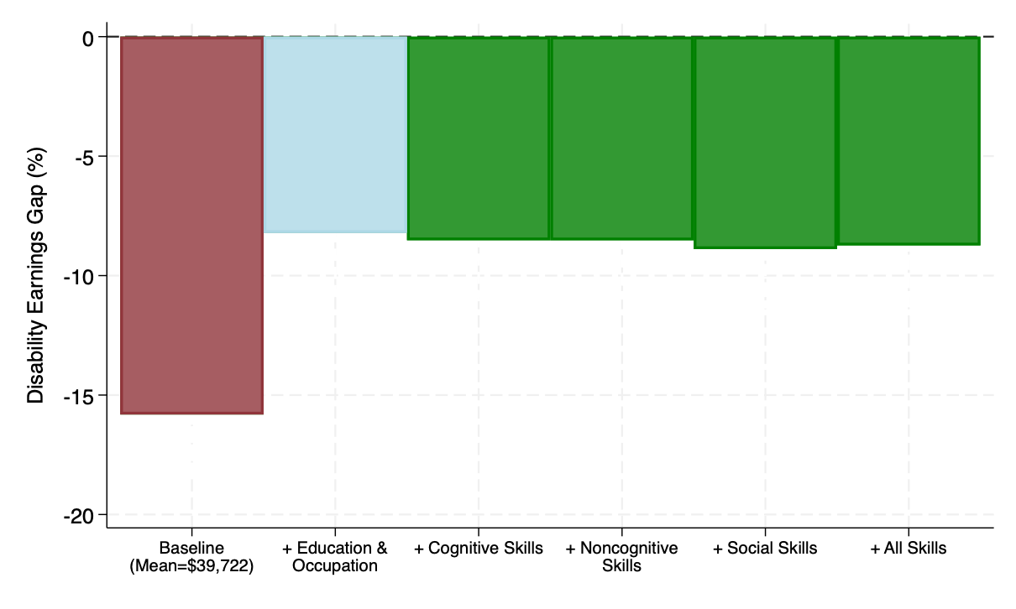
The disability earnings gap
No difference between bars: accounting for different
skills does not explain the remaining earnings gap
Notes:
Triplicate, first bar, first and second bar, 1-3 bars, all bars and box-
Average earnings for people without disabilities: $16 (averaged across 2017-2019)
Figure: each bar corresponds to the estimated % under different specifications:
- "baseline" (1): controls only for background characteristics
- "+ educ & industry" (2): includes education years and industry fixed effects
"+ cognitive": (2) + proxy of cognitive skills
"+ noncognitive": (2) + proxy of noncognitive skills
"+ social": (2) + proxy of social skills
"+ all skills": (2) + 3 measures of skills at the same time
Takeaway: Small differences between specifications adding skills after accounting for education/industry FE.
Interpretation: Skills might play a role on educational choices but do not account for wage differences ---> Other unobserved factors explain the gap
First, when looking at stocks, the distributions look similar (with the exception of cognitive disability)
Second, in terms of differential returns, when we include skills x disability interactions we do not find evidence of differential returns

Slide 61
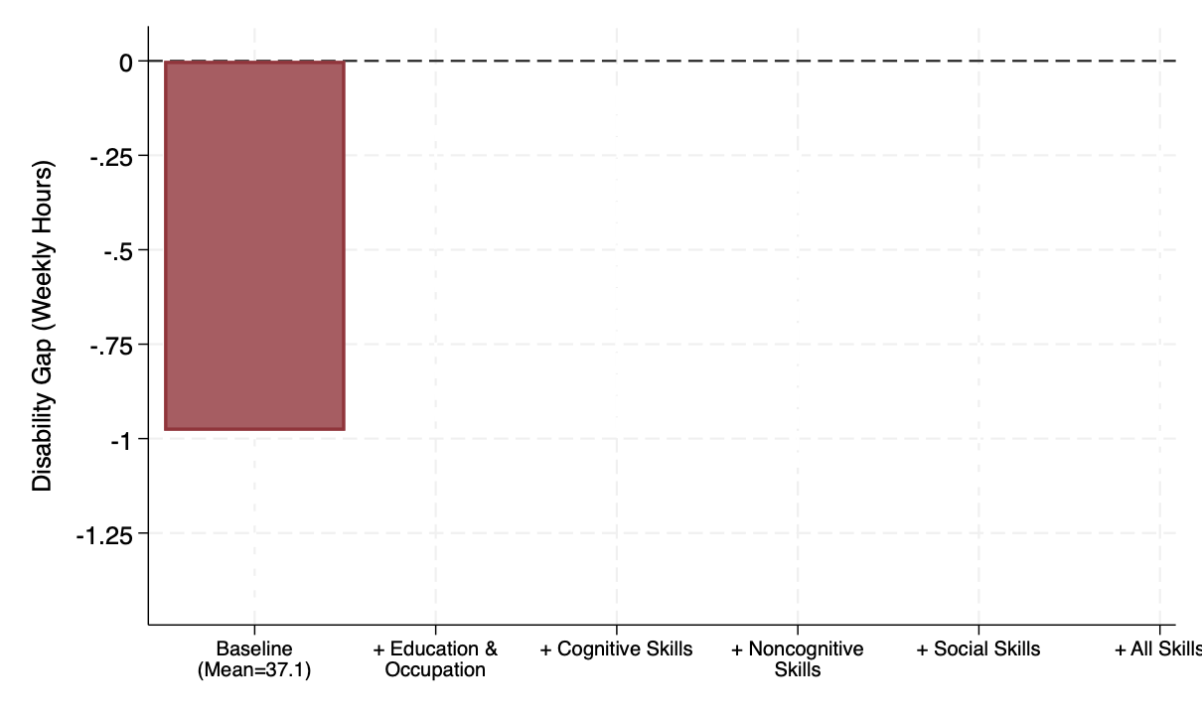
# of weekly hours gap
Notes:
- Average wage for people without disabilities: $16 (averaged across 2017-2019)
Figure: each bar corresponds to the estimated % under different specifications:
- "baseline" (1): controls only for background characteristics
- "+ educ & occ" (2): includes education years and occ fixed effects
"+ cognitive": (2) + proxy of cognitive skills
"+ noncognitive": (2) + proxy of noncognitive skills
"+ social": (2) + proxy of social skills
"+ all skills": (2) + 3 measures of skills at the same time
Takeaway: Small differences between specifications adding skills after accounting for education/industry FE.
Interpretation: Skills might play a role on educational choices but do not account for wage differences ---> Other unobserved factors explain the gap
First, when looking at stocks, the distributions look similar (with the exception of cognitive disability)
Second, in terms of differential returns, when we include skills x disability interactions we do not find evidence of differential returns

Slide 62
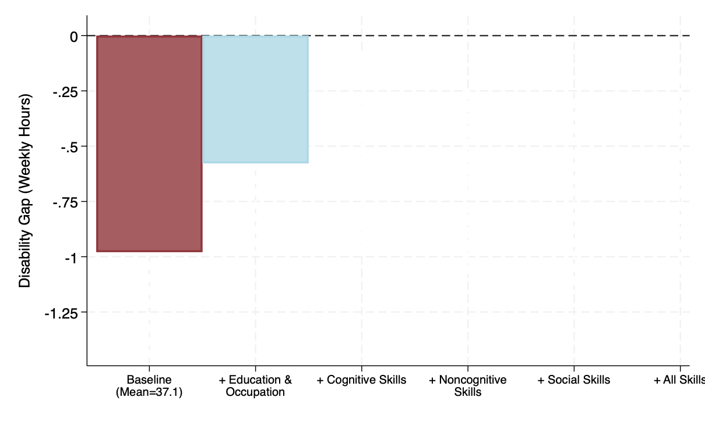
# of weekly hours gap
Notes:
- Average wage for people without disabilities: $16 (averaged across 2017-2019)
Figure: each bar corresponds to the estimated % under different specifications:
- "baseline" (1): controls only for background characteristics
- "+ educ & occ" (2): includes education years and occ fixed effects
"+ cognitive": (2) + proxy of cognitive skills
"+ noncognitive": (2) + proxy of noncognitive skills
"+ social": (2) + proxy of social skills
"+ all skills": (2) + 3 measures of skills at the same time
Takeaway: Small differences between specifications adding skills after accounting for education/industry FE.
Interpretation: Skills might play a role on educational choices but do not account for wage differences ---> Other unobserved factors explain the gap
First, when looking at stocks, the distributions look similar (with the exception of cognitive disability)
Second, in terms of differential returns, when we include skills x disability interactions we do not find evidence of differential returns

Slide 63
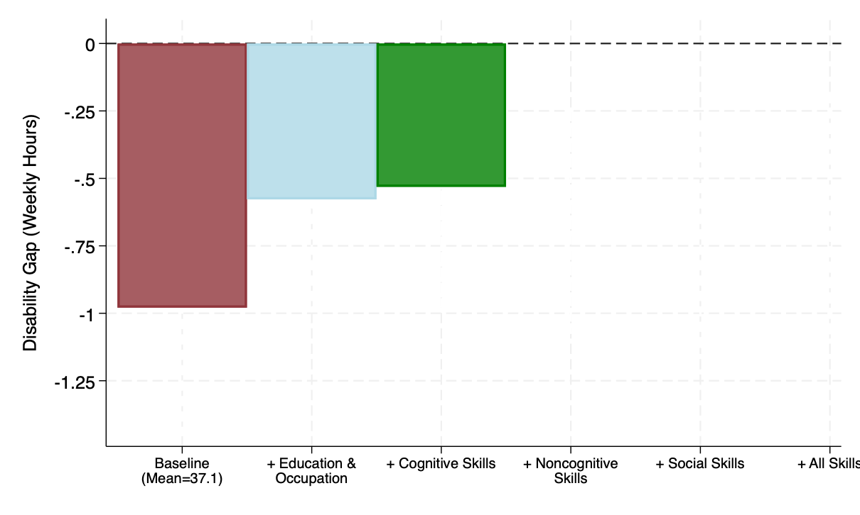
# of weekly hours gap
Notes:
- Average wage for people without disabilities: $16 (averaged across 2017-2019)
Figure: each bar corresponds to the estimated % under different specifications:
- "baseline" (1): controls only for background characteristics
- "+ educ & occ" (2): includes education years and occ fixed effects
"+ cognitive": (2) + proxy of cognitive skills
"+ noncognitive": (2) + proxy of noncognitive skills
"+ social": (2) + proxy of social skills
"+ all skills": (2) + 3 measures of skills at the same time
Takeaway: Small differences between specifications adding skills after accounting for education/industry FE.
Interpretation: Skills might play a role on educational choices but do not account for wage differences ---> Other unobserved factors explain the gap
First, when looking at stocks, the distributions look similar (with the exception of cognitive disability)
Second, in terms of differential returns, when we include skills x disability interactions we do not find evidence of differential returns

Slide 64
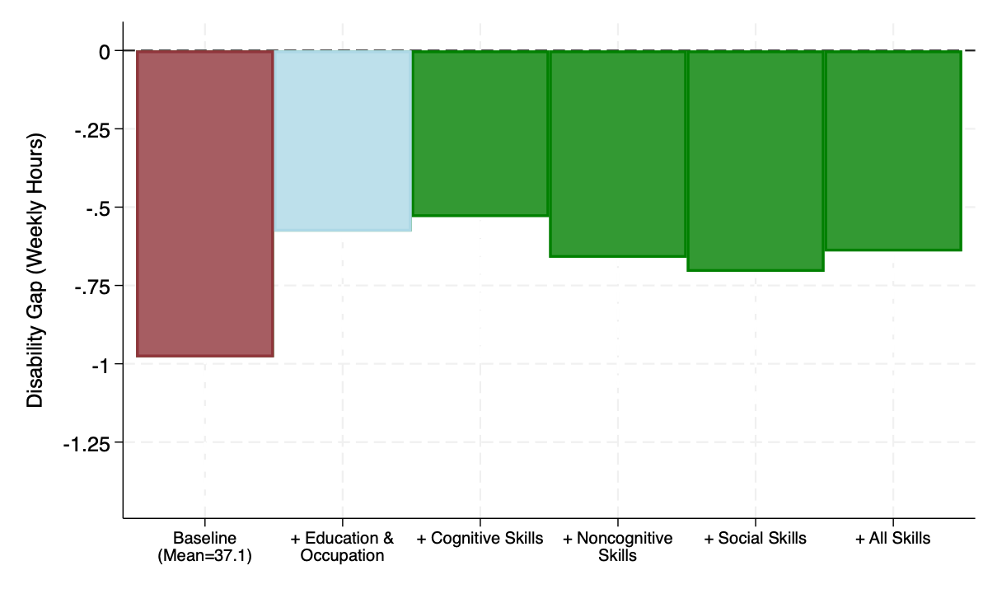
# of weekly hours gap
Notes:
- Average wage for people without disabilities: $16 (averaged across 2017-2019)
Figure: each bar corresponds to the estimated % under different specifications:
- "baseline" (1): controls only for background characteristics
- "+ educ & occ" (2): includes education years and occ fixed effects
"+ cognitive": (2) + proxy of cognitive skills
"+ noncognitive": (2) + proxy of noncognitive skills
"+ social": (2) + proxy of social skills
"+ all skills": (2) + 3 measures of skills at the same time
Takeaway: Small differences between specifications adding skills after accounting for education/industry FE.
Interpretation: Skills might play a role on educational choices but do not account for wage differences ---> Other unobserved factors explain the gap
First, when looking at stocks, the distributions look similar (with the exception of cognitive disability)
Second, in terms of differential returns, when we include skills x disability interactions we do not find evidence of differential returns

Slide 65
Finding 2

Slide 66
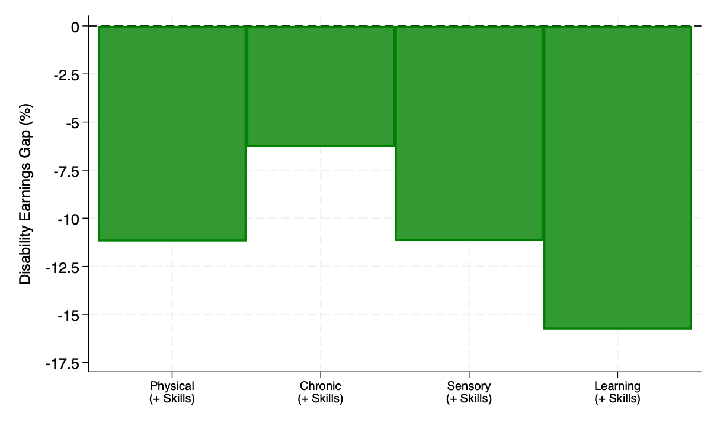
The pay gap varies significantly by disability type
Notes:
- Average wage for people without disabilities: $16 (averaged across 2017-2019)
Figure: each bar corresponds to the estimated % under different specifications:
- "baseline" (1): controls only for background characteristics
- "+ educ & industry" (2): includes education years and industry fixed effects
"+ cognitive": (2) + proxy of cognitive skills
"+ noncognitive": (2) + proxy of noncognitive skills
"+ social": (2) + proxy of social skills
"+ all skills": (2) + 3 measures of skills at the same time
Takeaway: Small differences between specifications adding skills after accounting for education/industry FE.
Interpretation: Skills might play a role on educational choices but do not account for wage differences ---> Other unobserved factors explain the gap
First, when looking at stocks, the distributions look similar (with the exception of cognitive disability)
Second, in terms of differential returns, when we include skills x disability interactions we do not find evidence of differential returns

Slide 67
Finding 3

Slide 68
Changes in Legislation and the Disability Earnings Gap
1990 | The Americans with Disabilities Act (ADA)
2014 | The Rehabilitation Act of 1973 Amendment
 | The Workforce Innovation and Opportunities Act (WIOA) passed in Congress

Slide 69
Birth Cohort Analysis
Pay gap for five cohorts who were born
  1980-1985
  1985-1990
  1990-1995
  1995-2000
  After 2000
Notes:
People born after 1985 generally have a smaller wage gap when we compare them to those with similar backgrounds born earlier. Despite this improvement, there's still a noticeable difference in earnings among different types of disabilities

Slide 70
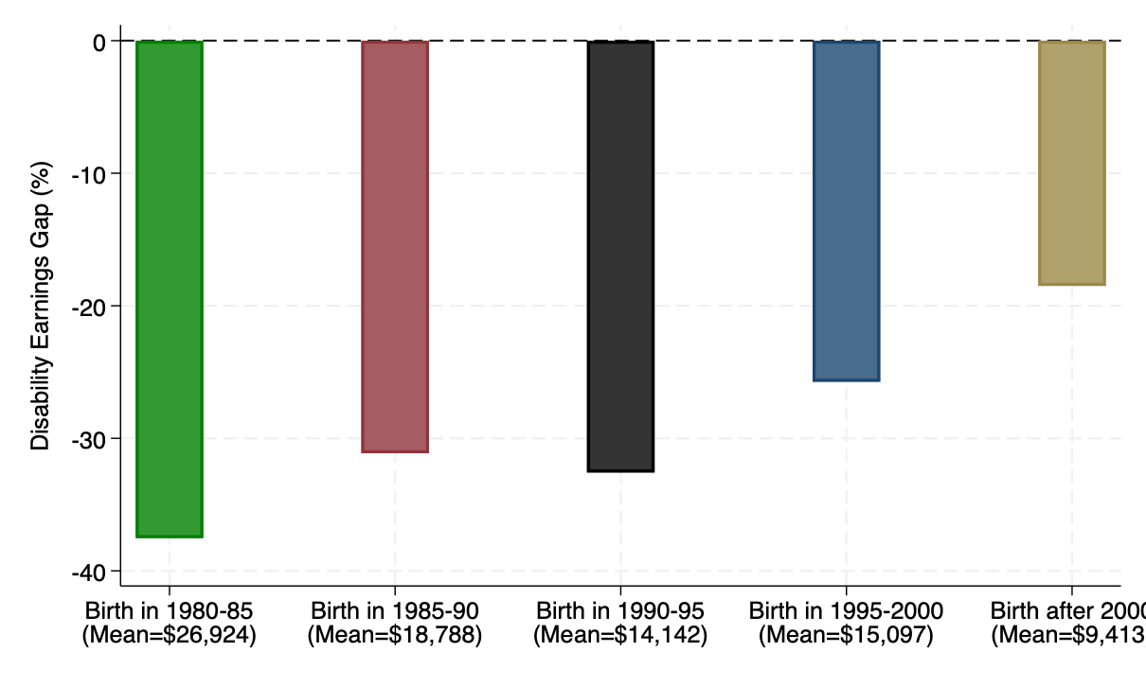
Disability pay gap: Differences across cohorts (ACS)
Data source: American Community Survey (ACS) 2008-2022
Notes:
Using the ACS 2008-2020 rounds we analyze whether these estimates have changed for more recent cohorts.
We employ 3 groups: individuals born before 1980, between 1980-1985, and after 1985 (5-year cohorts).
- Focus on individuals aged 23-41 years to maximize overlap across cohorts
We observe a smaller gap for individuals born after 1985, relative to individuals of the same characteristics born in earlier cohorts (comparison of green and black bars)
We check the robustness using separate regressions by cohort (more flexible since all parameters vary by cohort). We observe the same patterns.

Slide 71
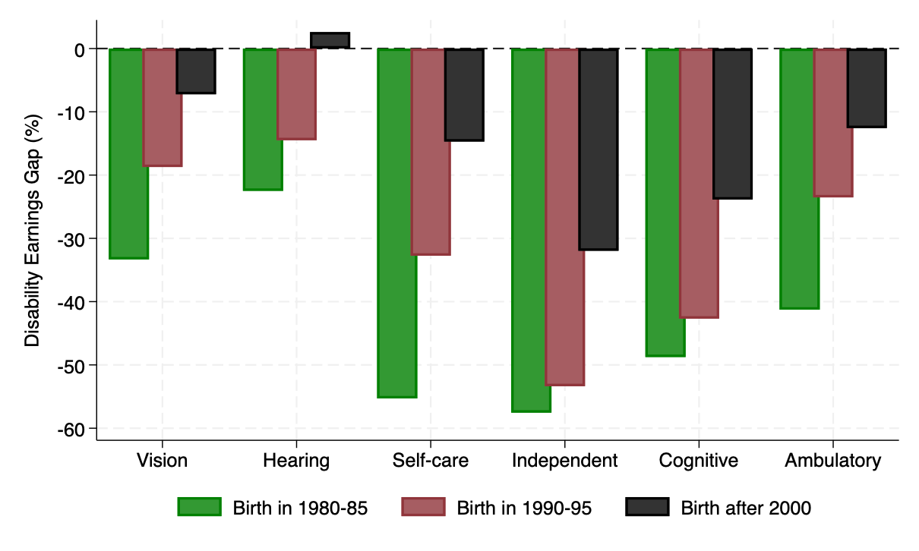
Disability pay gap: Differences across cohorts (ACS)
Data source: American Community Survey (ACS) 2008-2022
Notes:
Description of groups:

Slide 72
Exploring the effects of the Workforce Innovation and Opportunity Act (WIOA)
Notes:
The removal of subminimum wage laws marks a significant step towards equality.
However, it's just the beginning of the journey towards true employment equality for individuals with disabilities.

Slide 73
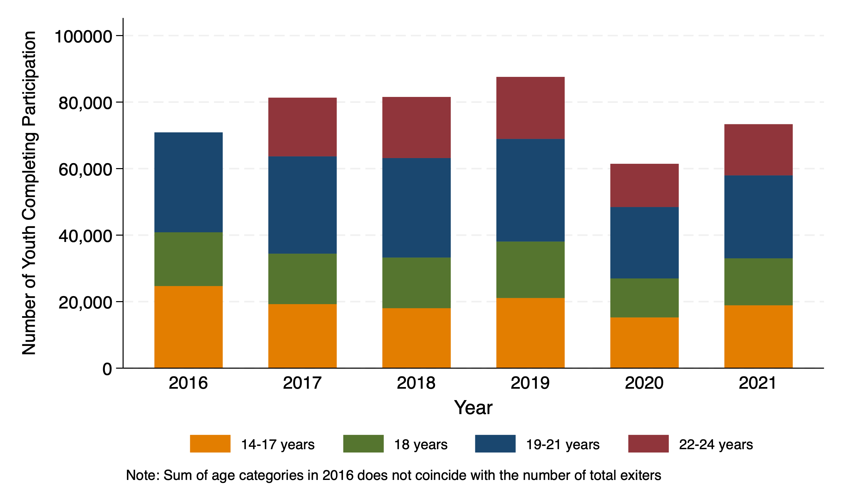
Number of Individuals Participated in a WIOA Youth Program, by Age Group
Notes:
Same slide as above, by age group. There is a missing point in the data – that's why the first column does not add up to the total shown in the previous slide.

Slide 74
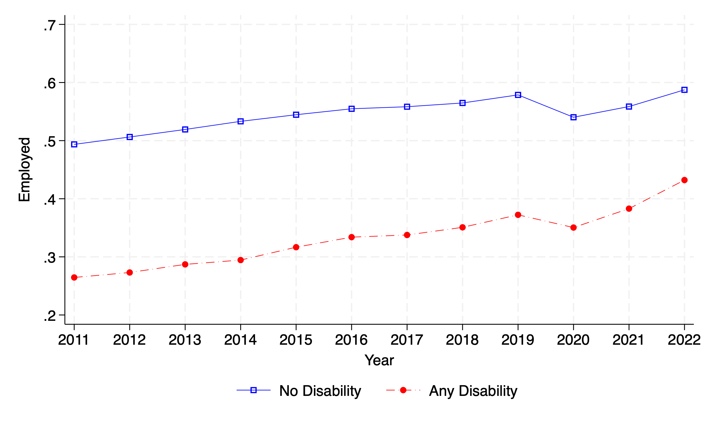
Employment Gap for Youth with Disabilities
Notes:
This plot uses the same data as in the motivation plots in slides 4-7 (ACS between 2008-22), but restricts the sample to individuals aged 16-25

Slide 75
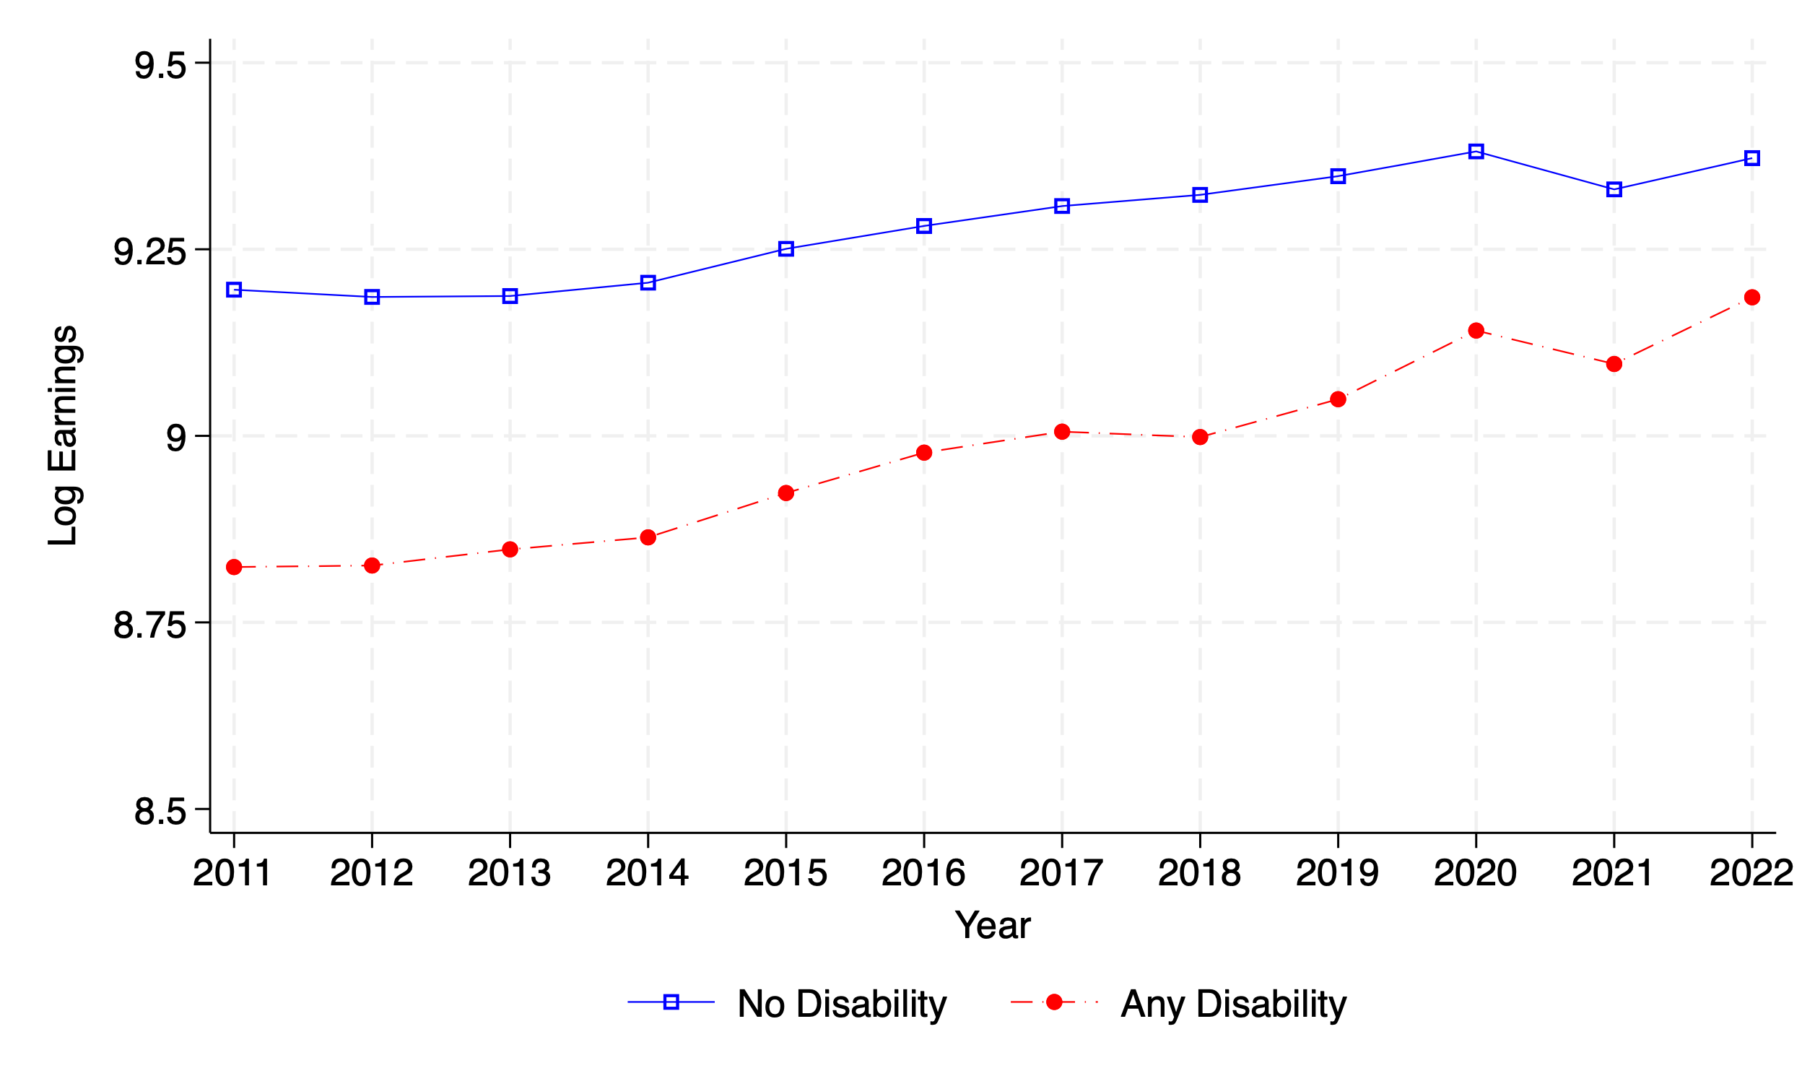
Pay Gap for Youth with Disabilities

Slide 76
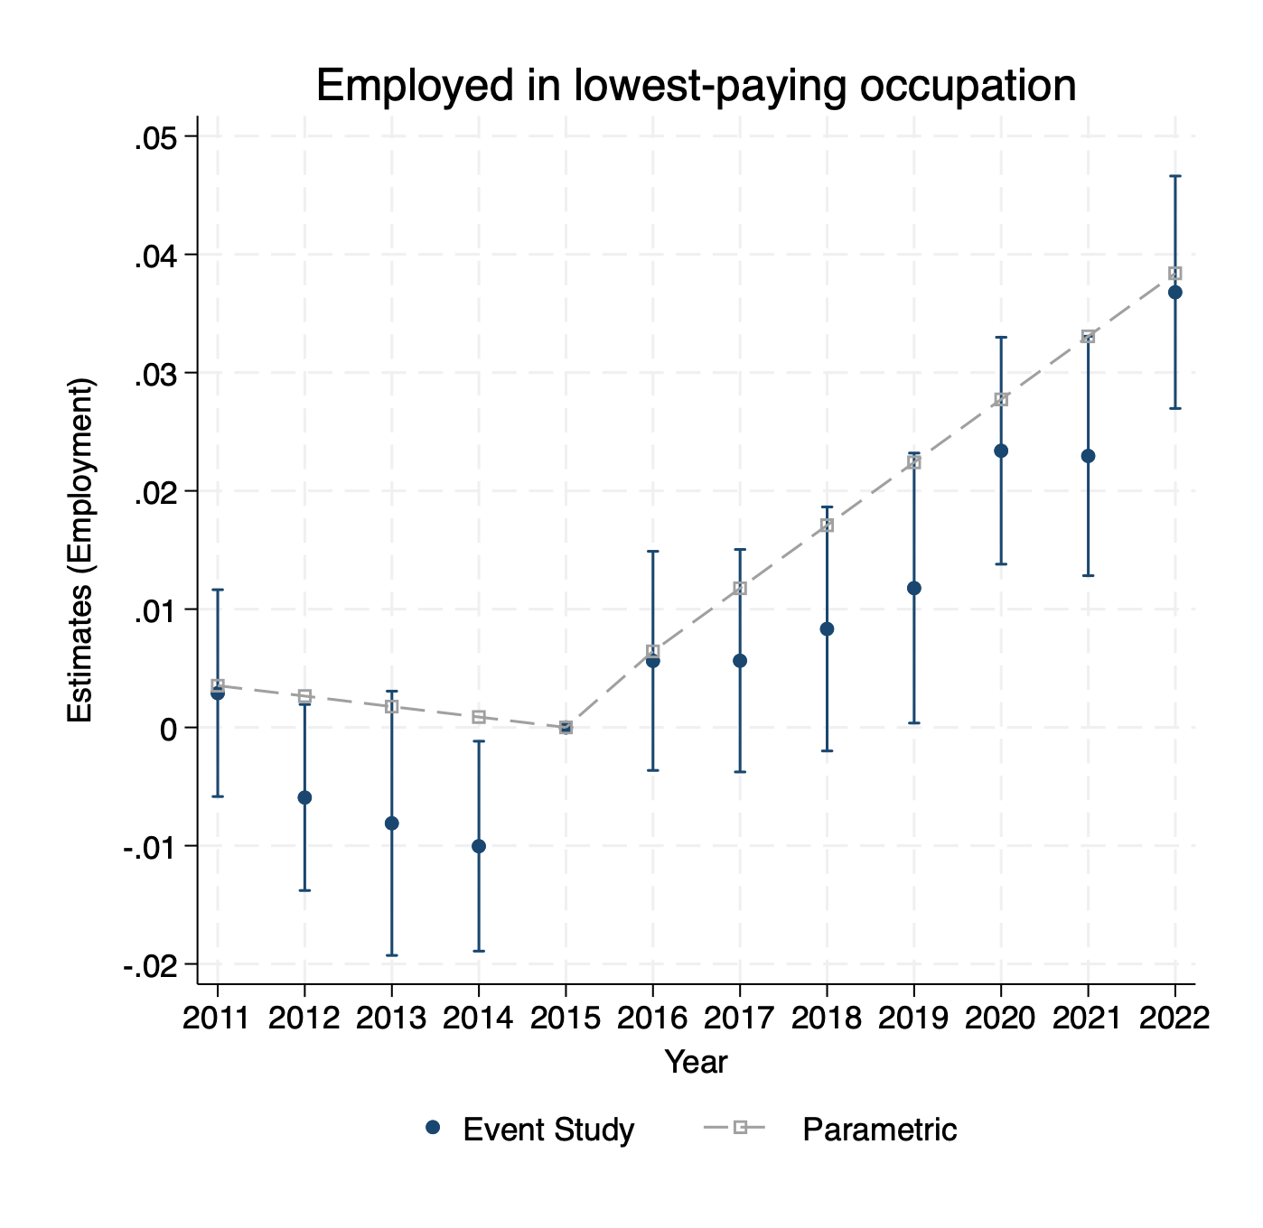
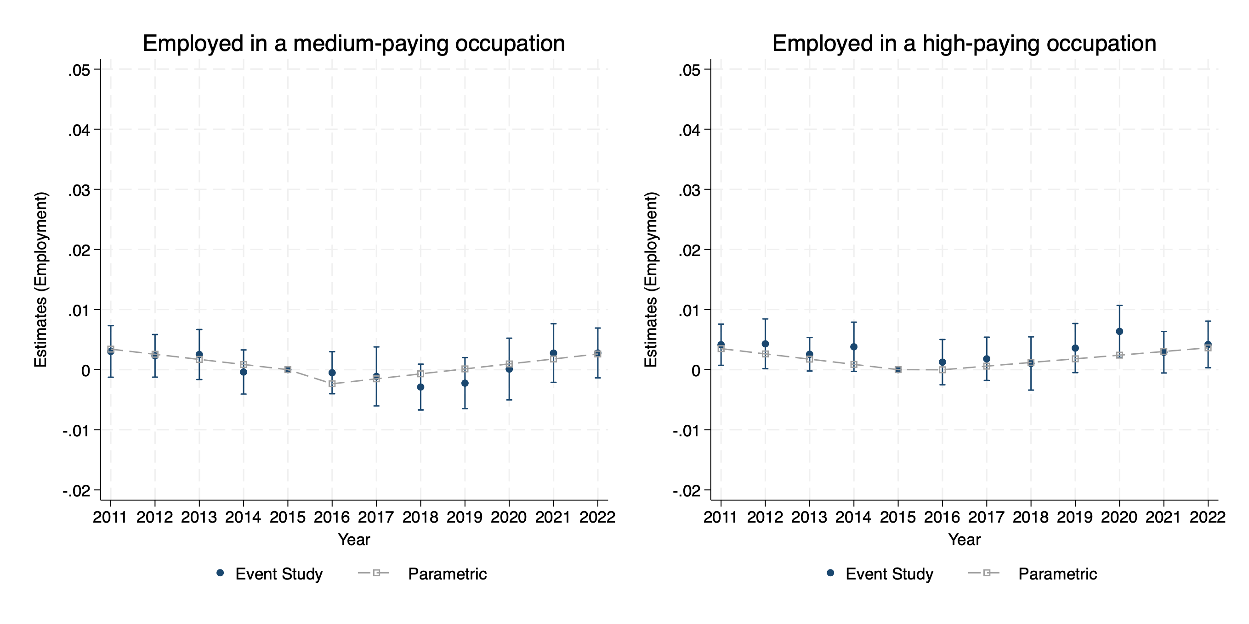
Changes in Employment Rates Concentrate on the Lowest-Paying Jobs
Notes:
Examples of lowest-paying occupations: lobby attendants, fast food workers, restaurant hosts, parking enforcement, product promoters, dishwashers
Can we look at SSI versus non-SSI for this study?

Slide 77
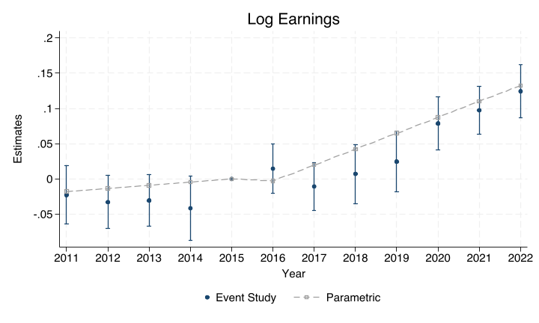
Changes in Relative Earnings
Notes:
This plot shows the estimates for the relative change in log annual earnings between youth with and without disabilities.

Slide 78
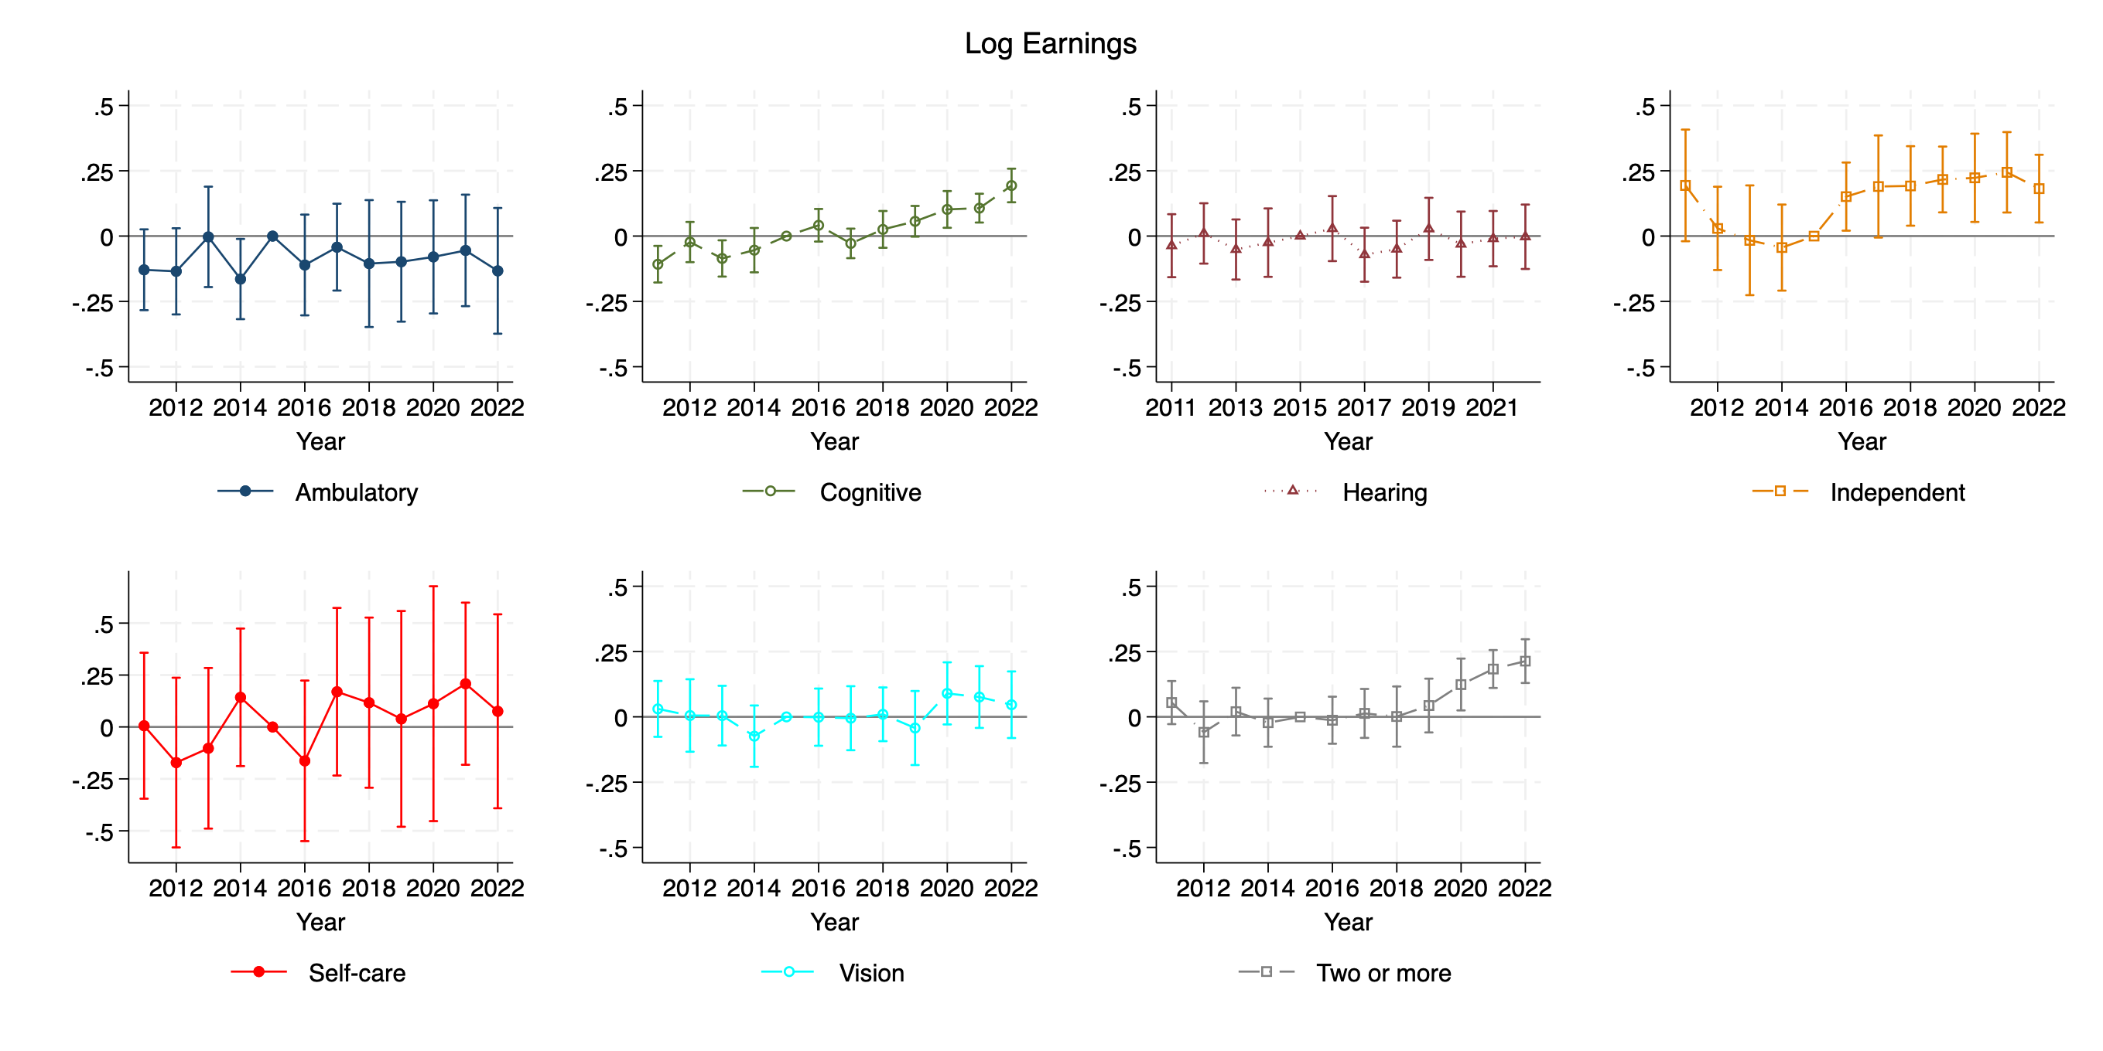
Changes in Relative Earnings, by Disability Type
Notes:
When looking into disability categories, we observe the largest change for individuals with cognitive and severe disabilities

Slide 79
Key Takeaways
The earnings gap between PwD and PwoD persists after accounting for differences in cognitive, non-cognitive, or social skills
On average, the earnings gap is smaller for workers born after 1990
Large differences by disability type

Slide 80
Implications for EPIC
Empirical evidence of the legislations effects is inconclusive
  Small subset of population from national data
  Lack of data accrual from recent policies
Opportunity for EPIC to shift results
  Focused on population of interest
  Offers training and programs beyond legislations (complementary)
  Ability to compare individuals before and after programs

Slide 81
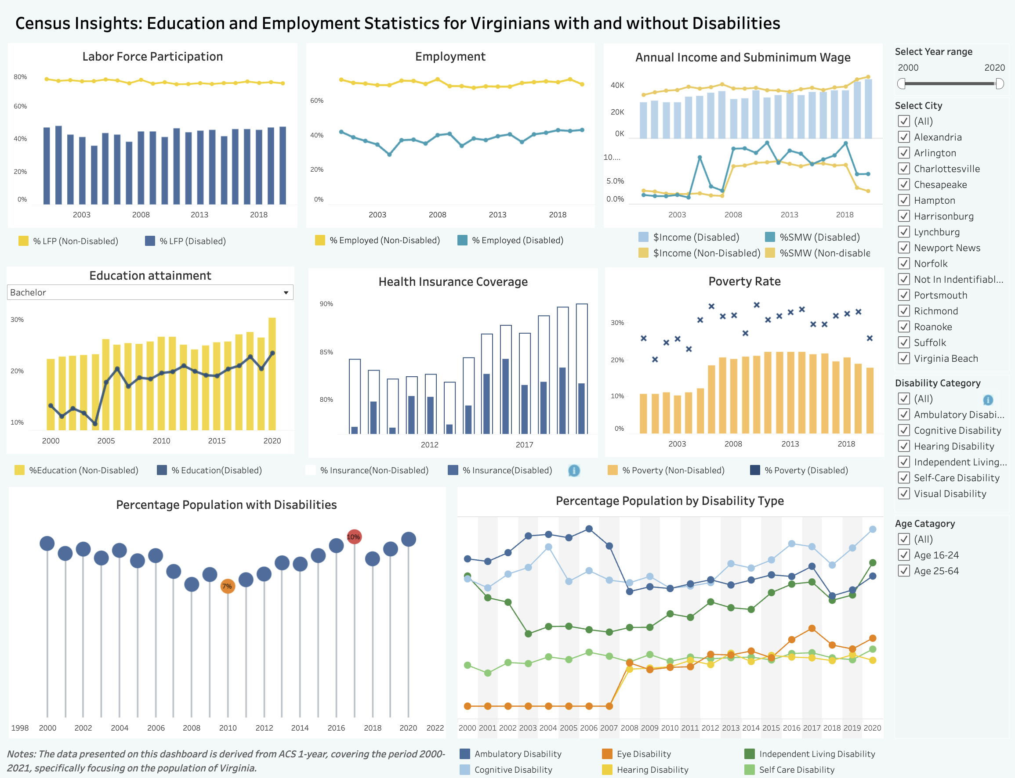
Virginia Dashboard: Census Insights
Notes:
This interactive dashboard provides data on education and labor force participation for individuals with and without disabilities in Virginia.
The data are from the American Community Survey from 2000 to 2021.
The ACS is a comprehensive statistical survey conducted by the Census Bureau that provides vital information about the American population and its characteristics. It gathers nationally representative data on various social, economic, housing, and demographic factors.
To use this dashboard:
Select the year range you wish to include.
Select the city you wish to include
Select the disability type(s) to include and age categories.
Hover your mouse over the charts to view information about a specific outcome.

Slide 82
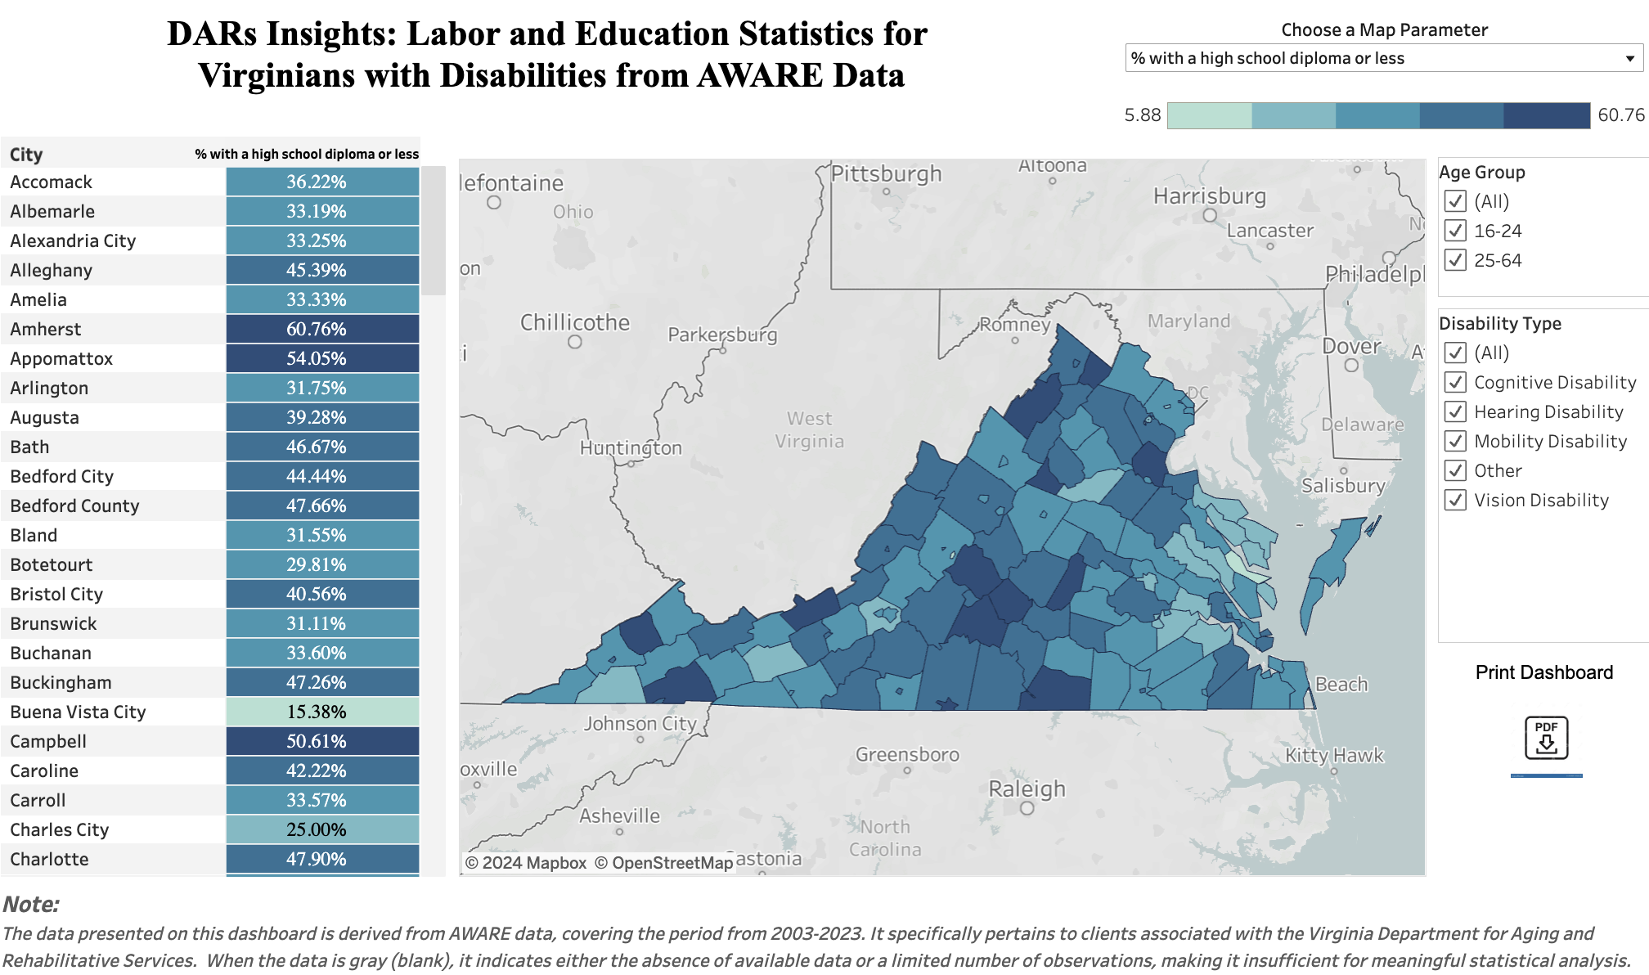
Virginia Dashboard: DARS Insights
Notes:
This is an interactive map that shows the education and employment outcomes of individuals with disabilities served by the Virginia Department for Aging and Rehabilitative Services (DARS) compared to their peers without disabilities.
The data presented in this dashboard are derived from the AWARE database, covering the period from 2003 to 2023.
This dashboard offers an overview look at educational milestones, employment trajectories, and rehabilitative progress for these DARS participants over the specified period.
How to use this interactive map?
Select a Map Parameter from the drop-down menu of education and labor data options.
Select the age group you wish to include, then select the disability type(s) to include.
Use the scroll bar in the left column to view data for cities in Virginia, or hover your mouse over the map to view information about a specific city.

Slide 83
Questions
1. What is the employment rate of youth (16-24) with disabilities at the time of application in Arlington?
2. What is the employment rate of youth (16-24) with disabilities at the time of closure in Arlington?
3. What is the percentage of youth (16-24) with disabilities in Virginia in 2021?

Slide 84
Questions
1. What is the employment rate of youth (16-24) with disabilities at the time of application in Arlington?
Answer: 3.61%
2. What is the employment rate of youth (16-24) with disabilities at the time of closure in Arlington?
Answer: 20.55%
3. What is the percentage of youth (16-24) with disabilities in Virginia in 2021?
Answer: 8%

Slide 85
Donna Bonessi, Director of Employment Services & Special Programs, VA-G
Donna.Bonessi@dars.virginia.gov
Michelle Yin, Associate Professor, Northwestern University michelle.yin@northwestern.edu
Virginia EPIC Project Real Pay for Real Jobs
James Knauf, Director of Field Operations
Illinois Institute for Rehabilitation & Education Research, SWTCIE Project Manager
jknau01s@illinois.edu
Robyn Lewis, Policy Advisor, Division of Rehabilitation Services, SWTCIE Project Manager IL-C
Robyn.lewis@illinois.gov
SWTCIE Illinois – From subminimum wage to competitive integrated employment for Illinois with disabilities
SWTCIE IL mailing list

