Slide 1
RSA Update: Supporting Your Success
CSAVR Spring 2025 Conference
April 9, 2025

Slide 2
Christopher Pope Acting Commissioner

Slide 3
OSERS and RSA Leadership Updates
Diana Diaz, OSERS Acting Assistant Secretary and Deputy Assistant Secretary
Erin McHugh, OSERS Senior Advisor
David Cantrell, OSEP Acting Director and OSEP Deputy Director
Christopher Pope, RSA Acting Commissioner and SMPID Director
Ashley Brizzo, TSPD Director and Acting Chief of Training Programs Unit
Ed Vitelli, Chief of VR Program and Technical Assistance Units
David Steele, Chief of Fiscal Unit
Michael Quinn, Chief of Data Collection and Analysis Unit
Corinne Weidenthal, Chief of Service Programs Unit

Slide 4
FY 2025 and 2026 Congressional Appropriations
For CR#3 (through September 30, 2025), the Department made its apportionment request and it is pending OMB’s approval and OMB’s release of funds.
Decisions related to the CPIU also remain pending.
RSA plans to conduct reallotment from July 15-August 15, 2025.
FY 2026 funding is subject to Congressional action.

Slide 5
FY 2026 Maintenance of Effort (MOE) Reductions
RSA will soon begin issuing MOE reduction letters for the FY 2026 VR awards.
Approximately 20 States will receive MOE letters related to FY 2023 MOE deficits.
Additionally, several States will receive MOE letters for prior years due mostly to adjustments made by grantees to financial reports after submission.

Slide 6
VR Fiscal Update: Reallotment
Total Reallotment Pool = Sum of VR funds relinquished and maintenance of effort reductions
Notes:
Appears to be an inversion approximately every 4 to 5 years (2015, 2019, 2024)

Slide 7
VR Fiscal Update: Year of Appropriation Outlays
Year of Appropriation (1st Year of Award)
Notes:
Shows progress in spending more VR Federal funds during the year of appropriation. Went from 34 percent in 2023 to 42 percent in 2024.

Slide 8
Real Property Reporting
RSA is in the process of finalizing the Real Property Reporting form instructions for the VR program.
The forms are required for VR agencies that use Federal VR funds, program income, or non-Federal funds used for match, to acquire, construct, or improve real property.
RSA anticipates issuing the form instructions within the next few months.

Slide 9
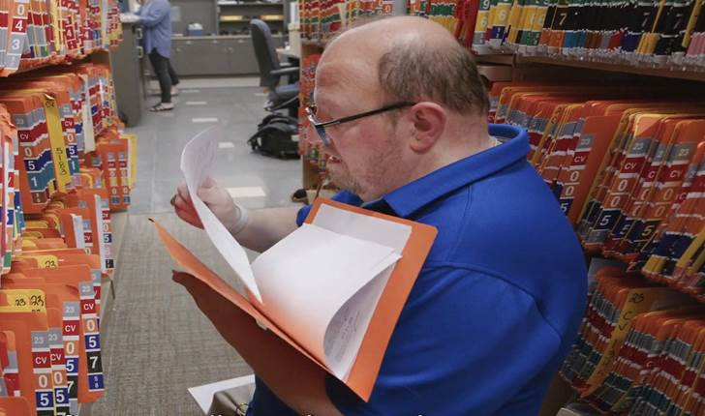
Success Story: Pat from Pennsylvania
Notes:
Pat, a dedicated employee in Walmart’s candy aisle for over 20 years, aspired to a more challenging career. Through the collaborative efforts of the Pennsylvania Office of Vocational Rehabilitation and his participation in the Project SEARCH program, Pat’s talent and work ethic were recognized. After completing Project Search, he was hired on and now holds a records management position at the Dauphin County courthouse in the Prothonotary Office which records and files all legal papers related to civil court. Congratulations to Pat and the Pennsylvania team!

Slide 10
Pre-Employment Transition Services
State VR programs have continued to make progress with meeting the 15% reserve/expend requirement for serving students with disabilities.
From FY 2021 to FY 2022, 15 more States met the requirement.
In FY 2022, 11 States did not meet the requirement.
From FY 2022 to FY 2023, 4 more States met the requirement.
In FY 2023, only 7 States did not meet the requirement.
Overall, from FY 2021 to FY 2023, 19 States made strong progress.

Slide 11
Order of Selection (OOS) Update
Under the PYs 2024-2027 WIOA State Plans, more VR agencies are electing to implement an OOS.
RSA has approved the following amendments to VR Services Portions:
ID-G: 0 of 3 priority categories open
MD-C: 1 of 3 priority categories open
MN-G: 1 of 4 priority categories open
MO-G: 1 of 3 priority categories open
OK-C: 1 of 3 priority categories open
PA-C: 1 of 3 priority categories open
VT-G: 3 of 4 priority categories open
WA-G: 2 of 5 priority categories open
WV-C: 1 of 3 priority categories open
WI-C: 2 of 3 priority categories open
Only one of the 10 VR agencies have all categories closed.

Slide 12
VR Program Monitoring Update
FY 2024: RSA issued all 8 draft reports and received responses from 7 VR agencies. RSA has issued one final report and others should be published soon.
FY 2025: In the fourth quarter, RSA plans to conduct monitoring reviews of MO-G, WV-C, MS-C, and CT-G.
FY 2026: With leadership, RSA will plan for scope of monitoring and TA plans.

Slide 13
WIOA Reauthorization
118th Congress
In December 2024, Congress passed a CR that did not include A Stronger Workforce for America Act (ASWA).
119th Congress
On March 6, 2025, within the House’s Committee on Education and Workforce, the Subcommittee on Higher Education and Workforce Development held a hearing on WIOA reauthorization to re-advance ASWA.
The Senate’s HELP Committee has not yet planned action.

Slide 14
Michael Quinn Chief, Data Collection and Analysis Unit

Slide 15
WIOA Performance Assessments
State VR programs are assessed under the provisions of section 116 of the Workforce Innovation and Opportunity Act. These provisions explain that:
A Statistical Adjustment Model (SAM) is used to predict what program outcomes will be and could have been, given differences in participant characteristics and economic conditions unique to each state.
The SAM is used to adjust negotiated levels in the assessment of performance.
Failing indicator scores (below 50%) or program scores (below 90%) in consecutive program years incur a sanction.

Slide 16
Illustration of Performance Assessment
Employment Rate 2nd Quarter after Exit
Adjustment Factor 4.9%
Indicator Score
97.1%
63.0%
= Actual Level
/
Adjusted Level
59.0%
62.1%
Negotiated
Level
Adjusted
Level
Actual
Level

Slide 17
Recent Developments and New Resources
PY 2023 WIOA Assessments
10/18/24: RSA published PY 23 WIOA Performance Assessment Results.
01/17/25: Department of Labor’s Employment and Training Administration (ETA) published their PY 23 Annual WIOA Performance Assessments in collaboration with RSA.
02/21/25: The Departments published non-binding state performance results for indicators not assessed in PY 23, as described in FAQ-24-02.

Slide 18
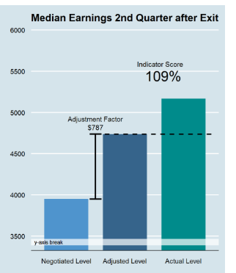
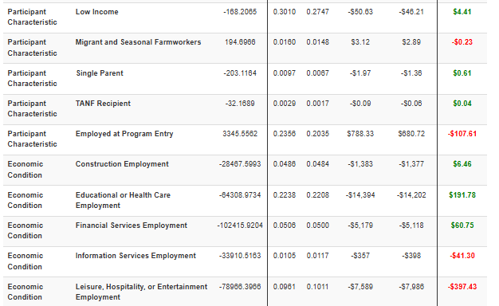
PY 23 State Performance Assessment Resource
Visit the Department of Labor Performance Assessments
* The above is not the full list of participant characteristics and economic variables

Slide 19
PY 2023 Non-Binding WIOA Performance Results
https://www.dol.gov/agencies/eta/Performance/resources/nonbindingassessment
Outcome Legend
Employment Rate Q2 After Exit
Employment Rate Q4 After Exit
Median Earnings Q2 After Exit
Credential Attainment
Measurable Skill Gains
Program Score
Click here to download the accessible version of the data (xlxs) used in this workbook

Slide 20
Implications for the Future
RSA is nearing a decision point on the assessment of Measurable Skill Gains Rate and Program Scores for Program Year 2024.
The Non-Binding Assessments illustrate that the 90% threshold is a greater challenge for State VR programs.
Since Adjustment Factors are influenced by the reporting of participant characteristics, the details of quarterly reporting matter.
RSA has added some updates to the Data Dashboards to assist VR agencies in recognizing errors and omissions in reporting.

Slide 21
Success Story: Louis from Oregon
Notes:
Overcoming a challenging background of foster care, substance abuse, and incarceration, Louis from Oregon thrived through the coordinated efforts of his VR counselor, the Inclusive Career Advancement Program (ICAP), a tribal support system, and on-campus resources.
Louis is a member of the Klamath Tribes and received assistance through the tribal VR program which helped him transition to life after prison and connected him to VR. From there this network provided crucial assistance, from a healthy home and spiritual environment with native rituals and customs for him and his son, tuition coverage and academic supports to financial aid navigation, and other daily living supports such as an on-campus food pantry and a voucher to lower his energy costs. With over 4 years sustained sobriety and unwavering determination, Louis earned an Addiction Studies Pathway certificate from Klamath Community College in June 2023 and completed his AA degree in Psychology last year. He is now working as a substance use counselor for Place2Heal Counseling Services in Klamath Falls, working toward the required 1,000 clinical hours needed to sit for the Certified Alcohol and Drug Counselor examination. Congratulations to Louis and the Oregon team!

Slide 22
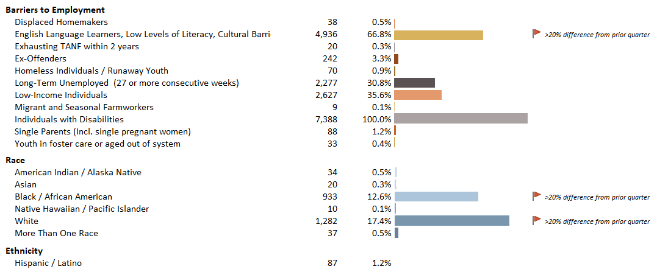
RSA-911 Quarterly Data Dashboard – Update 1
Participant Characteristics – Flags added for unexpected changes in data

Slide 23
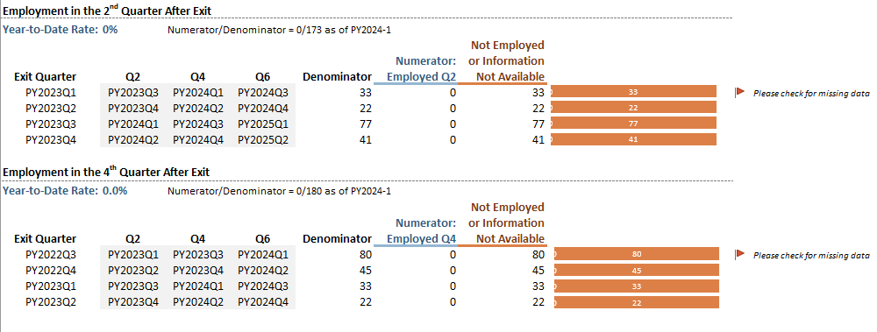
RSA-911 Quarterly Data Dashboard – Update 2
Post Exit Performance – Identifying Potential Data Gaps

Slide 24
RSA-911 Quarterly Data Dashboard – Update 3
Other Updates and Modifications for Program Year 2024
Updated calculations for Eligibility and Initial IPE timeliness
Data on the use of extensions
Added service category for Home Modifications
Added employment status at Initial IPE

Slide 25
Efficiency, Engagement, and Outcomes
Nationally, from PY 2020 to PY 2023 VR programs:
Reduced
Average days to eligibility determination from 37 to 32 days
Average days from eligibility to initial IPE from 77 to 52 days
Percent exiting after an IPE without an employment outcome from 42% to 40%
Increased
Percentage of Students with a Disability receiving services from 33% to 43%
Employment rate in the 2nd quarter after exit from 47% to 56%
Median earnings in the 2nd quarter after exit from $4,022 to $5,513

Slide 26
Additional Observations
RSA compared the Employment Rate at Program Exit for Program Year 2022 to the Employment Rate in the 2nd Quarter after Exit in PY 23.
This is the same cohort of participants
All exited the VR program between July 1, 2022, and June 30, 2023.
Results are mixed by state and agency type but pose interesting questions about attrition after IPE and supplemental wage verification.

Slide 27
PY 22 VR Employment Rate vs. PY 23 ERQ2 - State

Slide 28
PY 22 VR Employment Rate vs. PY 23 ERQ2 - Blind

Slide 29
Ashley Brizzo Director, Training and Service Programs Division

Slide 30
Training and Service Programs Division: Program Implementation Highlights
Disability Innovation Fund: CIE success through Project InVEST;
Career Advancement through Inclusive Career Advancement Program
NCRTM: Email AI examples to NCRTM@neweditions.net
VRTAC-QM: Manager Minute Podcast on Order of Selection;
Podcast on Pathways to Partnership DIF grantee
VRTAC-QE: National Symposium on Quality Employment
AIVRTAC: Success Stories
Randolph-Sheppard Vending Facility Program: TAC 25-01 on Management Services

Slide 31
Anticipated FY 2025 Discretionary Grant Competitions
Program Name | Additional Information About Competition
American Indian Vocational Rehabilitation Services 84.250 | Federal Register (applications closed 4/7/25)
Vocational Rehabilitation Technical Assistance 84.264 | Grants Forecast
Parent Information and Training 84.235 | Grants Forecast-F Grants Forecast-G
Innovative Rehabilitation Training 84.263 | Grants Forecast
Independent Living Services for Older Individuals Who Are Blind Training and Technical Assistance 84.177 | Grants Forecast
Long-term Rehabilitation Training 84.129BEHLPQW | Grants Forecast; Grants Forecast; Grants Forecast; Grants Forecast; Grants Forecast; Grants Forecast; Grants Forecast

Slide 32
Success Story: Kelley from New Hampshire
Notes:
Kelley’s journey to a fulfilling career was made possible by New Hampshire’s Vocational Rehabilitation (VRNH) agency and Services for the Blind and Vision Impaired (SBVI). VR supported Kelley in earning a Bachelor’s degree in Communication with a focus on Professional Writing from Southern New Hampshire University. The agency provided essential services, including an 8-week CVS Health Work from Home Internship where she worked as an Administrative Assistant. This reintroduced her to the corporate environment after a 20-year gap and VR facilitated necessary accommodations and equipment. Kelley is now successfully employed full-time in a remote role with CVS’s Aetna division. Congratulations to Kelley and the New Hampshire team!

Slide 33
Connect with RSA & OSERS
Website: rsa.ed.gov
RSA State Liaisons:
https://rsa.ed.gov/about/people/state-liaisons
OSERS Blog: https://sites.ed.gov/osers/

