Slide 1
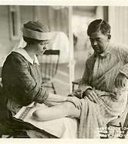
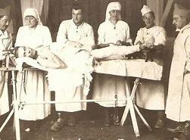
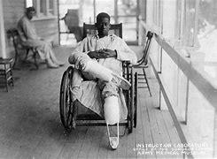
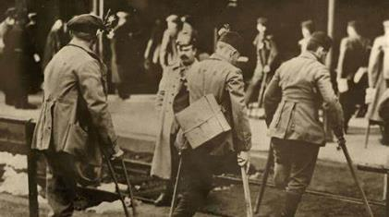
The Early Years 1920 - 1945
Throughout WWI, 224,000 soldiers sustained injuries that rendered them unfit for front-line duty
Approximately 4,400 individuals returned home with partial or complete limb loss.
Smith-Fess Act of 1920: The federal VR program officially began with the passage of the Smith-Fess Act (also called the national Civilian Vocational Rehabilitation Act), which extended services to individuals with physical disabilities.
Notes:
When we look at the history of VR – During the Early Years of 1920 – 1945
We begin with The Soldiers Rehabilitation Act which paved the way for the Smith-Fess Act. The Smith-Fess Act provided crucial support to veterans returning from World War I with disabilities; and in 1920 Congress expanded the veteran's program making VR services available for anyone with a physical disability – not just veterans.
This established the federal-state VR program and marked the beginning of the Public Vocational Rehabilitation Program, or VR – With the first state implementing its VR program in 1920 (Massachusetts or Montana) and several other states quickly following suit.

Slide 2
The Early Years 1920 – 1945
The Early Years 1920 – 1945
The VR program provided these veterans the necessary support to reintegrate into civilian life and the workforce.
VR programs focused on vocational training and job placement, enabling individuals with disabilities to gain meaningful employment and improve their quality of life.
Veterans Rehabilitation: Vocational Rehabilitation Act of 1943 After World War II, the GI Bill expanded the scope of VR to veterans, many of whom needed rehabilitation due to war injuries.
Increased Professionalism: The demand for more structured rehabilitation services led to the rise of training programs in fields like physical therapy, occupational therapy, and psychology.
Introduction of Social Workers: Social workers became integral to VR teams, helping individuals address psychological and social barriers to employment.
Businesses gained access to a new pool of skilled workers, enhancing their workforce diversity and productivity.
Notes:
CONSUMERS –
Establishment of the state VR programs added value to the lives of VR Consumers by….
Providing veterans returning from the war with disabilities with the necessary support to reintegrate into civilian life and the workforce.
VR’s focus on vocational training and job placement, enabled individuals with disabilities to gain meaningful employment and improve their quality of life.
Towards the end of this Era, VR began to expand its reach to include services for more disability populations. Thanks to the expansion of the Rehab Act of 1943, VR services were made available to people with mental illness and intellectual disabilities. This gradually doubled the number of people finding jobs through VR.
In addition to training and guidance, VR consumers began benefitting from corrective surgical procedures paid for by VR, as well as equipment needs such as hearing aids, wheelchairs and anything that improved the ability of a VR consumer to obtain and maintain employment.
The 1943 amendments also allowed states to create separate VR agencies for people with blindness, if the states chose to do so.

Slide 3
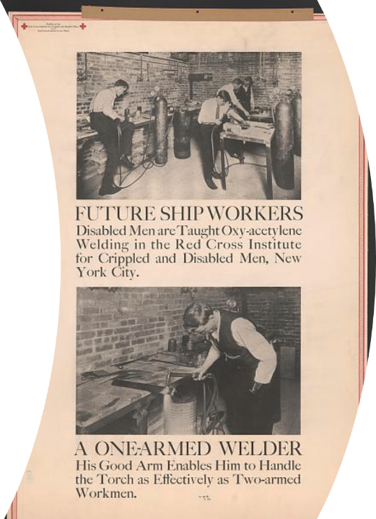
The Early Years 1920 – 1945
Businesses gained access to a new pool of skilled workers, enhancing their workforce diversity and productivity.
Notes:
VR added value to businesses by helping them gain access to a new pool of skilled workers, enhancing their workforce diversity and productivity.

Slide 4
The Early Years 1920 – 1945
By reintegrating veterans and other individuals with disabilities into the workforce, communities benefited from increased economic activity and social cohesion. The skills and talents of individuals with disabilities were utilized, contributing to the overall economy
Notes:
By reintegrating veterans and other individuals with disabilities into the workforce, communities benefited from increased economic activity and social cohesion.
Communities began to see positive contributions to the overall economy as people with disabilities went to work putting their skills and talents to good use.

Slide 5
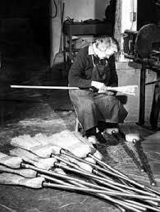
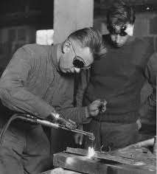
The Early Years 1920 – 1945
In its earliest stages, VR primarily responded to the needs of disabled veterans returning from World War I. The vocational rehabilitation staff played an administrative role, helping individuals with physical disabilities reenter the workforce through limited job training programs. These programs were basic and focused primarily on physical labor, reinforcing a narrow view of both disability and employment. However, despite the limited scope of early efforts, this period laid the groundwork for vocational rehabilitation as a critical element of public policy. VR staff began to emerge as essential advocates for veterans and workers with disabilities, although the services provided were often uneven and underfunded. The establishment of VR programs created stable employment opportunities for VR counselors and staff, fostering a dedicated workforce committed to making a difference.
Notes:
VR added value through our VR Pioneers; individuals called to serve and support people with disabilities. Initially providing administrative resources, helping consumers re-enter the workforce through job training programs.
Laying the groundwork for vocational rehabilitation as a critical element of public policy as VR staff began to emerge as essential advocates for veterans and workers with disabilities, fostering a dedicated VR workforce committed to making a difference.

Slide 6
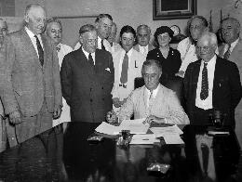
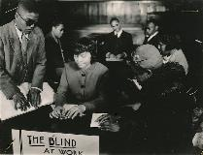
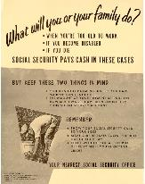
Expansion and Growth
1946-1970
Social Security Act
The Social Security Act expanded VR services by providing additional funding to assist people with disabilities, emphasizing vocational training to help individuals achieve employment.
1943
Barden-LaFollette Act
This law broadened the scope of VR to include individuals with intellectual and mental disabilities, significantly increasing the population eligible for VR services. It also expanded services to people with visual impairments and established rehabilitation facilities.
1954
Vocational Rehabilitation Amendments
The VR Amendments of 1954 increased funding for rehabilitation services and established long-term training for VR counselors. It aimed to strengthen the professional standards within the VR field, improving the quality of services.
1935
1956
1935
1938
Creation of
Social Security Disability Insurance
Wagner-O'Day Act
Notes:
EXPANSION AND GROWTH 1946-1970 Next came the era of Expansion and Growth between 1946 – 1970…..
The VR program continued to add value. During the post-World War II era there was significant expansion of the VR program. The Rehabilitation Act of 1954 provided additional funding and resources, allowing the program to serve more individuals.
Funding for scientific research into disabilities and rehabilitation began, eventually leading to the National Institute on Disability and Rehabilitation Research, or NIDRR.
Politically, Vocational Rehabilitation was popular because we helped thousands of people.
We had a clear definition of who our target group was - people with disabilities who could return to work with help from VR - and a clear definition of success - employment of people with disabilities.
During this era President Lyndon Johnson recruited VR into his Great Society program, which was a plan aiming to create a more equitable and just society.
Because of VR’s success in helping people with disabilities find employment opportunities, the administration sought to expand VR’s services. Suddenly the term Disability included drug abuse, alcoholism, repeated jail sentences, Behavior Disorders, public assistance recipients, and many other conditions that posed barriers to employment.
VR’s reach extended and we began setting up itinerate sites operating offices within partner agencies, in prisons, and even storefronts.
Where the VR system had once served thousands of people, it now served tens of thousands.

Slide 7
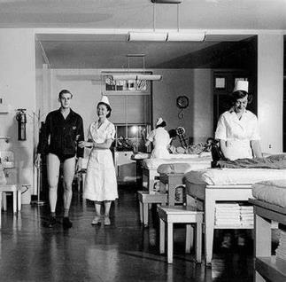
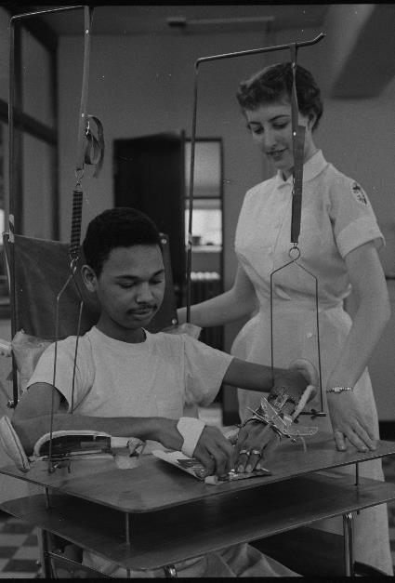
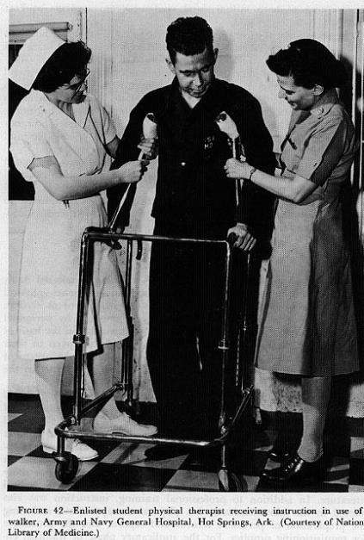
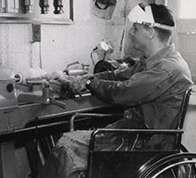
Expansion and Growth​
1946-1970
Notes:
CONSUMERS Our Consumers benefited from the introduction of new VR services during this era, such as physical and occupational therapy, to better support their rehabilitation.
VR added value to business by providing a more skilled and efficient workforce, offer a wider variety of training and rehabilitation services to consumers. The VR program enabled individuals with disabilities to acquire new skills and improve their productivity.
Additionally, Businesses that hired individuals with disabilities could receive tax incentives and financial support from the government. Making it economically advantageous for businesses to collaborate with the VR program in hiring people with disabilities to fill their workforce needs.

Slide 8
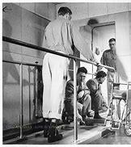
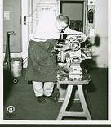
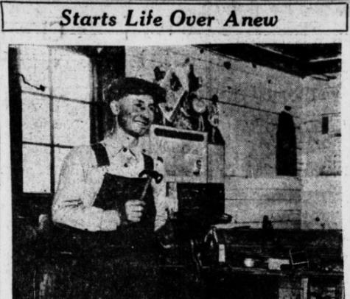
Expansion and Growth
1946-1970
Notes:
COMMUNITY
Communities became more inclusive and supportive of individuals with disabilities.
VR PROFESSIONALS
The VR program’s value extended beyond the individuals served. VR provided stable employment opportunities for VR counselors and staff, fostering a dedicated workforce committed to making a difference.
As the demand for services grew, so did the responsibilities of VR professionals. Counselors took on a more active role in advocating for opportunities for people with psychological conditions, not just people with physical disabilities.
The Vocational Rehabilitation Act of 1954 was a key legislative milestone, allowing VR staff to work within a more expansive framework that emphasized individualized planning and broader services.
During this period, VR staff became critical in shaping rehabilitation plans that not only addressed immediate employment needs but also provided comprehensive support, including mental health services and vocational training.

Slide 9
Advocacy and Rights 1971-1995
Notes:
The ADVOCACY AND RIGHTS ERA! Spans the years of 1971 - 1995
This was a pivotal time in the disability rights movement. The Rehabilitation Act of 1973, particularly Section 504, was a landmark in prohibiting discrimination based on disability and the VR program played a crucial role in advocating for these rights.
Counselors and consumers would now work in close partnership to individualize services.
And each counselor-consumer team would develop a formal Individualized Written Rehabilitation Program to help them plan and carry out individualized services.
During this era, In 1986, the VR system integrated concepts of “consumer choice”.
VR's focus began to shift away from jobs in protected places like sheltered workshops, and towards providing even more supports to address barriers to employment and help adapt to work in typical jobs out in the community.
In addition, these amendments also created the State Rehabilitation Councils - to increase the voice of consumers in the policy and operations of state agencies.
• The presumption of eligibility - presuming that everyone with a disability could benefit from VR services.
• The requirement of partnerships between the public rehabilitation system and other state and federal agencies that provide employment-related services.
• As part of this partnering effort, the Rehab Act became Title Four of the Workforce Investment Act.

Slide 10
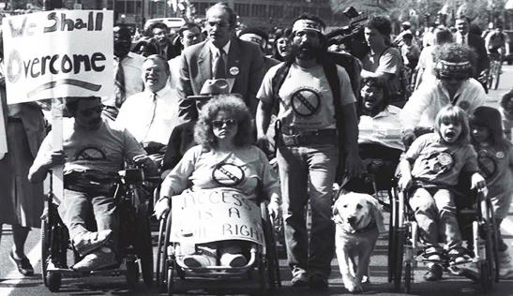
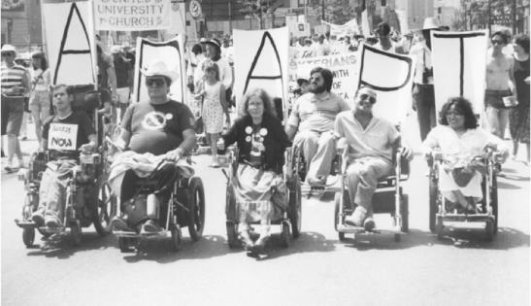
Advocacy and Rights 1971-1995
Rehabilitation Act of 1973: This landmark legislation emphasized the rights of people with disabilities, particularly focusing on nondiscrimination and equal access. It led to more specialized training for VR staff to understand disability rights and accommodations.
Graduate-Level Training: As the field matured, the importance of formal education grew. Many VR counselors began receiving Master’s degrees in Rehabilitation Counseling, which included specialized training in vocational assessment, psychology, and job placement for individuals with disabilities.
Development of Certification: The Certified Rehabilitation Counselor (CRC) designation became available in 1974, requiring professional counselors to pass an exam and adhere to ethical standards. This marked a shift toward greater professionalism in the field.
Notes:
VR added value to our Consumers through ensuring that individuals with disabilities had equal access to employment opportunities.
Helping consumers to advocate for themselves, increasing their role in planning for their service delivery.
To ensure consumers had competent professionals working with them to PROVIDE proper advocacy, service provision, placement and support; specialized trainings in rehabilitation were developed, certifications, and many VR Counselors began receiving Master’s degrees in Rehabilitation Counseling.

Slide 11
Advocacy and Rights 1971-1995
Notes:
Employers who partnered with VR and hired individuals with disabilities benefited from a diverse and innovative workforce.
Businesses that embraced diversity and inclusion saw increased employee satisfaction and retention.

Slide 12
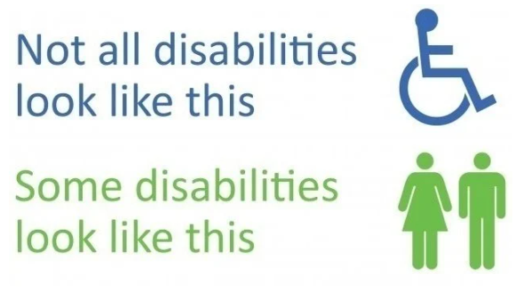
Advocacy and Rights 1971-1995
Notes:
VR’s support and advocacy during the disability rights movement led to greater awareness and acceptance of individuals with disabilities within communities.

Slide 13
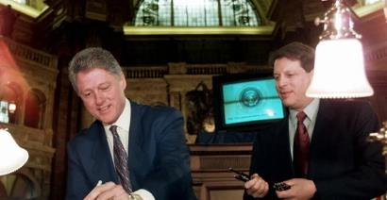
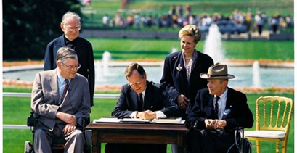
Advocacy and Rights 1971-1995
Americans with Disabilities Act (ADA) of 1990: The passage of the ADA had a profound impact on VR staff training. There was a shift toward preparing counselors to advocate for workplace accommodations and educate employers on accessibility.
Workforce Innovation: The emphasis on competitive employment for individuals with disabilities increased. VR staff received more training in job placement strategies, assistive technology, and workplace accommodations.
Expansion of Rehabilitation Services: During these decades, vocational rehabilitation expanded to include individuals with cognitive, psychiatric, and developmental disabilities, requiring further specialization and understanding from VR staff.
Notes:
During this era the role of the VR professional began to be redefined.
The Americans with Disabilities Act (ADA) of 1990 represented a turning point in the evolution of vocational rehabilitation. The law introduced a rights-based approach to disability, VR professionals became key facilitators of workplace inclusion. Counselors now worked in partnership with employers, advocating for accessibility, adaptive technologies, and equal treatment in the workplace.
VR staff began using a more holistic approach, addressing the broader needs of individuals with disabilities. This included helping consumers navigate new types of assistive technology, securing appropriate accommodations, and ensuring that workplace environments were inclusive and welcoming.
Also, the educational requirements for VR counselors evolved, with a greater emphasis on specialized training and higher education standards for all VR counselors.

Slide 14
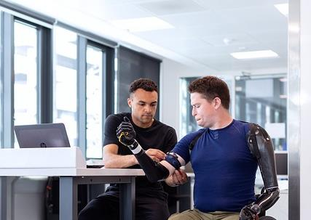
Modernization
and Innovation 1996-2020
Notes:
During 1996 – 2020, we moved into the MODERNIZATION AND INNOVATION ERA.
The turn of the century brought about significant advancements in technology and innovation. The Workforce Innovation and Opportunity Act (WIOA) of 2014 further integrated VR services with workforce development systems, enhancing VALUE and our ability to serve individuals with disabilities.
Data from this period shows that state VR agencies served over one million individuals annually, with employment outcomes for 180,000 to 220,000 people each year. This not only highlights the program’s scale but also its effectiveness in helping individuals achieve their employment goals.

Slide 15
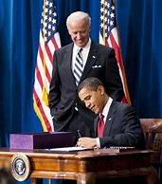
Modernization and Innovation
1996-2020
From 2000 to 2017, several key initiatives were launched to improve employment opportunities for people with disabilities. In 2001, the Social Security Administration introduced the Ticket to Work and Self-Sufficiency Program, helping Social Security Disability beneficiaries access employment services while maintaining healthcare. The American Recovery and Reinvestment Act of 2009 allocated over $500 million for vocational rehabilitation, enhancing job training and placement services. That same year, the Campaign for Disability Employment was launched to promote the value of hiring people with disabilities. In 2010, Executive Order 13548, signed by President Obama, directed federal agencies to increase the hiring of people with disabilities. The 2013 updates to Section 503 of the Rehabilitation Act strengthened affirmative action requirements for federal contractors. The Workforce Innovation and Opportunity Act (WIOA) of 2014 emphasized competitive integrated employment and supported youth transitioning from school to work. In 2017, the Centennial of Vocational Rehabilitation marked a century of advancement in aiding individuals with disabilities to integrate into the workforce.
Notes:
VR Consumers benefited from increased integration of VR services with workforce development systems. Fostering collaboration and enhancing access to services for consumers throughout workforce agencies.

Slide 16
Modernization and Innovation
1996-2020
As of recent estimates from the U.S. Census Bureau and the Centers for Disease Control and Prevention (CDC), approximately 61 million adults in the United States, or about 26% of the adult population, live with some form of disability. This number includes people with a wide range of disabilities, including mobility, cognitive, hearing, and vision impairments, as well as mental health conditions.
Notes:
Employers benefited from positive public relations and enhanced corporate social responsibility.

Slide 17
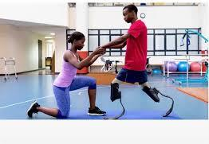
Modernization and Innovation 1996-2020
Workforce Investment Act (WIA) of 1998 and Workforce Innovation and Opportunity Act (WIOA) of 2014: These acts emphasized integrated employment and career advancement for people with disabilities. VR staff needed to be well-versed in employment trends, labor market data, and emerging career opportunities.
Assistive Technology Training: With rapid advancements in technology, VR professionals began incorporating technology into their work. They were trained to recommend, implement, and support the use of assistive devices that could enhance job performance for individuals with disabilities.
Diversity and Inclusion Training: As society focused more on diversity and inclusion, VR staff were trained on intersectionality, understanding the unique challenges faced by individuals from different ethnic, cultural, and socio-economic backgrounds, in addition to their disabilities.
Notes:
In our communities, we saw even more inclusion and cohesion, with a focus on opportunities and abilities as opposed to barriers and inabilities.

Slide 18
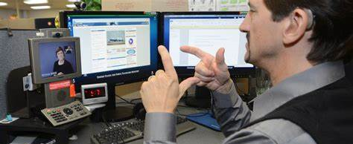
Modernization and Innovation
1996-2020
Each year, state vocational rehabilitation (VR) agencies in the United States typically serve around 1 million people with disabilities.
This number includes individuals who receive various services such as career counseling, job training, assistive technology, and job placement assistance to help them achieve competitive employment outcomes.
VR services are tailored to the needs of each, with a focus on enhancing employment opportunities and independence for people with disabilities.
Notes:
The modernization of VR services provided VR counselors and staff with new tools and resources to better support individuals with disabilities.
Playing a crucial role in helping individuals achieve their employment goals and improve their quality of life.

Slide 19
Embracing the Future 2021-Present
Notes:
Today, we stand on the cusp of a new era………

Slide 20
Thank you
803.896.6500
www.scvrd.net

