Slide 1
Building on Success
Concurrent Session X.X
HOW WYOMING UNIFIED FISCAL & PROGRAM TEAMS FOR STRONGER INTERNAL CONTROLS

Slide 2
Key objectives and takeaways
Objectives
Takeaways
Understanding the Importance of Internal Controls
Identifying Risks and Weaknesses
Implementing Best Practices
Th Role of Internal Controls in Risk Management
Importance of Segregation of Duties
Ongoing Monitoring and Continuous Improvement

Slide 3
Session connection to CSAVR Strategic Priorities

Slide 4
Session connection to CSAVR Message House

Slide 5
The Wyoming Way
HOW WYOMING UNIFIED FISCAL & PROGRAM TEAMS FOR STRONGER INTERNAL CONTROLS

Slide 6
INTRODUCTIONS
Aubree Porter
Jennifer Cassidy
TJ Mechem
Carol Pankow
VR Accounting Manager
DVR Programs Manager
VRTAC Project Director
Deputy CFO

Slide 7
our story

Slide 8
HOW DID WE GET HERE?
Leadership Transition
Retirements of key personnel (administrator, fiscal manager, 2018-2019).
VR fiscal moved under broader agency fiscal teams.
7 Fiscal Managers in a span of 3-4 years
Impact of Transition
Limited knowledge of Federal guidelines (EDGAR & 2 CFR 200).
Loss of direct oversight by VR administrator, affecting communication.
Challenges Identified by QA Team (Jan 2021)
Issues with reporting and fiscal practices.
2022 RSA Monitoring identified significant findings requiring corrective actions.
System Changes
In 2018 Fiscal went through a new system development at the same time key personnel retired
In 2022 VR implemented a new CMS with a lot of issues arising

Slide 9
What issues did we see as a result of this?
Organizational Challenges
Corrective Action Plan
Lack of Communication between Fiscal & Program staff.
Nothing was written down, creating a lack of resources with turnover.
Fiscal responsibilities were siloed, with limited inter-team communication.

Slide 10
WHAT DID THIS BOIL DOWN TO?

Slide 11
POOR INTERNAL CONTROLS

Slide 12
WHAT ARE INTERNAL CONTROLS?
Plain Language Definition Internal controls are systems, procedures, and practices designed to:
Safeguard assets
Ensure accurate financial reporting
Promote operational efficiency
Ensure compliance with laws and regulations
Key Components of Internal Controls:
Control Environment
Risk Assessment
Control Activities
Information & Communication
Monitoring & Evaluation

Slide 13
WHAT DO INTERNAL CONTROLS DO FOR US?
Our Context Internal controls mean having the right checks and balances in place to ensure that we are managing the VR award in compliance with all relevant statutes and regulations.
Some examples include:
Clarifying Expectations & Requirements
Streamlining Processes
Defining Roles & Responsibilities
Collective Responsibility Across Levels
Ensuring Compliance & Accuracy

Slide 14
CLARIFYING EXPECTATIONS & REQUIREMENTS
Purpose of Internal Controls
Distinguish between best practices and mandatory policies/procedures.
Ensure all team members understand expectations and must-follow guidelines.
What it does
Establishes Consistency Across Teams
Everyone has access to the same information.
Ensures a unified approach to managing the grant.

Slide 15
STREAMLINING PROCESSES
Purpose of Internal Controls
Reduces unnecessary steps and improves workflows
Minimizes errors and inefficiencies
What it does
Makes for easier tracking, management, and reporting of funds
Leads to better decision making

Slide 16
DEFINING ROLES & RESPONSIBILITIES
Purpose of Internal Controls
Establishes a clear division of labor by outlining specific roles & responsibilities
Reduces the risk of important tasks being overlooked
What it does
Develops a skeleton when multiple individuals are involved in different aspects of managing the grant

Slide 17
ENSURING COMPLIANCE & ACCURACY
Purpose of Internal Controls
Ensures all procedures align with federal and organizational regulations
What it does
Mitigates risk by minimizing errors
Improves transparency and accountability in fund management

Slide 18
What risks arise without proper internal controls?
Fraud & Misappropriation of Funds
Errors & Inaccuracies
Non-Compliance with Regulations
Inconsistent Decision Making
Missed Deadlines & Reporting Failures

Slide 19
FISCAL INTERNAL CONTROLS BUCKETS
Expenditure Controls
Grant Management Controls
State Funding & Budget Allocation Controls
Budget Modification Controls
Inventory Controls

Slide 20
EXPENDITURE CONTROLS
Verification of Goods and Services Received
Ensure goods and services paid for have been received in the correct quantity and quality.
Designate staff to confirm receipt and verify purchase orders.
Authorization Process
Identify roles responsible for approving expenditures.
Align authorizations with procurement requirements.
Budget Monitoring
Implement controls to ensure expenditures stay within approved budget limits.
Regularly review expenditure reports for potential over-expenditures or discrepancies.

Slide 21
GRANT MANAGEMENT CONTROLS
Grant Award Notification (GAN)
Define the process for distributing the GAN to relevant parties
Governor’s Office Notification
Establish procedures for notifying the Governor’s Office of grant requirements and seeking approval.
Budget Setup
Outline the process for creating grant budgets in the accounting system
Include steps for internal budget alignment with program needs.
Grant Utilization
Detail how authorizations and expenditures against the grant will be monitored and approved.

Slide 22
State funding & budget allocation process controls
Budget Development
Collaborate with fiscal and program teams to identify needs and forecast expenditures.
Address standard budget needs and potential exception requests.
Legislative Approval Process
Define steps for presenting budget needs to the legislature and Governor during budget sessions.
Budget Tracking
Use state accounting systems to monitor expenditures and reconcile state and federal funds.

Slide 23
BUDGET MODIFICATIONS CONTROLS
Approval Process
Identify required levels of approval
Define criteria for approving modifications, such as appropriateness and correctness.
Types of Modifications
Expense Budget Modification (BGA120): Address changes to overall budget series.
Cost Accounting Modification (CAM): Allocate expenditures to the correct funding codes.
Documentation and Compliance
Maintain records of all modifications for audit purposes.
Conduct regular training for staff on budget modification processes.

Slide 24
INVENTORY RECORD CONTROLS
Asset Management and Inventory
Conduct annual physical inventory checks and reconcile results with property records.
Fixed and Non-Fixed Assets
Use accounting systems to track and monitor assets.
Tag all equipment with program-specific identifiers for accountability.
Vehicle Maintenance
Maintain logs and records for all state-owned vehicles.
Implement a schedule for regular maintenance and compliance checks.

Slide 25
SO HOW DO WE START?

Slide 26
6 STEPS TO KILLER INTERNAL CONTROLS

Slide 27
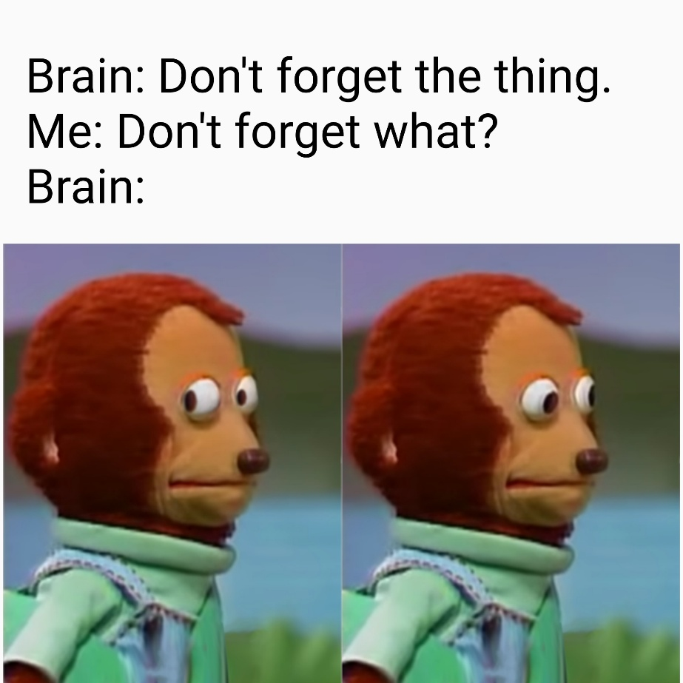
STEP 1
WRITE IT ALL DOWN
Time-Consuming but Necessary
Writing down policies and procedures is essential, even though it’s not quick or fun.
We worked closely with Carol and VRTAC
Developing Policies and Procedures
This process began as part of our Corrective Action Plan (CAP) submission.
RSA was receptive but had concerns about how everything “fits together.”
Creating a Dynamic, Interconnected Resource
Focused on building a well-organized table of contents.
Policies now link to corresponding procedures, improving navigation with links to related procedural documents.

Slide 28
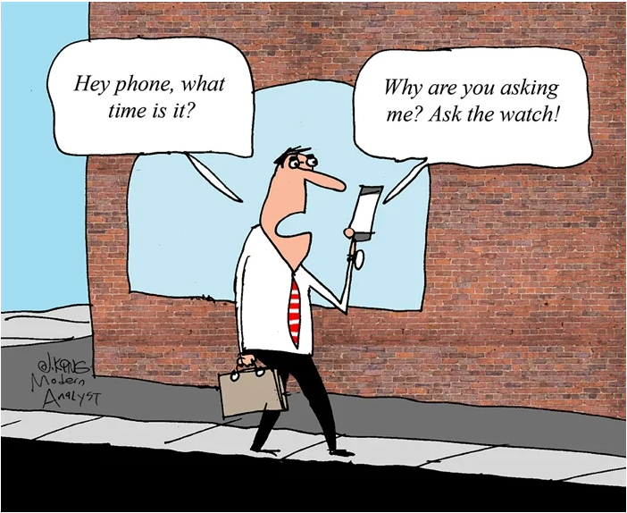
STEP 2
ROLES & RESPONSIBILITIES
Clarify Responsibilities
Own your tasks while being open to learning others' responsibilities.
Avoid Siloed Information:
Ensure knowledge is shared across the team to prevent gaps.
"hit by a bus or won the lottery" analogy:
Ensure others can step in without disruption.
Achieve Balance
Foster accountability while reducing the risk of duplicated, missed, or inconsistent tasks.

Slide 29
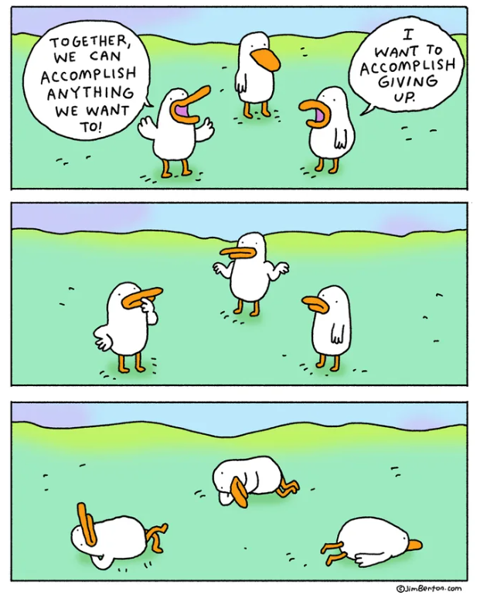
STEP 3
DEVELOPING TOOLS FOR EVERY ROLE
Implementing Tracking sheets & Internal Reports
Contract Monitoring Sheet
Weekly Budget Sheet for Program Staff
Monthly Financials
Developing Resources for Every Level
Budgets Reference Doc
Transactions Reference Doc
Resources for Program Staff
Purchasing Card Cheat Sheet
Have you heard of ScribeHow?
Let’s walkthrough how this works!
ScribeHow Demo

Slide 30
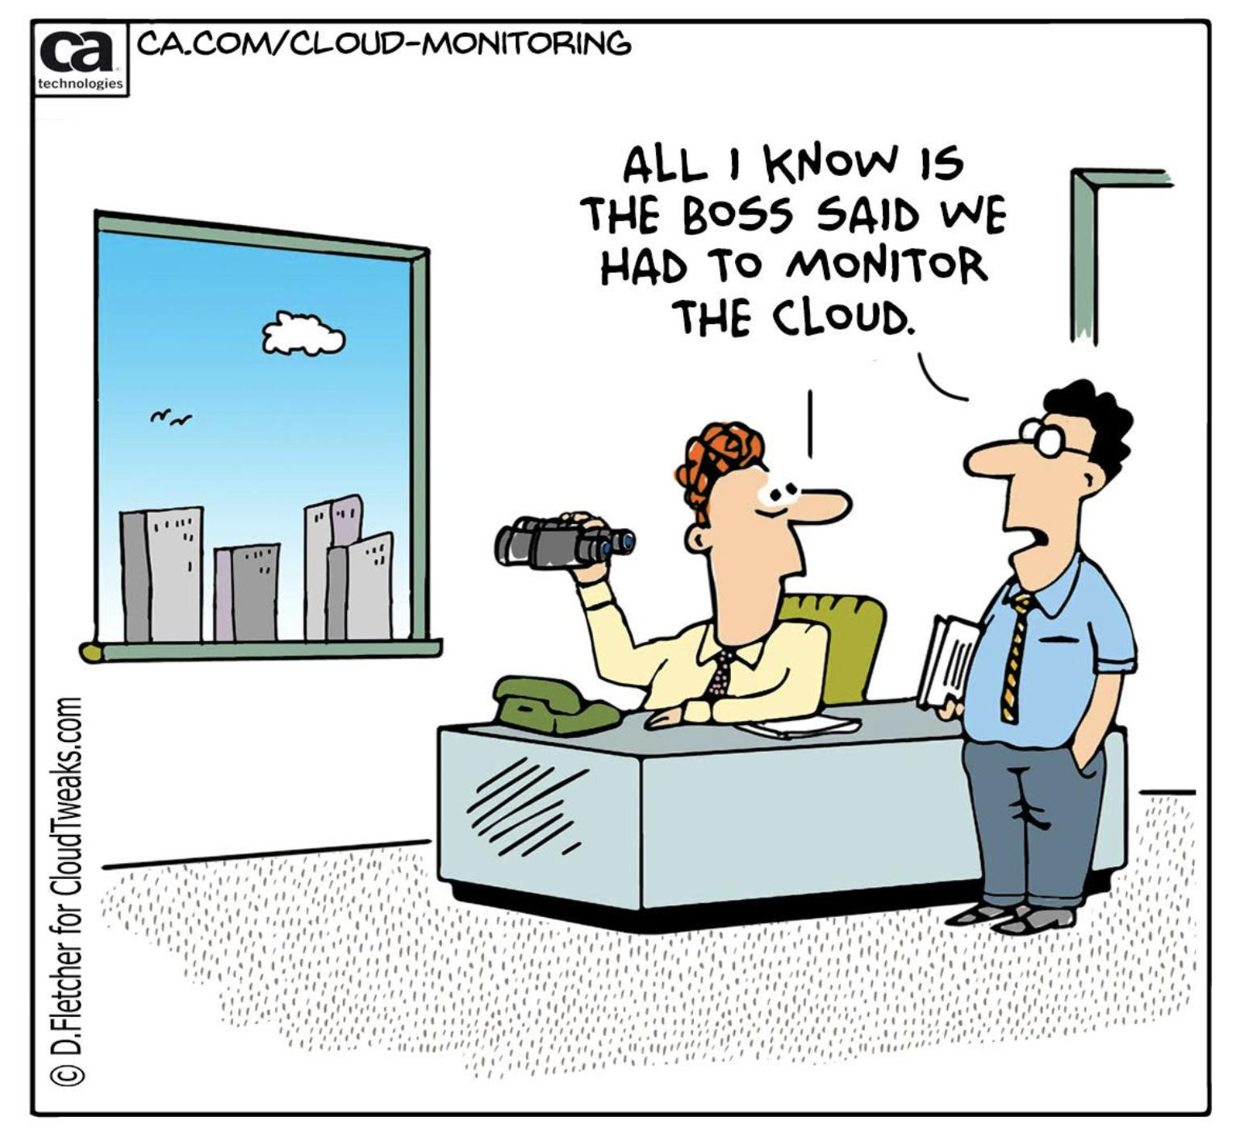
STEP 4
Regular Monitoring of Expenditures
Weekly Reconciling:
Balance CMS data with budgets/PPCs in the accounting system after weekly interface
Monthly Reconciling:
Reconcile paid authorizations from the CMS with payments made in the Accounting system to ensure tracked changes and adjustments after upload.
Monitoring Expenditures for Federal Reporting:
Reviews help address errors early and prevent recurring issues and focus on consistency in descriptions, performance periods, and coding.
Quarterly Projections & Special Projects:
Provide insights into spending patterns, program growth, and capacity.
Includes reviewing time charges, analyzing participant services, and identifying trends.
Why do we Monitor/Reconcile Regularly?
Identifies discrepancies due to post-upload changes.
Ensures refunds and Purchasing Card authorizations are properly tracked.
Critical safeguard to maintain accurate data.

Slide 31
STEP 5
COMMUNICATON
Bridging the Gap Between Fiscal & Program
Different areas of responsibility lead to different perspectives. Effective communication helps align both teams’ goals and actions.
Why Communication Matters
Helps identify how decisions impact the grant.
Uncovers trends and patterns from both Fiscal and Program perspectives.
Weekly Touchbase Meetings
VR Accounting Manager and VR Administrator meet regularly to share findings, update financial status, and discuss adjustments.
Different Fiscal Meetings/Communication
Higher-level discussions.
Grant Managers, though working on separate tasks, stay connected and aligned.
Provides exposure to the bigger picture and learning opportunities for the team.

Slide 32
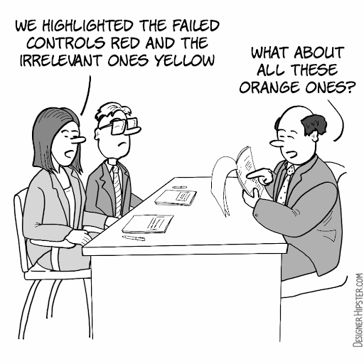
STEP 6
INTERNAL CONTROLS REVIEWS
Importance of Ongoing Review
Developing and implementing internal controls is crucial for grant success.
Continuous monitoring and updating are just as important to maintain effectiveness.
Tips for Effective Control Management
Review by Different People: Gather input from different levels to identify gaps and address day-to-day challenges.
Update with New Guidance: Stay informed about new regulations and ensure they are incorporated into internal controls.
Living Documents: Keep internal controls as live documents on an intranet site for easy access and up to date information.

Slide 33
SPEAKING OF LIVING DOCUMENTS…
How did we get this to all work together?

Slide 34
PUTTING IT TO USE
Challenges with Traditional Methods
Printing or saving old P&P documents for reference.
Reliance on external services was costly and required additional logins.
Our Solution
Piloted a previous intranet but faced staffing changes.
Self-taught how to use Google Sites to create an accessible, centralized intranet.
Benefits of the Intranet
All documents in one place: Easy access to P&P, job aids, and other resources.
Real-time updates: Documents and information can be updated instantly.
Links to relevant resources: Quick access to related policies and procedures.
INTRANET DEMO

Slide 35
FINAL TIPS FOR SUCCESS
Collaborate across departments for system development.
Think outside the box on how this works for you, where you want this to live.
Regularly train and update staff.
Document all processes to maintain transparency and prepare for audits.
Focus on both compliance and operational efficiency.

Slide 36
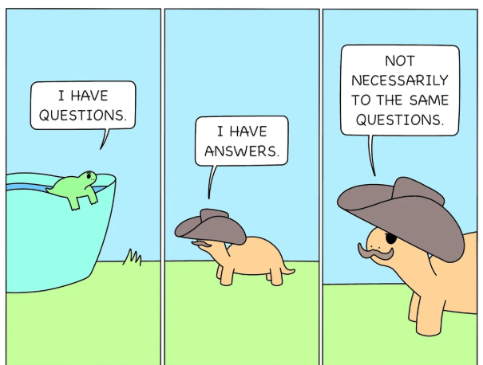
ANY QUESTIONS?

Slide 37
THANK YOU!
Aubree Porter
TJ Mechem
Aubree.porter@wyo.gov
TJ.mechem@wyo.gov
Jennifer Cassidy
Carol Pankow
Jennifer.cassidy@wyo.gov
cnpankow@email.gwu.edu
CONTACT INFORMATION

Slide 38
Evaluation and Feedback
Complete evaluation – get your CRCC credits
Also may provide direct feedback to info@csavr.org
What’s next on the agenda?

