Slide 1

Advancing Vocational Rehabilitation (VR):
Successful Strategies for Impactful Business Services for VR Programs and Customers
Notes:
(Eric)

Slide 2
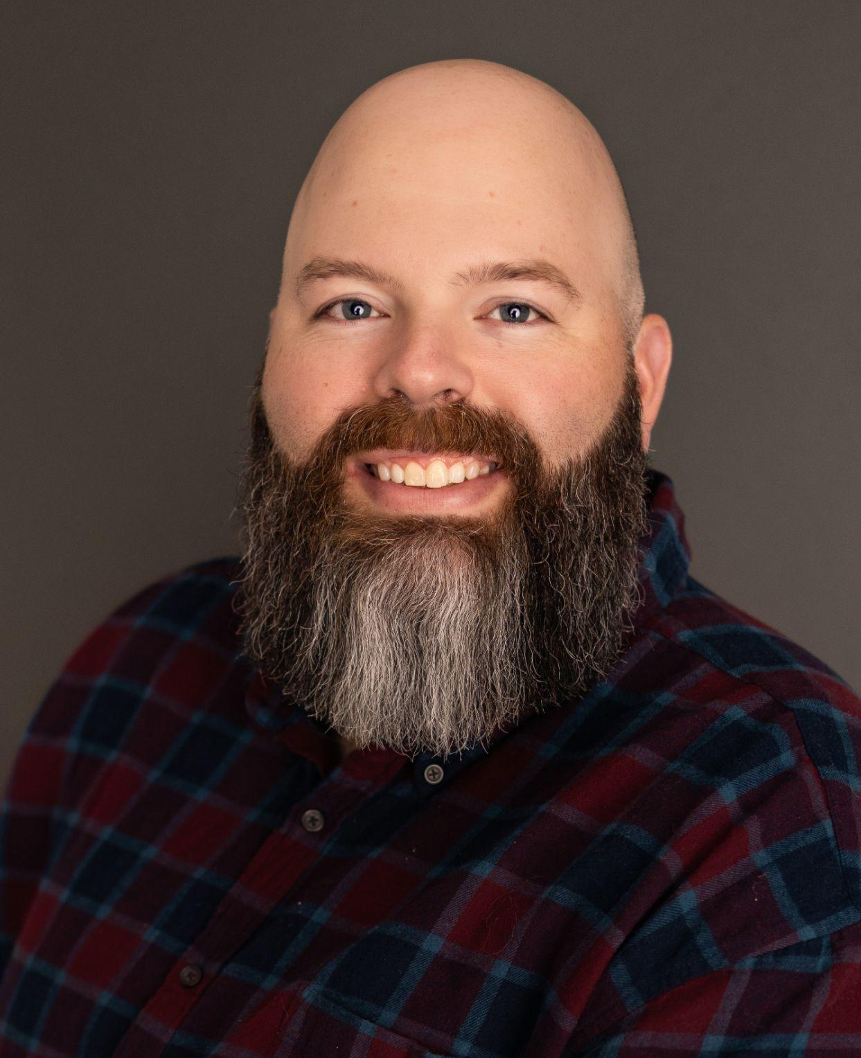
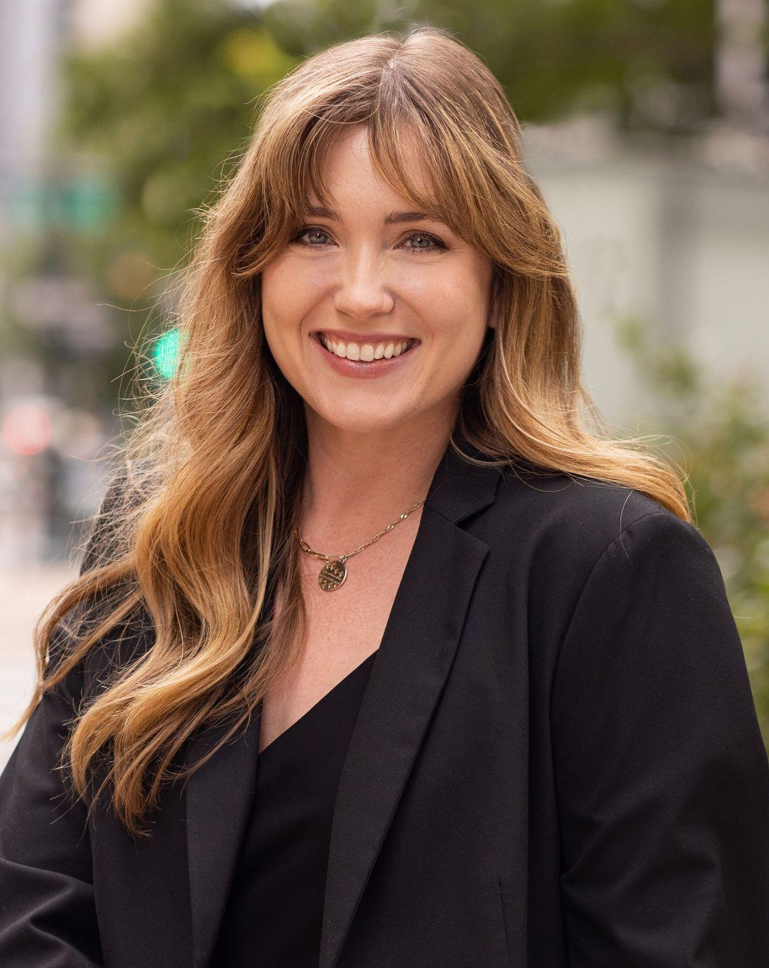
Hello! We are Colorado’s Business Relations Unit
Eric Clark, Manager of Workforce Strategy & Business Development
Heather Brooks, Manager of Business Outreach Services
Notes:
(Eric and Heather)

Slide 3
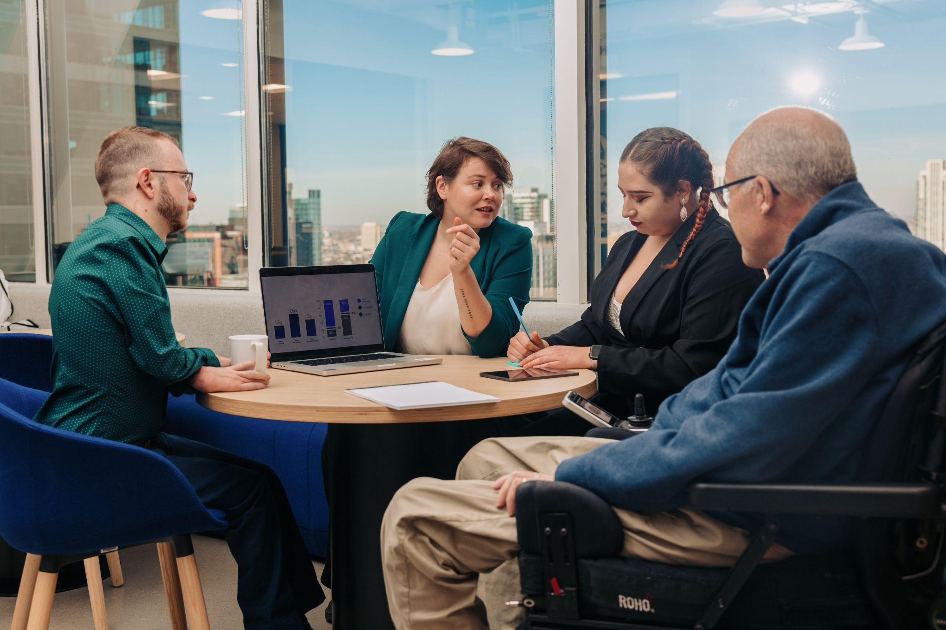
DVR seeks to be a resource and partner for those we serve in achieving employment that aligns with the Business needs.
At DVR, we believe...
All people with disabilities can choose a career path leading to meaningful employment and independent living.
AND
That anyone with a disability who wants to work, can work, regardless of the type or severity of their disability.
Notes:
(Eric)

Slide 4

The Business Relations Unit (BRU)
Because employers are our customers too!
The goals of the BRU are to create long-term, strategic partnerships with businesses across the State of Colorado in an effort to:
Link business to talent/resources as well as with DVR job seekers
Promote People with Disabilities as an untapped talent pool
Gather real time LMI to promote viable career opportunities
Provide training to business on Diversity, Equity, Inclusion, & Accessibility
Notes:
(Heather)
***add more script content
The purpose of the Business Relations Unit is to provide services to employers by building long-term relationships based on their business need.
Our goal is to link businesses to the talent and resources that DVR offers, while promoting people with disabilities as an untapped talent pool. We also work within our communities to gather local labor market information which we share with the DVR counselors and job seekers to help promote viable career paths within our regions. And we provide training and business consultation on Diversity, Equity, and Inclusion topics to business and community partners.

Slide 5

The purpose of the Business Relations Unit is to lead with intention through meaningful relationships with Partners, Employers, and People with Disabilities, so that all workers in Colorado benefit from inclusive and accessible workplaces.
Notes:
(Heather)

Slide 6
Session Objectives
We are excited to speak with you today and provide:
An overview of the Colorado BRU’s organizational structure and professional development models, that fuze DVR as an integral part of the workforce development ecosystem in Colorado;
Effective strategies for expanding BRU’s impact through initiatives that support both internal and external customers with education and partnership;
And share some of out successes on how Colorado BRU has leveraged partnerships and strategies to bolster DVR’s overall Mission and goals
Notes:
(Heather)

Slide 7

Part 1: BRU’s Structure
06
Notes:
(Eric)

Slide 8
BRU’s Structure
Eric Clark, Manager of Workforce Strategy & Business Development
Heather Brooks, Manager Business Outreach Services
Linda Wray, Program Assistant
Sandra Sharp, SAME Development Specialist
Tiffany Garcia- Team Lead, Pueblo
Special Programs:
Adam Shake, Northern Colorado
David Atkinson, South Western Colorado
Self Employment Program
Disability Program Navigator (DPN) Program
Jerry Davis, Eastern Plains
Jeff Sidders, North Metro/ Boulder
Renee Romero, Denver Metro/ Aurora
Michael Gordon, Denver Metro/ Golden
Kasey Watts, Western Slope
Connie Brachtenbach, Colorado Springs
Notes:
(Eric)

Slide 9
Coverage
Notes:
(Eric)

Slide 10
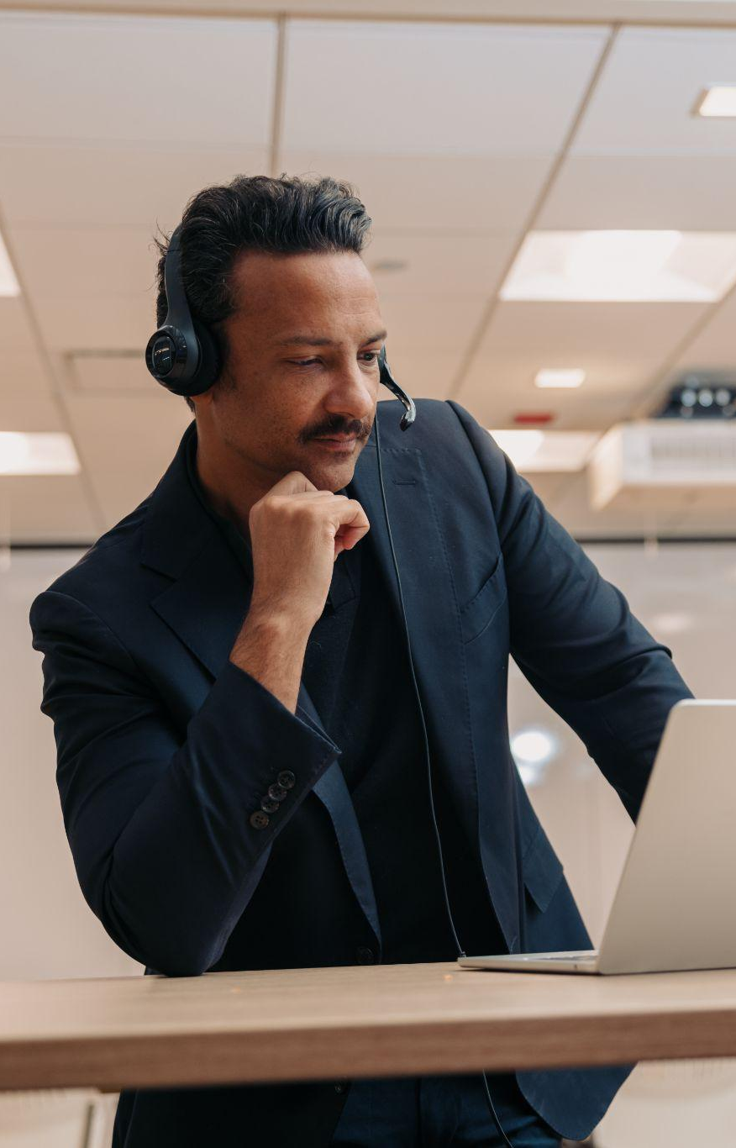
Developing your Team
Onboarding
Prior to 2020, there was no structured training system for onboarding a new Business Outreach Specialist (BOS), often resulting in a BOS taking 9-12 months to feel comfortable and effective in their role.
BOS’s lacked:
Understanding of internal systems and external purpose
Skill Development
Network/ Partners
In 2021, when our Unit took on it’s first Team Lead, we sought to change that and developed New BOS Academy.
An 8-week, structured training program that provides 1:1 mentorship and guidance from the Team Lead, weekly assignments to build employer connections, and full integration into their region of coverage.
Notes:
(Heather)
Potentially 2 separate slides (break out the topics into another slide)- structure vs impact of NBA

Slide 11
New BOS Academy
Training like a BOS…
Session 1: Introduction to DVR & the Business Relations Unit (BRU)
An introduction to CDLE, Overview of all things DVR, and the purpose of the BRU
Session 2: The BOS and their Teams
Comprehensive understanding of the BOS role and identifying the 5 Key Partners to a BOS, starting with internal partners- Rehab Counselors.
Session 3: Employer Engagement
A deep dive into expectations, strategies, and practice in engaging with Employers. Initial outreach begins.
Session 4: AWARE Documentation
Extensive lesson on AWARE documentation, overview of Employer Module, service entry, and methods of efficient use. In Person practice with Team Lead for a community day this week!
Session 5: Building Your Network of Community Partners
Lesson on identifying and building strong relationships, laying boundaries, and creating strategies for best practices with Community Partners in their region of coverage
Session 6: Disability Awareness Training
Fully interactive practice and facilitation of all BRU Disability Awareness Training materials
Session 7: Engaging with the People We Serve (PWS)
General topics on engaging and supporting People with Disabilities, types of service, and Service-J process
Session 8: Review & Wrap Up
Recap of training sessions, meeting with BRU Leadership to identify additional learning opportunities and support needed.
BOS Fully independent, meeting monthly with manager and Team Lead (as needed)

Slide 12

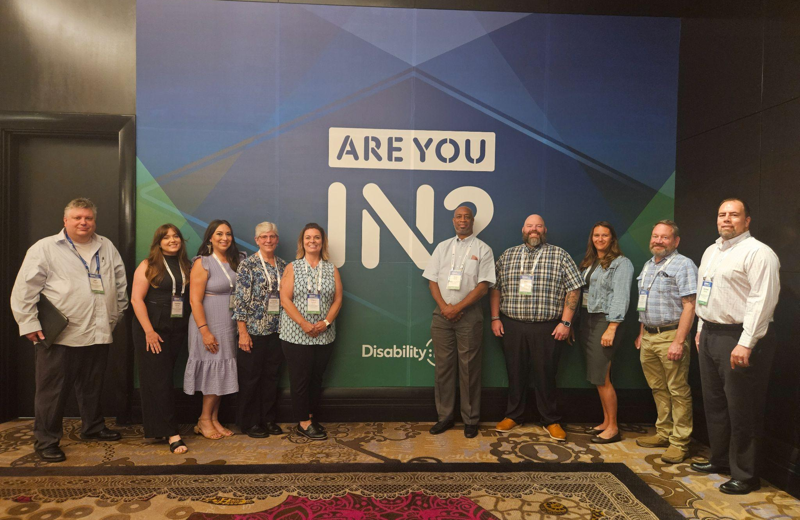
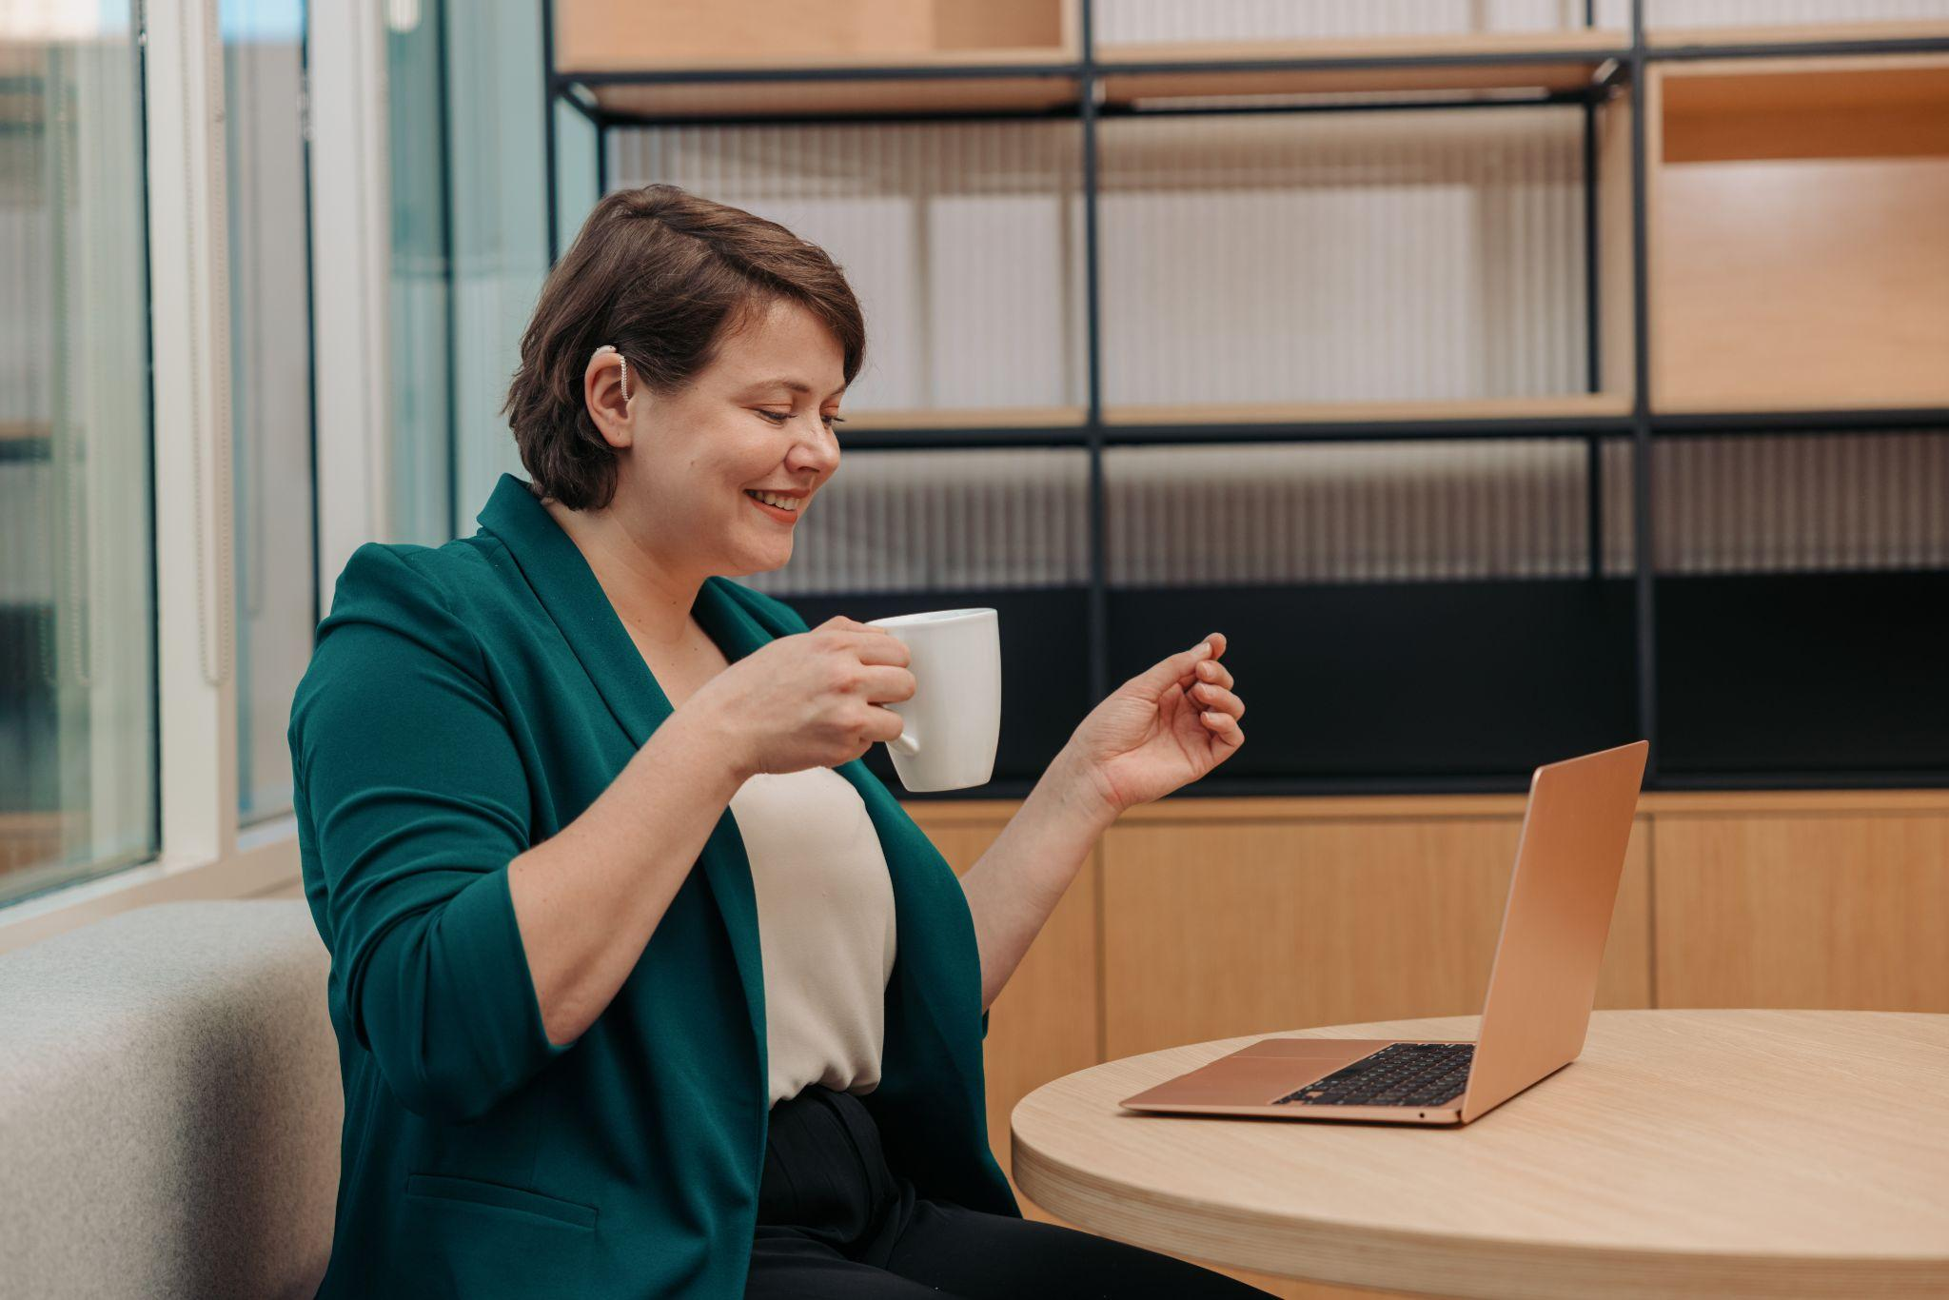
Strength in Professional Development
Certified ADA Coordinators
State & National Conferences
Continued Learning Opportunity
As our Unit provides guidance and education on ADA topics, several of our Unit members are pursuing the Certified ADA Coordinator credential for Professional Development. We currently have two (2)!
We regularly attend both State and National Conferences to meet businesses where they are at, understand the future landscape of changing workforce trends, and network with Employers and partners.
As part of CDLE’s Performance Management requirements, we are committed to supporting our BOS’ with continued learning opportunities through approving skill development trainings, webinars, courses, and other activities.
Notes:
(Heather)
“Help BOS take ownership of their own development”- shows how we have created this culture

Slide 13

Notes:
(Heather)

Slide 14
Part 2: BRU’s Strategies
06
Notes:
(Eric)

Slide 15
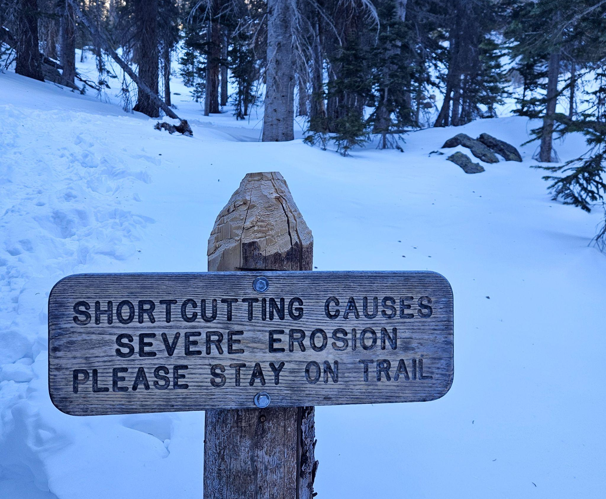
Leadership Buy-In
Essential to a successful business services strategy
Colorado’s key leadership investments:
December 2018 - Creation of a specific Unit with a dedicated Manager to oversee Business Service activities
  Member of Senior Leadership and Field Leadership
December 2020 - implementation of a Unit Lead
September 2022 - implementation of Manager devoted to specifically Business Outreach
Continued support of activities, initiatives and professional development
Notes:
(Eric)
Because of Buy in its an easier path- focus on how we would still be doing good work, but its better with buy in. If you’re leadership in the room, recognize that your buy-in could be helping or hindering success.
WHat does Buy In mean- trust in us, the buy in on promotional opps, inclusion in FLN, this is what you can do to buy in (action steps). Bigger than just Kristin, its buy in from all leaders in the org. Bought into the goals of the BRU, trust in what we are doing and who we are.

Slide 16

BRU Four Core Priorities
RETENTION
RECRUITMENT
PARTNERSHIP
EDUCATION
Notes:
(Eric)
***add more script content, use the material below
All of the activities and services that the Unit does revolves around these four cour priorities:
Recruitment
Retention
Education
and Partnership.
And as you can see here, one priority tends to lead to another, and another, and another, until all of these priorities are applied to the relationships we build with our business partners.

Slide 17
Business Services
More than just Job Development
In Colorado, we have over 23 unique Business Services that we provide to Employers. Through our philosophies on engagement and strategies for documentation, we look to measure the whole relationship with a Business, not just the interaction.
Employer Relationship Cycle: New > Developing > Strategic
New Business Status
Developing Business Status
Strategic Business Status
Describes businesses in which DVR in is in the initial stages of engaging
Describes business in which DVR has engaged in a process of building credibility and trust with the business
DVR and the Business collaborate strategically across the entirety of the business structure for the overall success of people with disabilities
Notes:
(Eric)

Slide 18






Partnering with RCs
On the same Team
BOS are assigned to local DVR offices, and work directly with RCs
Standard Process
RC’s and BOS’ work together over job prepared Participants through the “Service-Job Seeking” process
The BOS Meeting
BOS’ hold regular meetings with their team of RCs 1-2x per month to maintain connection
Employer Connections
BOS’ share information with RCs and Participants about Employers and Work Opportunities
Ongoing Support
RC’s benefit from the BOS’ guidance on LMI, Reasonable Accommodations, Disclosure Decisions, and more!
Notes:
(Heather)

Slide 19
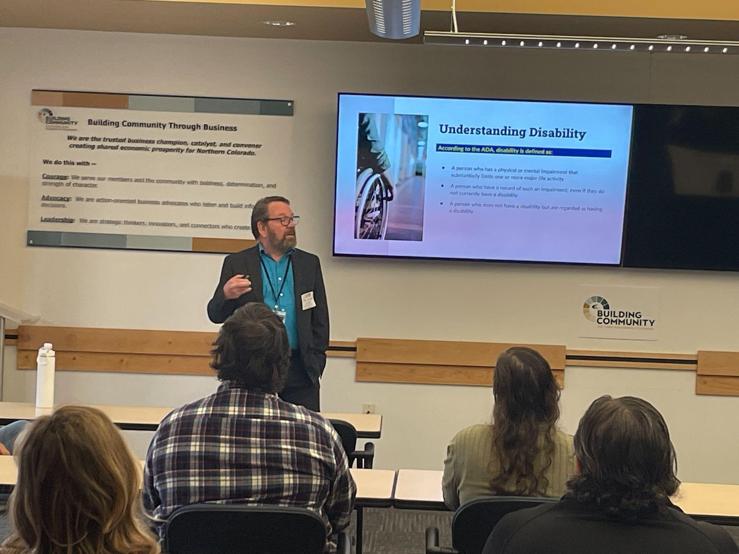
Educating Employers on Embracing Disability
A different approach to DEIA Training
BRU has come a long way from our previous years of educational materials on DEIA topics in the workplace. Since 2020, we’ve worked hard to create standard training materials that our Unit uses to educate employers, community partners, stakeholders, and staff; building off of the principles, understandings, and changing conversations in the Disability Community. Topics include:
Disability Etiquette & Ableism
ADA Basics for Employers
Breaking Barriers: Employing People with Disabilities
DVR 101
Northern Colorado BOS, Adam Shake, presents to employers at the Fort Collins Chamber of Commerce
Notes:
(Heather)
Strategy has helped us build an even more diverse audience for our trainings- small biz, large corps, chambers, sectors, partners- broader spectrum of customers, getting more inbound request for this material. Shows how it supports BOS’ development, had a hand in development what we share, helps build stronger relationships, shows us as the experts. Goes hand in hands with their professional development, utilizing their knowledge and skills.

Slide 20
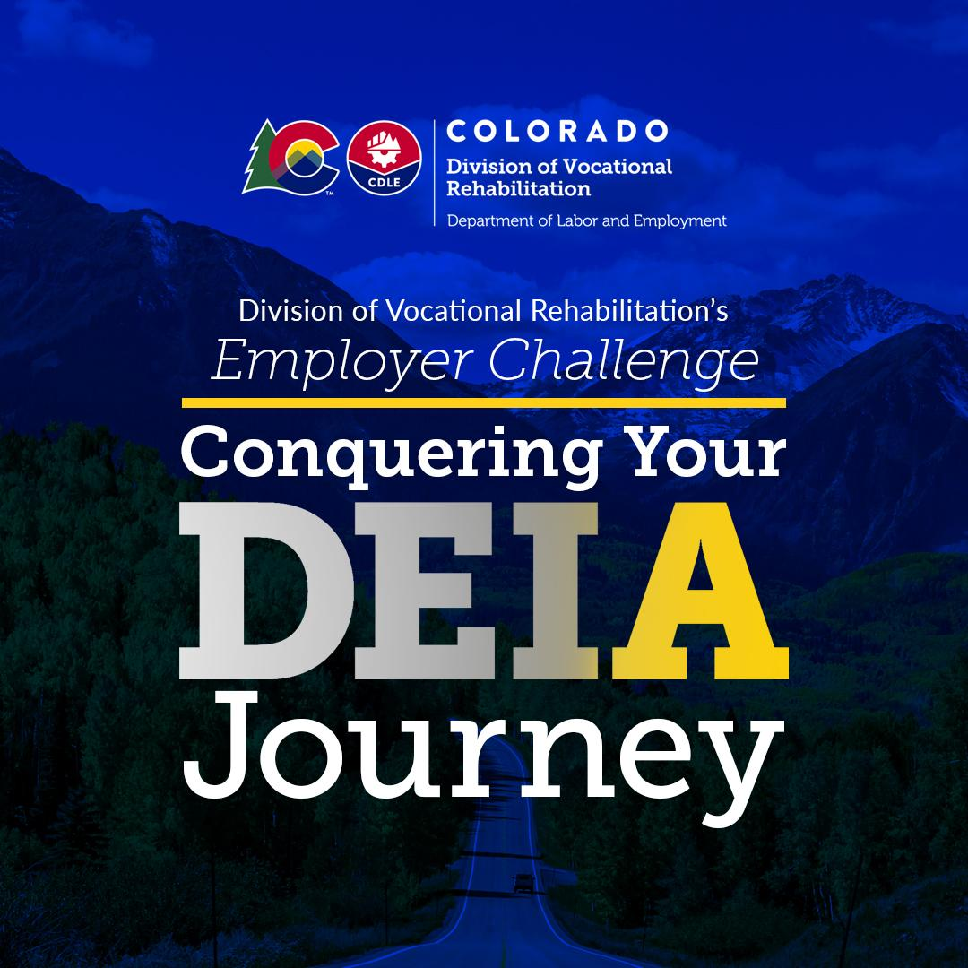
DVR’s Employer Challenge:
Conquering Your DEIA Journey
BRU is spearheading a year long, 3-part training series for strategic employers to complete by October 2024.
Session Information:
Session 1: Trailhead- Disability Etiquette and Ableism in the workplace (Feb 2024)
Session 2: Basecamp- ADA Accommodation & EEOC Case Examples (May 2024)
Session 3: The Summit- “going beyond”, Best Practices for Inclusive Workplaces (July/Aug 2024)
Employers who completed all three session were recognized formally at our NDEAM Celebrations on October 16th and will receive a full year of maintenance support and ongoing community building with their fellow cohort members (The Descent).
First year: 13 Challengers completed the Challenge this year! Goal to cycle it annually.
Notes:
(Heather)
We’ve already shared that one of our strongest and most popular services to employers in the Educational material that we provide to employers and community partners across the State. Every year in October, our Unit is typically very busy with providing Disability Awareness Trainings as October honors National Disability Employment Awareness Month, or NDEAM for short. This is a time to honor the employment success of PWDs and to find new or expanded ways of embracing disability and increasing accessibility in our workplaces each year.
This Past year in 2023, our Unit decided to do something different. Instead of NDEAM lasting only one month, we wanted to honor NDEAM all year round and we launched our first Annual Employer Challenge. This is a year-long, 3 part training series, where our most Strategic Employers from across the state have signed up and sent representatives to participate in all three sessions. This cohort of employers will complete come October 2024, closing out our first cycle of Employers who met the challenge.
The Series titled: Conquering Your DEIA Journey, is themed after our iconic mountain culture here in Colorado, with the first session called Trailhead, where we start employers out in understanding the basics of embracing disability in the workplace, which as we’ve already shared here today, typically starts with our language, behaviors, and attitudes towards PWDs as well as addressing Ableism in ourselves and workplaces.
The second Session, Basecamp, builds on the cohort’s standing knowledge and goes into a more comprehensive understanding of the ADA and Reasonable accommodations. We walk the employers through EEOC Case Examples, learning from real life cases to help empower their decisions around reasonable accommodation in the workplace, some of the do’s and don’ts, and detailing how to have an effective Interactive Process when providing Reasonable accommodation.
…and helps to equip them for the third session, the Summit. Much like reaching the top of a mountain, once up there you can now see how much further you want to go, the Summit helps employers with understanding concepts like Universal Design, Best Practices in Accessible Workplaces, creating Employee Resource Groups, and more.
Once all three sessions are complete we will celebrate these Employers in our October 2024 NDEAM events, and they will receive a year of maintenance support and ongoing community building with their fellow cohort members, we are calling this the Descent, and the goal is to help them now implement strategies, ideas, or new processes for creating accessible workplaces. Also in October, we will start recruiting for the next cohort for 2024-2025.
This is our first year, we just completed Session 2: Basecamp earlier this month, and Session 1 was back in Feb. We will have our final session, the Summit later this summer. So far we have over 45 employers sign up and participating, including OEDIT- Colorado Office of Economic Development & International Trade, several County Government entities like Larimer, Adams, and Jefferson Counties, CU Boulder, UC Health, and more!

Slide 21
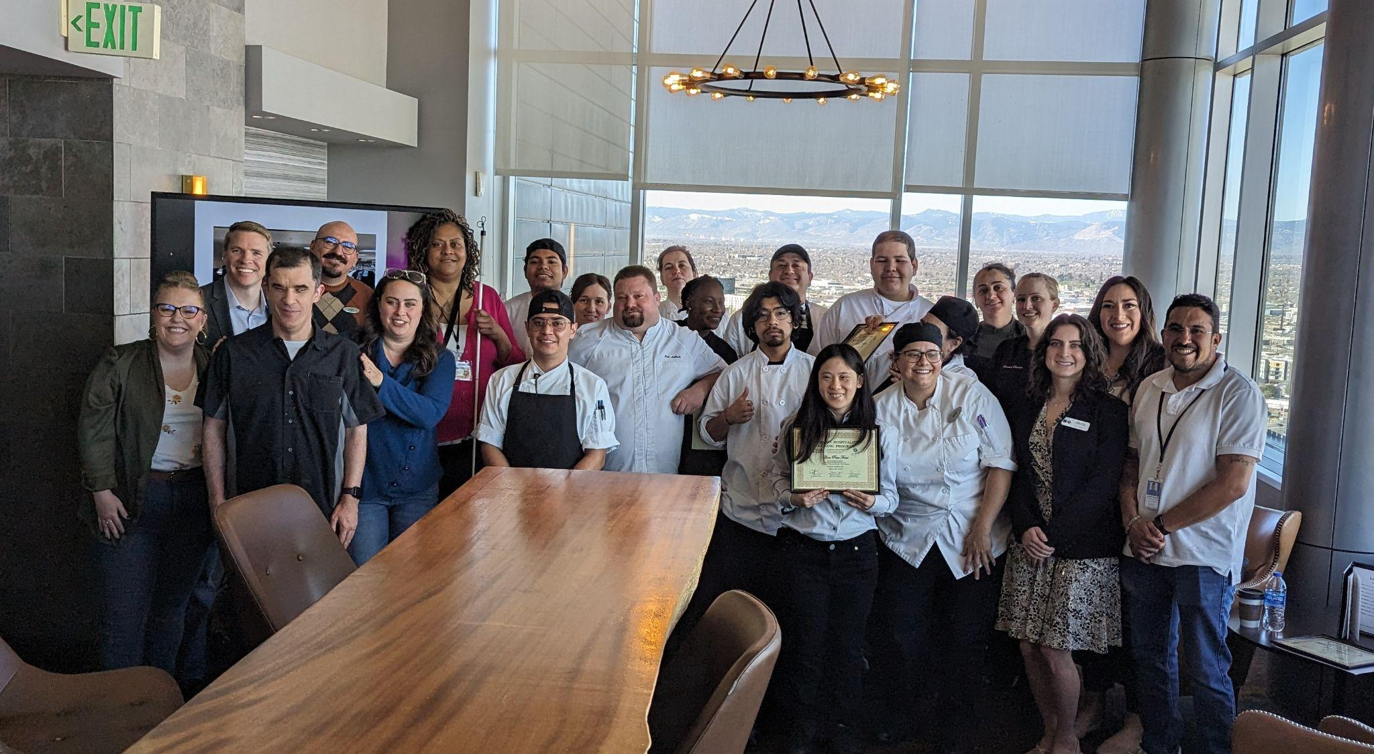
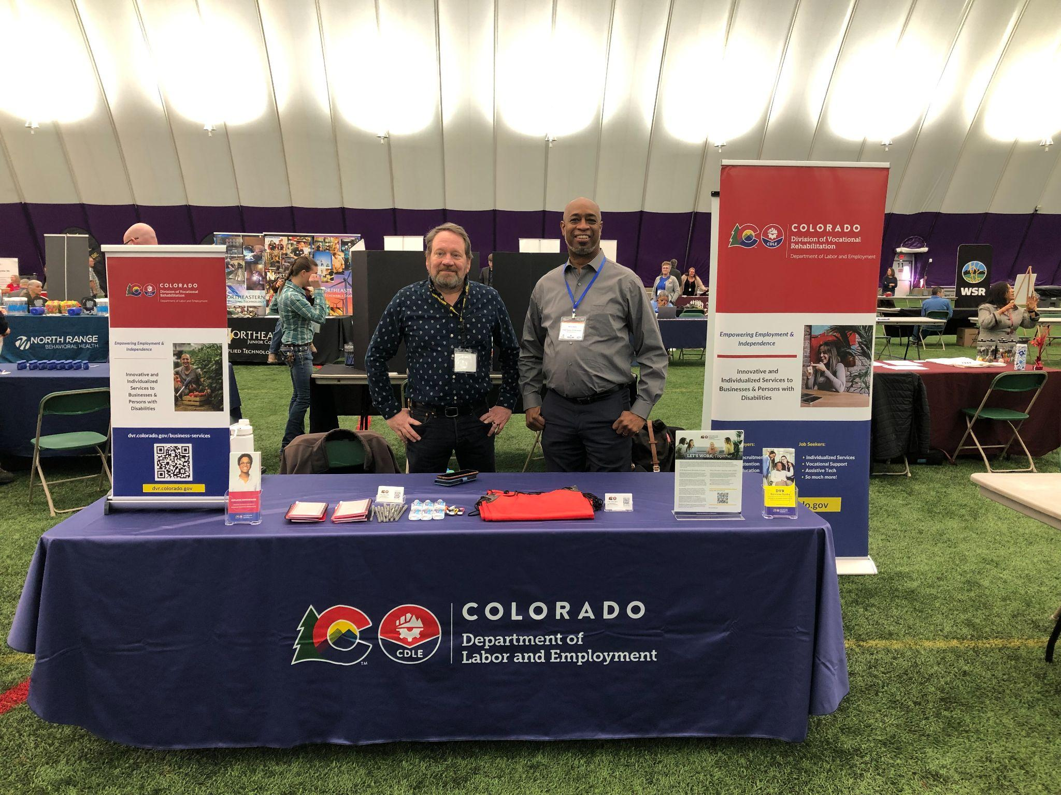
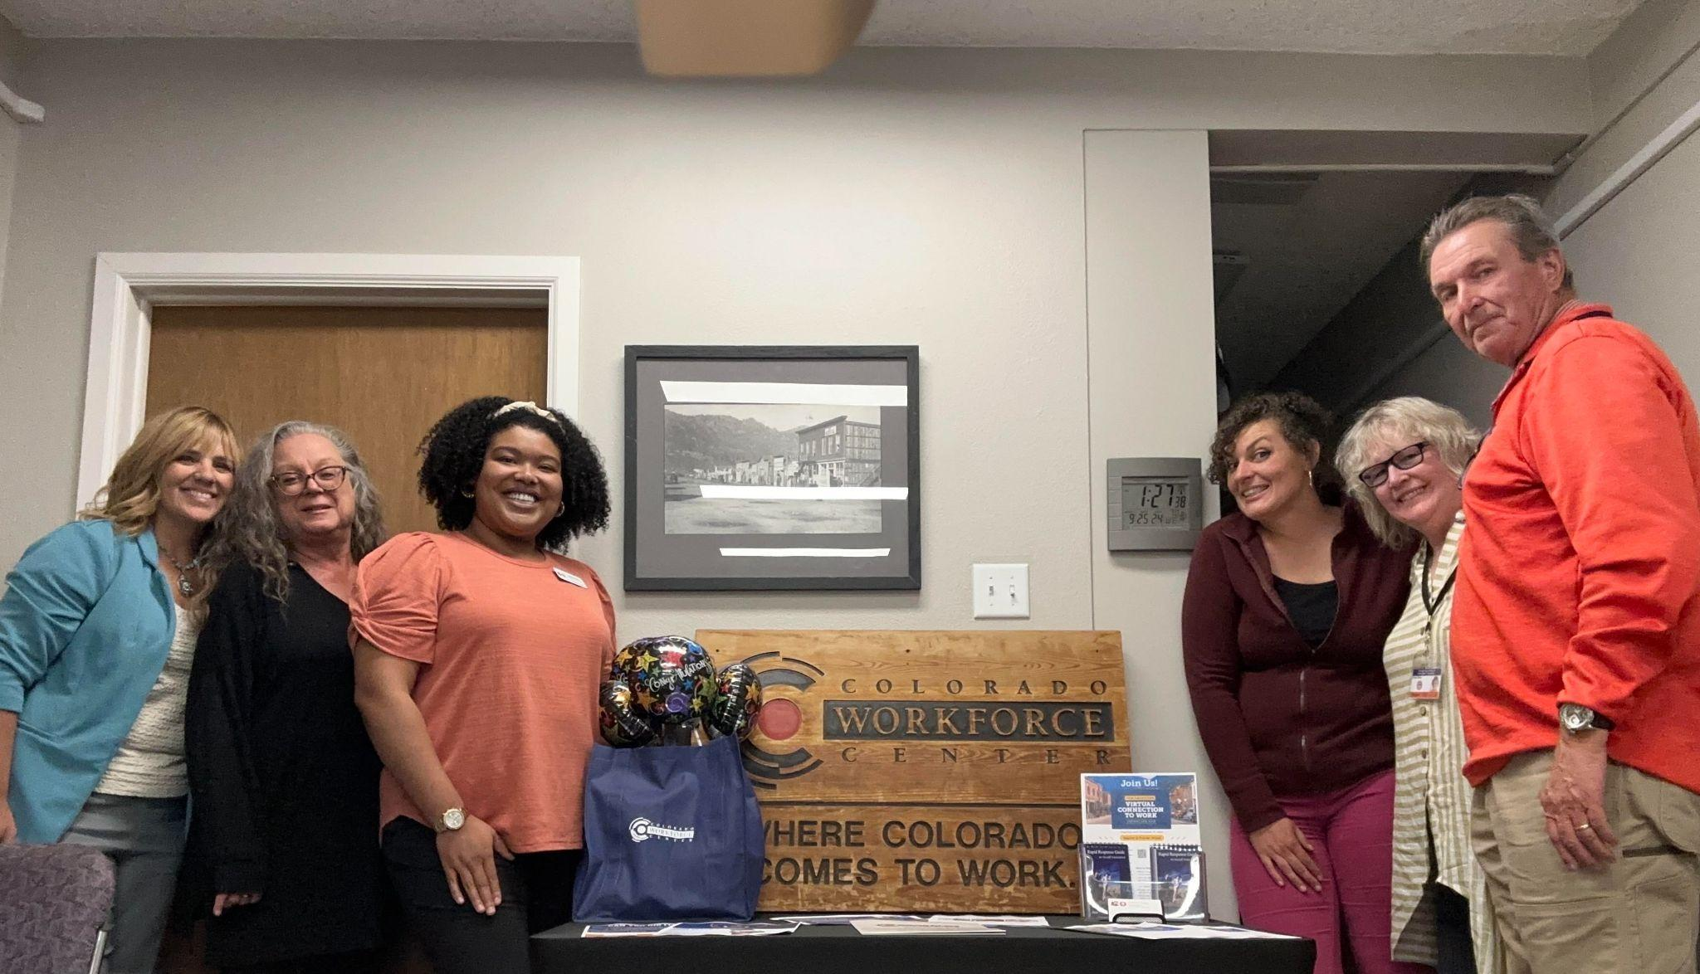
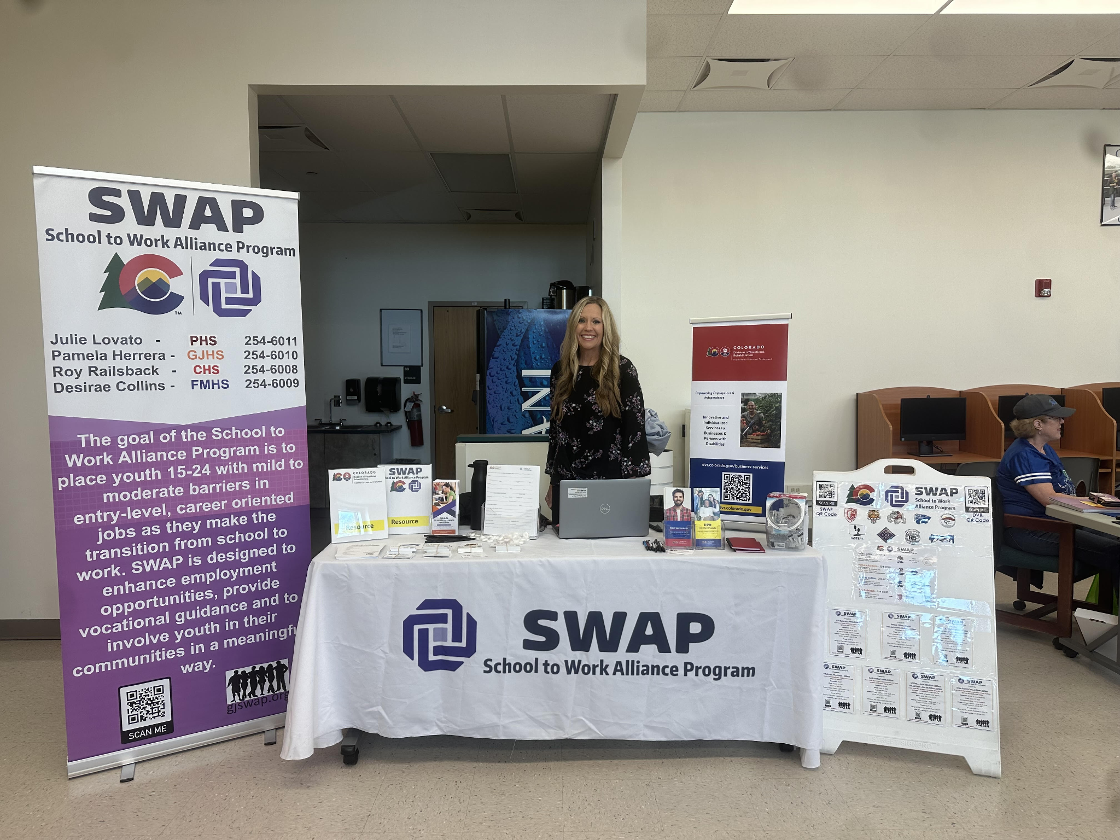
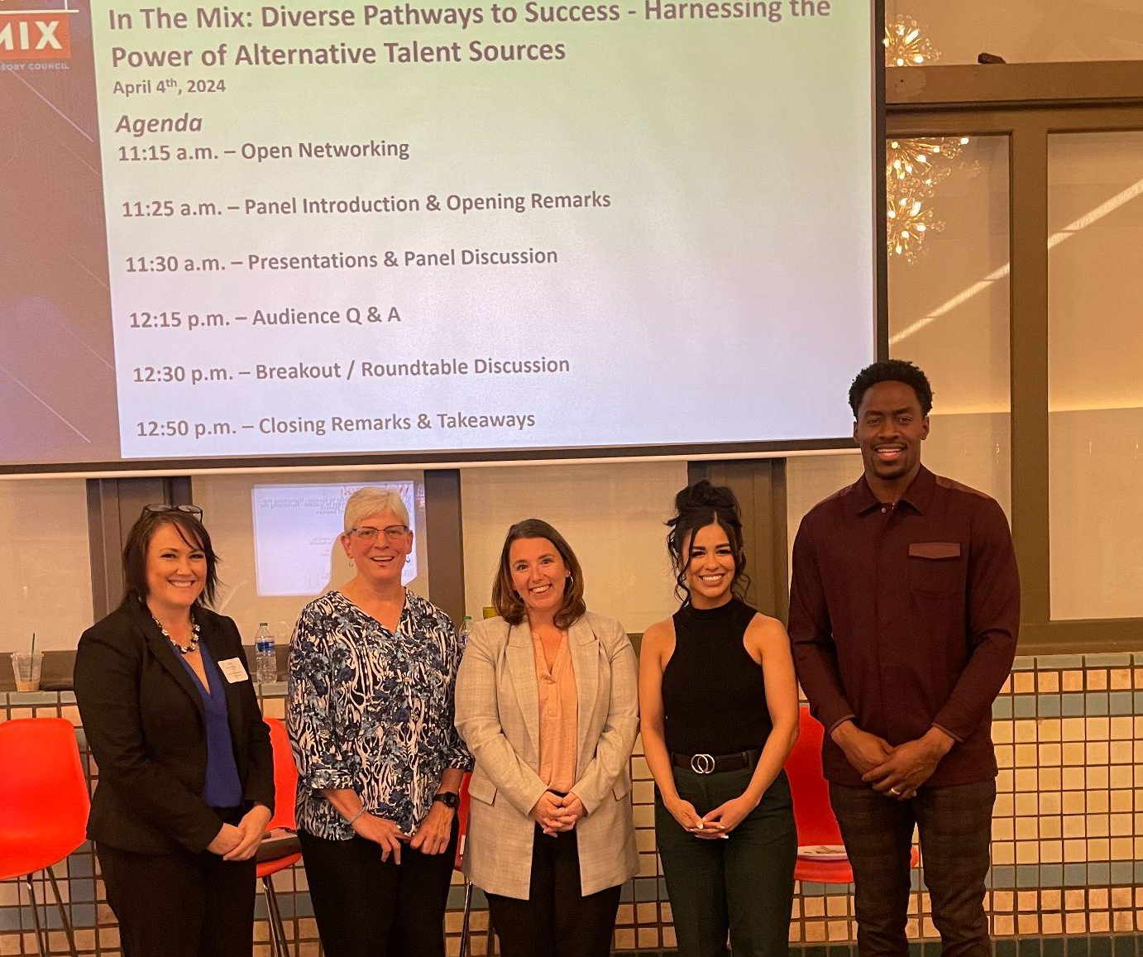
Finding ways to Connect
Growth Through Partnership
BOS’ are active partners in the communities we serve!
Notes:
(Heather)
BUild this out further, use content below to help
Connection to a vast network of community partners
Resources and services available to support business
Partners include: Workforce Center, Local Chamber of Commerce, Sector Partnerships, School Dist. Mental Health Providers, Independent Living Centers, Non- Profits, and so much more
***add a new slide showing Eric presenting at the NET. Speak to other national reach partners (DE webinar, RAPs calls, etc)

Slide 22
Part 3: BRU’s Success
06
Notes:
(Eric)

Slide 23

Disability Program Navigator (DPN)
Success through Partnership
Contracted program with American Job Centers (AJCs), in partnership with the Colorado Department of Labor and Employment’s Employment & Training Division, with the goal of creating a new patterns of service in order to:
Expand service opportunities for job seekers with disabilities
Increase program co-enrollment
Leverage shared resources through the braiding of services between DVR and AJCs
Why?
Fluctuations in staff and fiscal resources which impact collaboration and leveraging resources
Increase in fiscal and programmatic resources to expand Workforce Services in key areas to include Registered Apprenticeship Programs, COVID Response, Target Populations, as well as Upskilling Training
Data showed that co-enrollment between DVR and AJCs was very low
Leverage DVR expertise in program development, job seeker support services such as job coaching and job coaching; as well as knowledge of a variety of disability-related topics that benefit job seekers, businesses, and staff
Notes:
(Eric)

Slide 24
Disability Program Navigator (DPN)
Structure
Interagency Agreement between DVR and the AJCs in which the AJC provides DVR with non-federal match funds in order for DVR to in-turn drawdown additional federal funds to in
Increased funding is utilized to pay for allowable expenses under the terms of the contract with AJC, assist with administrative expenses for DVR to operate the program, as well as increase DVR case service funds in order to have resources to serve additional individuals with disabilities.
Launched with four (4) pilot sites in February 2022
Adams County Workforce & Business Center
Jefferson County Business and Workforce Center
Denver Economic Development and Opportunity
Arapahoe-Douglas Works!
Focused on three (3) key deliverables:
Co-enrollment
Customer Satisfaction of individuals participating in the program
Service braiding
Notes:
(Eric)

Slide 25

Disability Program Navigator (DPN)
What we have accomplished…
Since inception, 490 individuals have been co-enrolled in DVR and Workforce Services since program inception across all Workforce Regions and 17 DVR offices
102 individuals have obtained successful employment so far
Individuals have accessed career service support, training, youth programming, Dislocated Worker, RAP’s, discretionary grants, WBL, and more
In 2024, a collaborative budget request with DVR and CDLE E&T, was submitted to the State Legislature.
$389,366 in non-federal funds allocated to DVR, which in turn will generate $1,427,558 in federal funds ($1,813,924 in total funds)
Program has now expanded to all AJC Regions in Colorado (11 total Navigators and growing)
Notes:
(Eric)

Slide 26
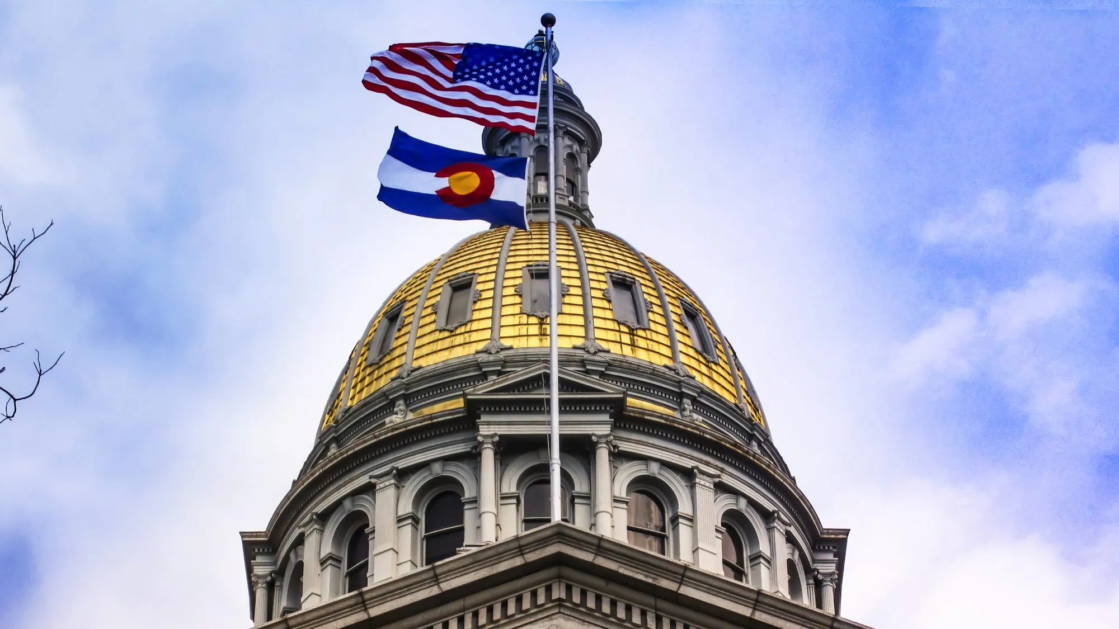
State As a Model Employer (SAME)
Leading the way…
Accomplishments/Involvement:
CDLE Disability Hiring Preference Pilot
Redaction of PII (Personal Identify Information) in the application process
Disability Affinity Groups
Skillful
Embracing Disability Trainings
Equitable Hiring Structure
How to Apply for A State Job video
SAME Community of Practice (CoP) with other SAME States
23 individuals have obtained State employment since January 2022
Notes:
(Eric)

Slide 27
DVR is a Qualified Apprenticeship Intermediary!
In both Industry & Talent Categories
BRU has delivered 61 RAP Consultation Services to individual businesses since July 1st!
Qualified Apprenticeship Intermediaries are organizations operating in Colorado that play a crucial role in expanding or enhancing our state’s Registered Apprenticeship System through their support of career seekers, apprentices, employers, and/or Sponsors.
Organizations can apply for recognition in one or both categories:
Industry Apprenticeship Intermediaries focus on addressing employer needs through apprenticeship by providing services such as designing and delivering curriculum, connecting employers to apprenticeship programs, reducing administrative burden through tools or acting as the Sponsor, offering professional development, and providing financial support and other resources to support the growth and sustainability of Registered Apprenticeship Programs.
Talent Apprenticeship Intermediaries focus on career seeker and/or apprentice needs, especially those facing employment barriers, by ensuring that they are aware of apprenticeship programs, have the resources and referrals to enroll in the program, and the support necessary to complete their program and understand their career pathway.
Notes:
(Heather)

Slide 28
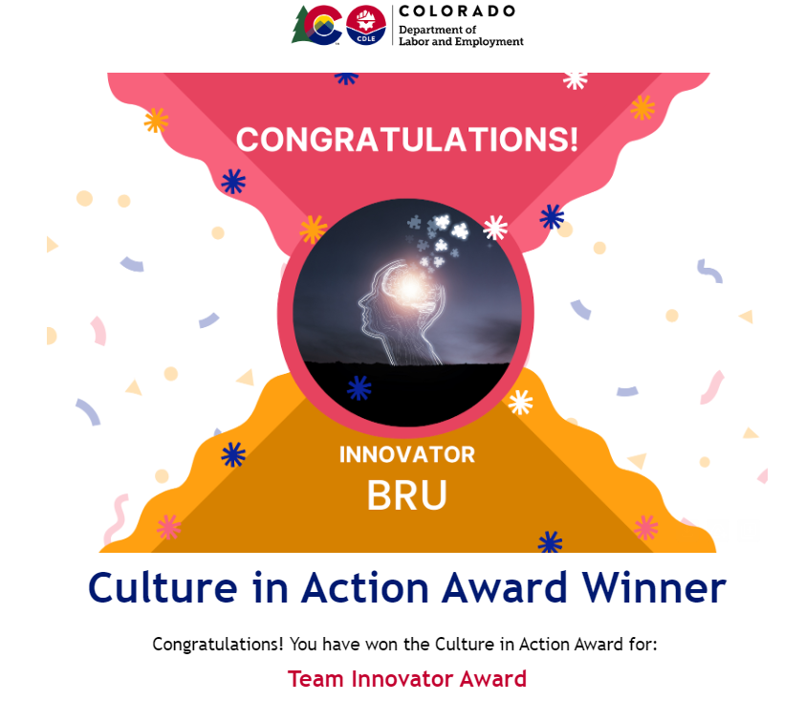
Culture in Action
Awarded the 2024 Team Innovator Award
Unit or Team within DVR that finds efficient, modern, and creative ways of doing things that solve a need, problem, or opportunity.They demonstrate collaboration, share their innovations and gets others on board. This Unit or Team embraces new opportunities, finds creative ways to solve problems and seeks to improve customer service. A Team who proactively assumes responsibility for new projects, while, executing effective strategies with positive outcomes, measured objectively or subjectively. Confronting adverse circumstances with ingenuity and passion.
Notes:
(Heather)

Slide 29

Successful Services
Hard work pays off
State Fiscal 2024 Performance:
6,258 total Businesses served by the BRU
  In 2018, that number was 1233
In August 2024, the BRU had their highest service month to date of serving 835 businesses.
Last year, BRU was involved in 790 employment opportunities, of which:
Only 26 ended prior to successful closure (3.3%), and only 14 ended in unsuccessful closure (1.8%)
BRU was involved in 39% of DVR’s total employment outcomes for the year.
For a team of 13, BRU proves that our Services provide excellent wrap-around support for both Businesses and DVR Participants in resulting in a successful match or transition in employment!
Notes:
(Eric)
Circle back to the main point, the numbers speak for themselves, but the philosophies are consistent.

Slide 30

Successful Strategies
Continued
Additional SFY24 outcome successes included:
847 total Retention Services
  Includes 407 services directly to individuals
587 specific Disability Awareness Trainings:
Provided training and consultation around Skills Based Hiring to 360 businesses
Made new connections with 931 businesses
Provided awareness of the value and purpose of the DVR program to 1128 businesses
For participants whose case closed with a business served by business services:
  Had an average hourly wage of $20/hour (DVR as a whole = $19.94/hour)
  Were working an average 29.26 hours/week (DVR as a whole = 28.4 hours/week)
Notes:
(Eric)

Slide 31
Resources
06
Notes:
(Heather)
Add a slide about next steps they can take. (last slide before questions)

Slide 32
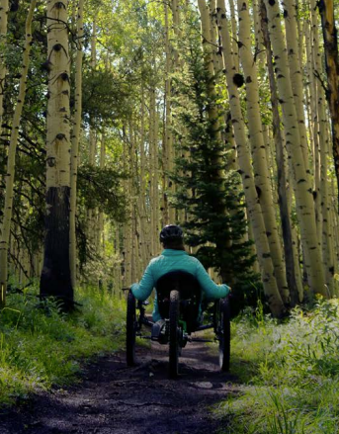
Colorado DVR Resources
For more information on DVR Case Services, please visit our main webpage:
https://dvr.colorado.gov/
Information includes services for Adults, Youth, Business partners, as well as details on how to become a Vendor with DVR and more resources!
For more information on Business Relations Unit, visit here:
https://dvr.colorado.gov/business-services
Notes:
(Heather)
For more information on our DVR office, we’ve provided our website information to both our main page and our Business Relations page. No matter where in the country you are today, you are more than welcome to check out our website and connect with us further. While we may not be able to offer services if you are outside of COlorado, we can certain connect further and help you to identify our DVR counterparts in your state.

Slide 33
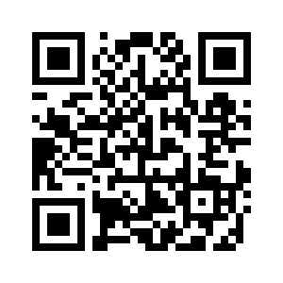
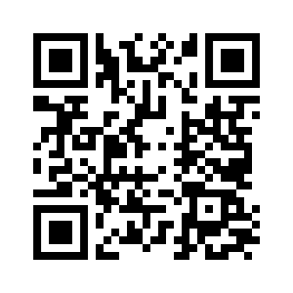
Eric Clark
Let’s Connect!
Email us at:
eric.clark@ state.co.us
heather.brooks@state.co.us
or connect with us on LinkedIn:
Heather Brooks
Notes:
(Heather)

Slide 34
What steps can you take to invest in Business Services?
Invest in developing Business Services staff, in skill and experience throughout their time with your agency
Find opportunities to link business & case services around the common goal: successful employment outcomes!
Develop a specific team tasked with engaging with businesses.
Seek out opportunities to partner with other Workforce entities to promote DVR’s Mission
Notes:
(Eric & Heather)

Slide 35




Thank
You!
Questions?
Notes:
(Eric & Heather)
We want to thank you again for your time today and allowing us to present to you this topic. We will open up for questions now.

