Slide 1
National Clearinghouse of Rehabilitation Training Materials (NCRTM)
10/29/22
Heather Servais, MS CRC CRL CVE CPM PMP
NCRTM Project Manager
New Editions Consulting, Inc.

Slide 2
Kick Off Discussion
What do the McDonald’s Happy Meal, Jason Momoa, and the NCRTM all have in common?

Slide 3
Learning Objectives
Understand the history and vision for the NCRTM
Learn how to locate and use resources from the NCRTM to benefit your teams
Understand where to find accessibility resources
Learn how to connect with the NCRTM

Slide 4
NCRTM: Brought to you By
Section 15 of the Rehabilitation Act of 1973 as Amended by Title IV of the Workforce Innovation and Opportunity Act
Funded and operated by the Office of Special Education and Rehabilitative Services (OSERS), Rehabilitation Services Administration (RSA)
Maintained through a contract with New Editions Consulting, Inc.

Slide 5
NCRTM Library
What can you find in the NCRTM Library?
How can you use the NCRTM Library?
Access to more than 3,500+ resources
Articles
Podcasts
Videos
Fact Sheets
Websites
Toolkits
And more
Implement evidenced-based and promising and effective practices and tools developed by RSA discretionary grantees
Strengthen and enhance delivery of services to individuals with disabilities
Increase skill development and knowledge for VR counselors

Slide 6
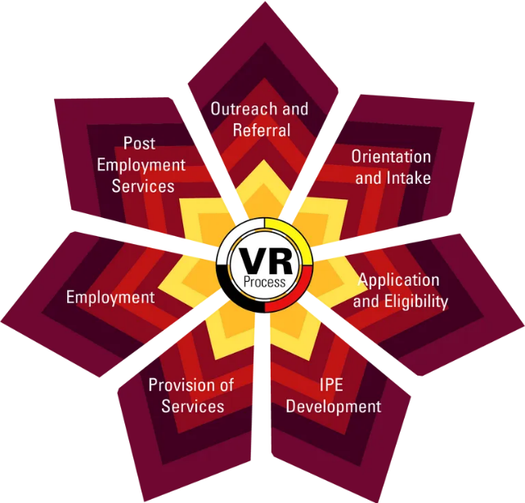
NCRTM Library Material Examples
VR Workforce Studios (VR Workforce Studios)
Manager Minute (VRTAC-QM)
And other podcasts from partners: Apprenticeship for All (PIA), Mentor Moments (Maryville University)
Effective Practices in Transition and Interagency Collaboration (NTACT:C)
VR Process Handbook
(AIVRTTAC)
Pre-Employment Transition Services: Set Aside Determination Guide (NTACT:C and VRTAC-QM)

Slide 7
Trainings and Events
NCRTM shares events from many sources
Live and On-Demand Training and Events are available
More than 150+ On-Demand Events Available
New events from partners added regularly
Technical assistance (TA) centers
RSA grantees
Federal partners
Many Offer CRC Credits

Slide 8
On-Demand Training Examples
For VR Counselors
Disability Specific Topic Areas (VRTAC-QE):
Autism
Multiple Sclerosis
Serious Mental Illness
Traumatic Brain Injury
Intellectual and Developmental Disabilities
Motivational Interviewing (Oregon VR)
Labor Market Information (CIT-VR)

Slide 9
On-Demand Training Examples (2)
For VR Managers and Supervisors
Performance Management Training (QM2022-0305)
The Crossword Puzzle of Management – Managing Up and Across (QM2022-0303)
Coaching Strategies for Performance Excellence and Organizational Effectiveness (QM2022-0302)
Clinical Supervision Series (CIT-VR)
Seven Secrets to Remote Supervision (CIT-VR)
Strategies for Mentoring Interns: Developing Qualified Professionals for the Future (OIB-TAC)

Slide 10
On-Demand Training Examples (3)
For VR Planning and Performance
Improving Career Outcomes for Youth with Mental Health Challenges (NTACT:C)
Improving Outcomes of Youth with Emotional Disturbances through Transition & CTE (NTACT:C)
Understanding and Using Data to Improve Outcomes for Students with Disabilities (NTACT:C)

Slide 11
Questions

Slide 12
Services and Programs: For Individuals with Disabilities
Resources targeted to Individuals with Disabilities
Information about competitive integrated employment, career advancement, employment laws

Slide 13
Business Engagement
Resources and information targeted to businesses and employers
Connection with state VR agencies
Hiring individuals with disabilities, disability awareness and sensitivity resources, inclusive workplaces

Slide 14
Resources from the NCRTM
Curated Lists
Curated List Topic Examples
Lists of resources for specific topic area
19 lists available
To access all published curated lists, visit the curated lists page through the Highlights section
If you have ideas or recommendations for future curated list topics contact New Editions: ncrtm@neweditions.net
Inclusive Apprenticeships
Career Pathways
Labor Market Information (LMI)
Pre-Employment Transition Services (Pre-ETS)
Culturally Responsive Practices
Motivational Interviewing

Slide 15
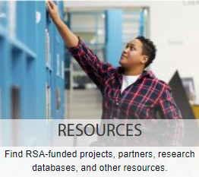
RSA Funded Assistance and Other Resources
RSA-Funded Assistance and Other Resources contains links to:
RSA’s Technical Assistance (TA) Centers
RSA-Funded Projects
WIOA Federal Partners
Other Resources
Research Databases

Slide 16
Accessibility Resources
Accessibility Resources
Includes brief tutorial videos, quick guides, and Federal resources to aid in ensuring accessibility.
Why Accessibility is Important
Why is Accessibility Important? (3.5 min.) A short video explaining the importance of accessibility.
Screen Reader Simulation (6 min.) demonstrates the difficulties users with screen readers have when reading inaccessible documents.

Slide 17
Accessibility Resources, continued
Top Ten Essentials for Accessible Webinars (10 min.) This brief video reviews the ten most important items to keep in mind when creating and hosting webinars.
Guides to assist accessibility efforts
PDF Accessibility
Webinar Accessibility
PowerPoint Accessibility
Word Accessibility
Excel Accessibility

Slide 18
Upcoming NCRTM Event
Developing Mobility and Transportation Supports to Facilitate Access to Employment
NCRTM with the National Center for Mobility Management (NCMM)
Presenter: Judy L. Shanley, Ph.D.
When: Tuesday November 8, 2022 at 2:00pm EST
Register for this event

Slide 19
Ways to Engage and Stay Connected
Sign up for the NCRTM Newsletter to stay current
Access Past Issues
Follow us on Twitter (@RSA_NCRTM)
Check out our YouTube Channel
Visit Trainings & Events training events page for training and education events
Upcoming, On Demand, and Past

Slide 20
Stay Connected, continued…
Catch us on the VR Workforce Studio podcast
Submit materials for inclusion in the NCRTM Library
Subscribe for monthly NCRTM Library updates
Volunteer to be part of a User Advisory Group (UAG)
Propose ideas for new events and content
Provide feedback online for the continuous improvement of the NCRTM
Notes:
Kristen Rhinehart-Fernandez
Podcast
Submit Materials
Volunteer for the UAG
Provide Feedback via Survey
Contact us by email NCRTM@neweditions.net

Slide 21
Discussion
What strategies can NCRTM use to get information and resources directly into the hands of individuals with disabilities and VR counselors?

Slide 22
New Editions Team
Tyler Matney
New Editions Vice President
tmatney@neweditions.net
Heather Servais
New Editions Project Manager for the NCRTM
hservais@neweditions.net
Stewart Kelsey
New Editions Project Coordinator for the NCRTM
skelsey@neweditions.net
Madison White
New Editions Project Coordinator for the NCRTM
mwhite@neweditions.net

Slide 23
NCRTM RSA Team
Kristen Rhinehart-Fernandez
RSA Project Manager for the NCRTM
Kristen.rhinehart@ed.gov
Jessica Queener
VR Program Specialist, Understudy to the RSA NCRTM Project Manager
Jessica.queener@ed.gov

Slide 24
Q&A

Slide 25
Reference
Section 15 of the Rehabilitation Act
INFORMATION CLEARINGHOUSE
SEC. 15. (a) The Secretary of Education shall establish a central clearinghouse for information and resource availability for individuals with disabilities which shall provide information and data regarding—
(1) the location, provision, and availability of services and programs for individuals with disabilities, including such information and data provided by State workforce development boards regarding such services and programs authorized under title I of such Act;
(2) research and recent medical and scientific developments bearing on disabilities (and their prevention, amelioration, causes, and cures); and
(3) the current numbers of individuals with disabilities and their needs.
The clearinghouse shall also provide any other relevant information and data which the Secretary of Education considers appropriate.
(b) The Commissioner may assist the Secretary of Education to develop within the Department of Education a coordinated system of information and data retrieval, which will have the capacity and responsibility to provide information regarding the information and data referred to in subsection (a) of this section to the Congress, public and private agencies and organizations, individuals with disabilities and their families, professionals in fields serving such individuals, and the general public.
(c) The office established to carry out the provisions of this section shall be known as the ‘‘Office of Information and Resources for Individuals with Disabilities’’.
(d) There are authorized to be appropriated to carry out this section such sums as may be necessary.
29 U.S.C. 712

Slide 26
Disclaimer
The National Clearinghouse of Rehabilitation Training Materials (NCRTM) is maintained by New Editions Consulting, Inc. and sponsored by the U.S. Department of Education, Rehabilitation Services Administration (RSA), under Contract No. 91990021C0033. However, these contents do not necessarily represent the policy of the Department of Education, and you should not assume endorsement by the Federal Government.

